Slide 1

Clickers in Organic Chemistry
Active Learning in Organic Chemistry
cCWCS Workshop
Charlotte, NC
Vincent Maloney and Jennifer Muzyka

Slide 2
Introduction
  Our experiences with classroom assessment techniques
  Based on a consensus of best practices
    Derek Bruff, Teaching With Classroom Response Systems, Jossey-Bass, 2009
Notes:
Not an innovator here, just about everything I present has been introduced by someone else
Also, much appears in Bruff’s book here
Although it always best to do what you are most comfortable, but there is a body of evidence that points to positive affects of clickers w/ or w/o clickers
Have used CAT’s for 12 years?
IPFW closer to mission (unitl recently) and demographics community colleges than other presenters, what works at IPFW can work for others

Slide 3
Classroom Assessment Techniques (CATs)
Variety of methods for obtaining immediate feedback of student knowledge and learning
  before any quiz or exam where it’s “too late”
Notes:
CAT’s variety of methods for immediate feedback to see if students get it
Although various methods, all involve checking student understanding and what misconceptions may be present
Find out where there are problems well before it’s to late on an exam or quiz

Slide 4
Example
e.g. Ask a question based on material just covered in lecture
  Have all students answer
  Quickly check answers
  Correct misconceptions/misunderstanding

Slide 5
Benefits
Immediate feedback of student knowledge and learning
  Address problems immediately
All students answer
Anonymous to students
Teacher can determine who answered and how

Slide 6
Benefits
Improve student learning
  Thomas D’Angelo and K. Patricia Cross, Classroom Assessment Techniques: A Handbook for College Teachers, Jossey-Bass, 1993
  Bruff for clickers
  David C. Haak, et al. Increased Structure and Active Learning Reduce the Achievement Gap in Introductory Biology, Science 332, 1213 (2011)
  Louis Deslauriers, et al. Improved Learning in a Large- Enrollment Physics Class, Science, 332, 862, (2011)
  Linda B. Nilson, Teaching at Its Best, Jossey-Bass, 2010, pp. 273 – 280
Notes:
Here are some useful references

Slide 7
What are the pedagogical benefits of using clickers?
Improved engagement
Improved retention of material
Improved retention of students in course and at institution
Better attitudes concerning course and material
All of the above

Slide 8
Types of Questions
Review/reinforce of recent or previous topics
  Retention of general chemistry topics
  Retention of course topics
  Least important
Notes:
One obvious type of question, but least useful is to review topics covered from general chemistry to see where students are at beginning of 1st semester, or to use as review questions before upcoming , but his doesn’t really address learning of topic as it’s being covered

Slide 9
Types of Questions
Understanding of lecture material
  Application of topic
Discovery based learning
  Given data/evidence predict properties
Notes:
More important is to ask questions or use other techniques the day topic is covered
Also can be used for discovery based learning
Present experimental results or demo, ask students about what data means or what’s happening, make predictions of what might happen next

Slide 10
Types of Questions
Problem solving
  Spectroscopy
    Determine structure of molecules through data, solving a puzzle
  Synthesis of Compounds
    Besides experimental design, aspect that organic chemistry that is creative problem solving

Slide 11
Types of Questions
Multiple Choice (all systems)
  Instructor generated choices
  Publisher generated
  Student generated (best)
Numerical (some systems)
  Not just calculations
Short text (some systems)
Notes:
I modified this slide because the model of clickers we use won’t allow Numerical or Short text input. Hopefully we’ll be upgrading soon…..

Slide 12
What kind of isomers are these?
Conformational
Structural (constitutional)
Enantiomers
Diastereomers

Slide 13
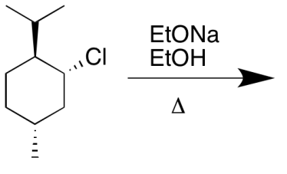
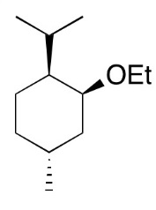
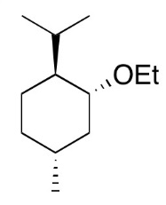
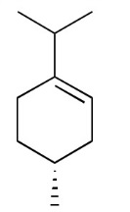
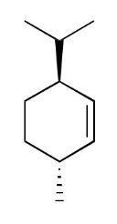
Which is the major product of the following reaction?
1
2
3
4

Slide 14
In the region indicated, subtraction of the wavefunctions occurs and the electron density in that region goes to zero. What do we call such a region?
Node
Notes:
There’s a typo In the image on this slide, with subtraction misspelled.
Do your students type in the word node with their clickers? Way cool!
I won’t be able to adapt this slide to use with the clickers I’m bringing to the workshop, but I think we should include the slide anyways, to show what’s possible.

Slide 15
How many absorptions appear in the ¹³C NMR of this compound?
Notes:
Same thing here – I won’t be able to adapt this slide without turning it into multiple choice. But I think we should keep it so folks realize what’s possible with different clicker systems.

Slide 16
Nucleophilic Substitution
Reaction Examples
How should the mechanism arrows be written? (Write a sequence of numbers right to left. The 1st number is the base of a curved arrow. The second number is the head. If there is a second arrow, the 3rd number would be the base and the 4th number would be the head.
Notes:
Same thing here – I won’t be able to adapt this slide without turning it into multiple choice. But I think we should keep it so folks realize what’s possible with different clicker systems.

Slide 17
Enter the #’s of the reagents in the proper sequence that will synthesize ethoxycyclohexane from cyclohexene
Notes:
Same thing here – I won’t be able to adapt this slide without turning it into multiple choice. But I think we should keep it so folks realize what’s possible with different clicker systems.

Slide 18
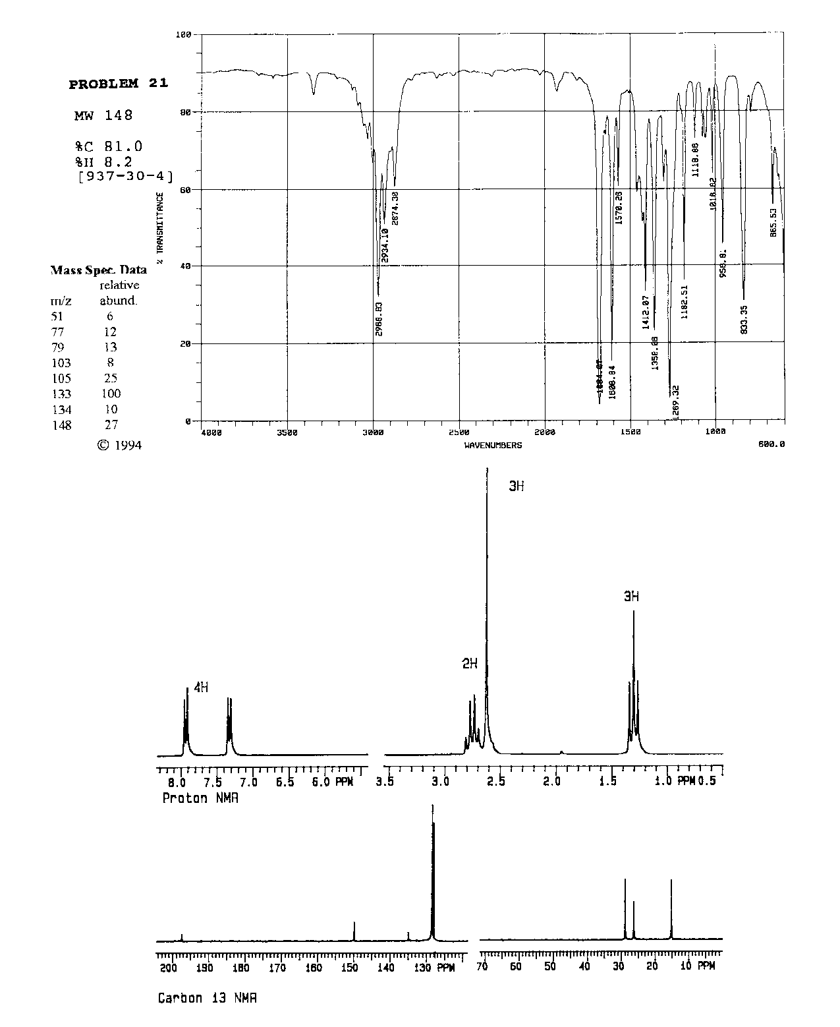
Notes:
It’s cool that your students suggest possibilities that your class then votes on. I like this approach.

Slide 19
Practices
Informal peer learning
  Students discuss questions
How time for questions?
  Varies, ~ 2 min.
  Listen to level of conversation
What is the minimum number of questions suggested per 50 min. class period?
Maloney uses 3. Muzyka uses 2.
Notes:
I often have only two questions per class period. But each question is asked twice, with student discussion on the second polling. I don’t know if that’s how you do it. I figure it’s useful to point out different approaches.

Slide 20
Practices
“Good” questions for peer learning
  < 70% correct but >30% correct
  Ask students to discuss with someone who disagrees and poll again
Easy questions (>80% correct) often given to avoid discouragement
Posting % responses
  Can affect follow up polling
Notes:
Okay, it’s clear that you’re reading the same literature I am, because you’re doing the peer learning approach the same way I do.

Slide 21
Practices
Class participation points
  e-mail reason for absence to avoid losing clicker points
  Maloney: No grade for % correct
  Muzyka: Higher points based on % correct

Slide 22
Practices
  Seems to work, up to this point, haven’t had problems occasionally reported
Never use for exams/quizzes
  Range of opinions concerning this issue
Notes:
I moved the bullet point about problems from the last slide to this one, since it seems to fit better here

Slide 23
Practices
All questions in Powerpoint
  Easier to transfer questions between systems
Is anonymity important for students answering questions in your class?

Slide 24
Logistics
Ownership
  Maloney/IPFW
  Muzyka/Centre
Integration with PowerPoint
  Maloney/iClicker and eInstruction
  Muzyka/TurningPoint

Slide 25
Available Classroom Response Systems
Original Conventional Wisdom
  Use one system across your institution
    TurningPoint
    eInstruction
    iClicker
    TopHatMonocle
    Poll Everywhere
    Qwizdom
    others

Slide 26
How do I do this all at once?
  Don’t!
  Start with a small class using low tech CAT’s
    Develop some questions
    Students answer with index cards

Slide 27
Acknowledgements
CELT at IPFW (Indiana U. Purdue U. Ft. Wayne)
ITS at IPFW
CTL at Centre College

Slide 28
Small group activity
Write questions to use with clickers

