Slide 1
Transformation of the Traditional Organic Chemistry Lecture Sequence into a Hybrid of Face to Face Peer Learning and Online Lecture
Vincent Maloney

Slide 2
Introduction
Outline
  Journey to “flipping” the course i.e. Why?
  Previous course structure
  Flipped course structure
  Student survey
  Assessment
  Observations
    General Chemistry flipped course lessons
  Conclusions

Slide 3

Why Change Everything?
Improved Learning
  Mounting evidence that active learning techniques are more effective than traditional lecture
    Hake, R. R. American Journal Physics, 66, 1998, 64-7
    S. Freeman et al. Proceedings of the National Academy of Sciences, 111 (23), 2014, 8410 – 8415
  Flipping the course just extends such practices

Slide 4

MOOCs
Massive Open Online Courses
  Can university professors be replaced? Should courses be taught a different way?

Slide 5
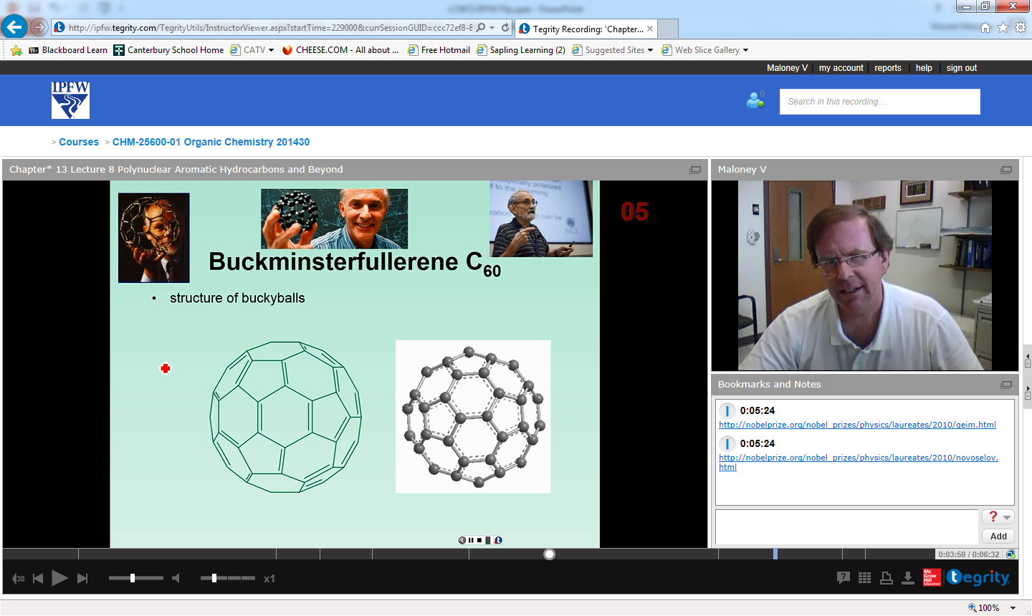
Recorded Lectures
Around for a long time
  What’s different
Much easier to access and watch anywhere
Easier to watch repeatedly

Slide 6
Other Benefits
Retention
  In specific class
  At university
Interactive learning
  Interactions that build relationships
    Students and professors
    Others students
Smith, K. A., Sheppard, S. R., Johnson, D. W., Johnson, R.T Journal of Engineering Education, 94, No. 1 2005, 87-101.

Slide 7
Traditional Lecture
  Students read text before lecture (maybe)
  Lecture given in traditional manner
  After class, students work on assignments
    May work together
    May ask instructor questions
  Problems in understanding not recognized until homework turned in or quiz/exam

Slide 8
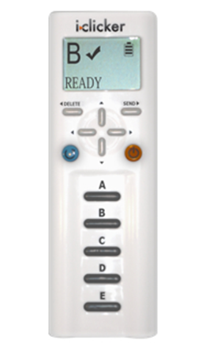
Organic Chemistry IPFW
“Traditional lecture”
Clickers questions
      ~ 3 per class with peer to peer problem solving
      Review sessions
        2x per week
        Peer to peer problem solving
        ~40% of class attended
        Arrangements for those who could not attend
    Lectures recorded on Tegrity for subsequent viewing

Slide 9
Organic Chemistry IPFW
  Is this a flipped class?
Yes
No
Partially

Slide 10
Flipping IPFW Organic Chemistry
  Course flip?
    Move traditional lecture out of face to face class
    Place homework and review in a peer to peer problem solving format into face to face class

Slide 11
Flipping IPFW Organic Chemistry
Course Preparation
  Summer 2013: recorded most lectures for both semesters
  Syllabus + 1st Day
    Explained course format and grading
    Rationale: data supporting active learning and different class format
      For their benefit
    Instructions for clickers
    General chemistry review 1st day

Slide 12
Flipping IPFW Organic Chemistry
What is the suggested length of video lectures?
50 min.
15 min.
10 min.
6 min.
2 min.

Slide 13
Flipping IPFW Organic Chemistry
Record lectures < 20 min.
    Lecture length based on topic
      1.5 – 20 min.

Slide 14
Flipping IPFW Organic Chemistry
Record lectures < 20 min.
    Lecture length based on topic
      1.5 – 20 min.
Chunking
  Nilson, L. B. Teaching at Its Best: A Research-Based Resource for College Instructors, 3rd ed.; Jossey-Bass: San Francisco, CA, 2010; pp. 273-280.

Slide 15
Flipping IPFW Organic Chemistry
What is the suggested number of concepts that should be covered in a video?
1
2
5
Variable

Slide 16
Flipping IPFW Organic Chemistry
295 lectures recorded year
    130 fall semester
      ≈17 h, ≈ 20.5 classes!
    165 spring semester
      ≈17 h, ≈20.5 classes!
What happened to the other 23.5?
ALOC!

Slide 17
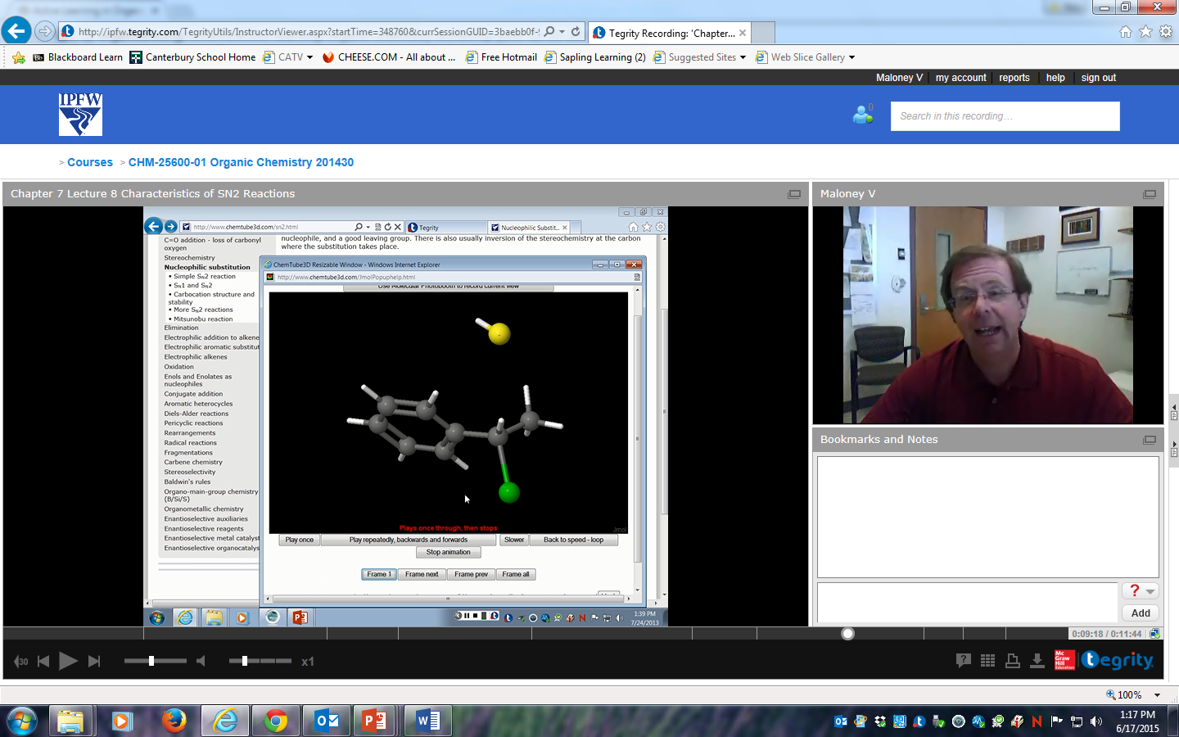
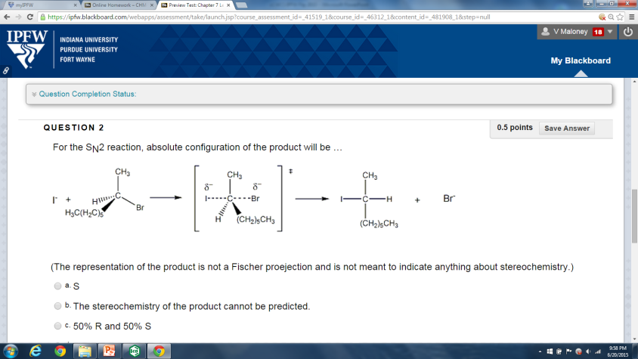
Flipping IPFW Organic Chemistry
  Students watch lectures before class
  Students complete online homework assignment in Blackboard
    162 questions in fall
    98 questions in spring

Slide 18
Flipping IPFW Organic Chemistry
Face to Face Class
  Nearly entire class devoted to peer to peer problem solving
    98 students fall semester
    88 students spring semester
No review or mini lecture at beginning of class!

Slide 19
Flipping IPFW Organic Chemistry
How many questions were covered in a class?
3-5
5-7
10-12
14-16

Slide 20
Flipping IPFW Organic Chemistry
Review session and some traditional homework from text now in class
  Everyone benefits from “review sessions”
Time neutral for student
Exam/quiz schedule kept the same

Slide 21
Student Survey
Given last week both semesters
22 questions
  Likert Scale
  1 strongly disagree to 5 strongly agree
  1 = never to 5 = always
Response rate
  64% fall, 33% spring

Slide 22
Student Survey
I prefer watching the online lectures because it allows more time to work on difficult problems and concepts in class.
1 Strongly disagree | 2 Disagree | 3 Neutral | 4 Agree | 5 Strongly Agree | n (% 4+5) Fall Spring
2 | 6 | 7 | 19 | 29 | 63 (76%)
2 | 0 | 5 | 9 | 13 | 29 (76%)

Slide 23
Student Survey
I believe that I learned material better with the current format than I would have if the course had been presented in the traditional format.
1 Strongly disagree | 2 Disagree | 3 Neutral | 4 Agree | 5 Strongly Agree | n (% 4+5) Fall Spring
5 | 2 | 9 | 22 | 24 | 62 (74%)
1 | 4 | 6 | 5 | 11 | 27 (60%)

Slide 24
Student Survey
I understand the material better when I can work on problems with other students during class.
1 Strongly disagree | 2 Disagree | 3 Neutral | 4 Agree | 5 Strongly Agree | n (% 4+5) Fall Spring
6 | 5 | 10 | 19 | 22 | 62 (66%)
0 | 1 | 12 | 6 | 7 | 26 (50%)

Slide 25
Student Survey
I got to know more classmates in this class than I would have in a traditional format.
1 Strongly disagree | 2 Disagree | 3 Neutral | 4 Agree | 5 Strongly Agree | n (% 4+5) Fall Spring
6 | 6 | 14 | 15 | 20 | 61 (57%)
2 | 2 | 6 | 7 | 9 | 26 (61%)

Slide 26
Student Survey
The current format should be continued for organic chemistry.
  A. Yes B. No C. Neutral

Slide 27
Student Survey
The current format should be continued for organic chemistry.
1 Strongly disagree | 2 Disagree | 3 Neutral | 4 Agree | 5 Strongly Agree | n (% 4+5) Fall Spring
2 | 0 | 9 | 14 | 36 | 61 (82%)
0 | 0 | 7 | 6 | 14 | 27 (74%)

Slide 28
Conclusions
Solid majority believed they are learning material better
Larger majority thought method should be continued
If meeting and building relationships helps with retention and obtaining a degree, then there is evidence that “flipping the classroom” does that.

Slide 29
Assessment and Grades
Assessment
  Pre- and post-test scores not available
  Compared grades to 2011-2012 and 2012-2013 organic classes.
    Obviously limited, many variables, exams and quizzes not the same
    Perhaps broad changes can be observed
    Data complicated by drop/make-up policy and changes to accommodate flip
  End of spring semester: National ACS 2004 Organic Chemistry Exam

Slide 30
Assessment and Grades
Grading Fall
Year | Quizzes | Nomenclature Quiz | Exams | Final Exam | Clicker | Homework | Total
2013 | 100 | 0 | 200 | 150 | 50 | 50 | 550
2012 | 100 | 25 | 200 | 150 | 25 | 50 | 550
2011 | 100 | 25 | 200 | 150 | 25 | 50 | 550

Slide 31
Assessment and Grades
Grading Spring
Year | Quizzes | Nomenclature Quiz | Exams | Final Exam | Clicker | Homework | Total
2014 | 100 | 0 | 200 | 200 | 50 | 50 | 600
2013 | 100 | 25 | 200 | 200 | 25 | 50 | 600
2012 | 100 | 25 | 200 | 200 | 25 | 50 | 600

Slide 32
Assessment and Grades Overall Results
Students prefer it
Over the entire year, the performance of the “flipped class” was comparable to the previous two “traditional” classes including the ACS exam

Slide 33
Assessment and Grades Overall Results
No improvement in grades????
  “Highest impact on courses with 50 or fewer students”
    High end of medium size class
    Freeman, S.; Eddy, S. L.; McDonough, M.; Smith, M. K.; Okoroafor, N.; Jordt, H.; Wenderoth, M. P. Active Learning Increases Student Performance in Science, Engineering, and Mathematics. PNAS. 2014, 111, 8410-8415.
  Substantial portion of “traditional lecture” already contained active learning.
    L. J. Jensen, L. J.; Kummer, T. A.; Gody, P. D. d. M. Improvements from a Flipped Classroom May Simply Be the Fruits of Active Learning. CBE Life Sci. Educ. 2015, 14, ar5 1-12.

Slide 34
Potential Improvements
More homework questions
  Increased number and rigor of pre-class questions
  Add post class questions
  Gross, D.; Pietri, E. S.; Anderson, G.; Moyano-Camihort, K.; Graham, M. J. Increased Preclass Preparation Underlies Student Outcome Improvement in the Flipped Classroom. CBE Life Sci. Educ. 2015, 14, ar36 1-8.

Slide 35
Potential Improvements
Scaffolding!
    Build up student mastery through a series of questions
    “lecture” by asking questions

Slide 36
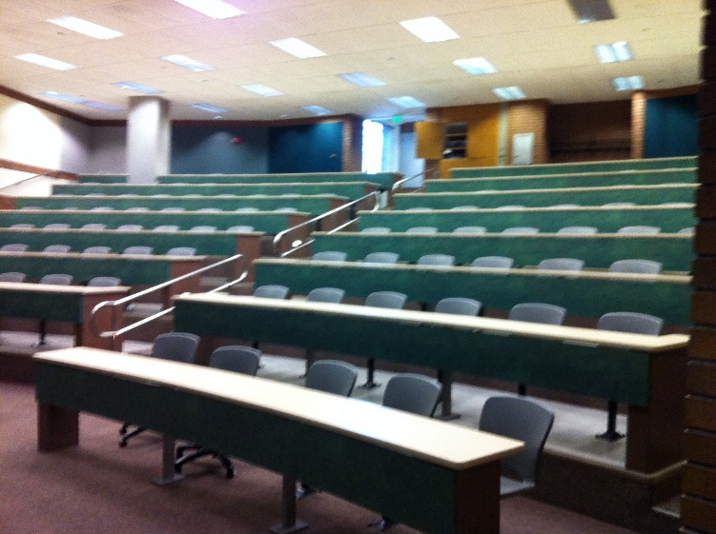
Lessons Learned from General Chemistry
Increasing Interactions
  Fall semester 2014 CHM 11100 General Chemistry
    No help in the classroom, less instructor interactions w/students
  Spring semesters 2015 and 2016 CHM 11100
    1 Supplemental Instructor in classroom, more instructor interaction

Slide 37
Assessment and Grades Overall Results
What do you think happened to the grades the following semesters with increased interactions?
Improved
Became worse
Unchanged
  2015: DFW rate the same, but A/B/C score distribution shifted upwards
  2016: DFW improved, but A/B/C score distribution shifted upwards

Slide 38
Organic Lab
Classroom Assessment Techniques
  Finally applied lab lectures
  quiz averages improved

Slide 39
Observations: Instructor
Much time investment required up-front but more efficient over time.
  Maybe best to evolve course so that flip doesn’t occur all at once
Flipping the class does not involve sacrificing content.

Slide 40
Observations: Students
Students may resist flipped learning.
  Some uncertainty at first but very little pushback
Very little review in face to face classes
  Varies with class
More interactions with students after class
  Suggested ways to improve online lectures

Slide 41
Observations: Instructor
Allowed for increased rigor and more explanations
More flexibility in pacing material

Slide 42
Conclusions
Majority of students prefer flipped class
Student did meet more fellow students
  Effect on retention and graduation?
Comparable grades but can be improved
How can you do it?

Slide 43
Thanks!
Center for Enhancement of Learning and Teaching
  Gail Rathbun
  Ludwika Goodson
  Stephanie Stephenson
ITS
  Mike Phillips
SI: Ian Gatchell and Rachel Maibach!

Slide 44
Student Survey
I watched the lectures before lecture topics were discussed in class.
1 Strongly disagree | 2 Disagree | 3 Neutral | 4 Agree | 5 Strongly Agree | n (% 4+5) Fall Spring
2 | 6 | 10 | 23 | 22 | 63 (71%)
0 | 2 | 7 | 16 | 4 | 29 (69%)

Slide 45
Student Survey
I prefer being able to watch the lectures online rather than in person because I can watch them more than once if necessary.
1 Strongly disagree | 2 Disagree | 3 Neutral | 4 Agree | 5 Strongly Agree | n (% 4+5) Fall Spring
4 | 0 | 3 | 14 | 42 | 63 (89%)
2 | 2 | 3 | 9 | 13 | 29 (76%)

Slide 46
Student Survey
I prefer watching the online lectures because it allows more time to work on difficult problems and concepts in class.
1 Strongly disagree | 2 Disagree | 3 Neutral | 4 Agree | 5 Strongly Agree | n (% 4+5) Fall Spring
2 | 6 | 7 | 19 | 29 | 63 (76%)
2 | 0 | 5 | 9 | 13 | 29 (76%)

Slide 47
Student Survey
I prefer live lectures in class because I can ask questions when a difficult concept comes up.
1 Strongly disagree | 2 Disagree | 3 Neutral | 4 Agree | 5 Strongly Agree | n (% 4+5) Fall Spring
9 | 16 | 20 | 10 | 8 | 63 (29%)
1 | 12 | 5 | 8 | 3 | 29 (38%)
Notes:
T

Slide 48
Student Survey
I worked out the online homework problems on my own before submitting the final answers.
1 Strongly disagree | 2 Disagree | 3 Neutral | 4 Agree | 5 Strongly Agree | n (% 4+5) Fall Spring
5 | 8 | 10 | 21 | 19 | 63 (63%)
0 | 0 | 4 | 11 | 12 | 27 (80%)

Slide 49
Student Survey
I worked with others to finish the online homework before submitting it.
1 Strongly disagree | 2 Disagree | 3 Neutral | 4 Agree | 5 Strongly Agree | n (% 4+5) Fall Spring
11 | 21 | 10 | 10 | 11 | 63 (33%)
4 | 5 | 2 | 10 | 6 | 27 (59%)

Slide 50
Student Survey
I just received answers from others to submit the online homework.
1 Strongly disagree | 2 Disagree | 3 Neutral | 4 Agree | 5 Strongly Agree | n (% 4+5) Fall Spring
41 | 12 | 5 | 1 | 4 | 63 (8%)
13 | 9 | 5 | 1 | 0 | 28 (4%)

Slide 51
Student Survey
I believe that I learned material better with the current format than I would have if the course had been presented in the traditional format.
1 Strongly disagree | 2 Disagree | 3 Neutral | 4 Agree | 5 Strongly Agree | n (% 4+5) Fall Spring
5 | 2 | 9 | 22 | 24 | 62 (73%)
1 | 4 | 6 | 5 | 11 | 27 (59%)

Slide 52
Student Survey
I believe that I am getting a better grade than I would have if the course had been presented in the traditional format.
1 Strongly disagree | 2 Disagree | 3 Neutral | 4 Agree | 5 Strongly Agree | n (% 4+5) Fall Spring
5 | 5 | 14 | 11 | 27 | 62 (61%)
2 | 4 | 8 | 4 | 9 | 27 (48%)

Slide 53
Student Survey
I learn the material better when I can work on problems with other students during class.
1 Strongly disagree | 2 Disagree | 3 Neutral | 4 Agree | 5 Strongly Agree | n (% 4+5) Fall Spring
2 | 3 | 12 | 22 | 23 | 62 (73%)
0 | 1 | 6 | 12 | 8 | 27 (74%)

Slide 54
Student Survey
I understand the material better when I can work on problems with other students during class.
1 Strongly disagree | 2 Disagree | 3 Neutral | 4 Agree | 5 Strongly Agree | n (% 4+5) Fall Spring
6 | 5 | 10 | 19 | 22 | 62 (66%)
0 | 1 | 12 | 6 | 7 | 26 (50%)

Slide 55
Student Survey
I learned how to approach organic chemistry from my classmates.
1 Strongly disagree | 2 Disagree | 3 Neutral | 4 Agree | 5 Strongly Agree | n (% 4+5) Fall Spring
9 | 16 | 20 | 9 | 8 | 62 (27%)
1 | 5 | 9 | 6 | 5 | 26 (42%)

Slide 56
Student Survey
I got to know more classmates in this class than I would have in a traditional format.
1 Strongly disagree | 2 Disagree | 3 Neutral | 4 Agree | 5 Strongly Agree | n (% 4+5) Fall Spring
6 | 6 | 14 | 15 | 20 | 61 (57%)
2 | 2 | 6 | 7 | 9 | 26 (62%)

Slide 57
Student Survey
The current format makes the class more enjoyable than the traditional format.
1 Strongly disagree | 2 Disagree | 3 Neutral | 4 Agree | 5 Strongly Agree | n (% 4+5) Fall Spring
2 | 4 | 13 | 9 | 33 | 61 (69%)
0 | 1 | 6 | 8 | 12 | 27 (74%)

Slide 58
Student Survey
The current format should be continued for organic chemistry.
1 Strongly disagree | 2 Disagree | 3 Neutral | 4 Agree | 5 Strongly Agree | n (% 4+5) Fall Spring
2 | 0 | 9 | 14 | 36 | 61 (82%)
0 | 0 | 7 | 6 | 14 | 27 (74%)

Slide 59
Student Survey
Overall I have had few problems using Tegrity. (online lecture software)
1 Strongly disagree | 2 Disagree | 3 Neutral | 4 Agree | 5 Strongly Agree | n (% 4+5) Fall Spring
7 | 7 | 7 | 17 | 23 | 61 (67%)
0 | 3 | 6 | 7 | 11 | 27 (67%)

Slide 60
Student Survey
Overall, I had few problems using Blackboard to access course material. (course management system) 6
14
15
20
61
1 Strongly disagree | 2 Disagree | 3 Neutral | 4 Agree | 5 Strongly Agree | n (% 4+5) Fall Spring
4 | 7 | 6 | 18 | 26 | 61 (72%)
0 | 5 | 2 | 6 | 14 | 27 (74%)

Slide 61
Student Survey
Overall, I had few problems submitting the online homework.
1 Strongly disagree | 2 Disagree | 3 Neutral | 4 Agree | 5 Strongly Agree | n (% 4+5) Fall Spring
5 | 6 | 4 | 17 | 29 | 61 (75%)
1 | 2 | 3 | 7 | 14 | 27 (78%)

Slide 62
Student Survey
I prefer that the textbook is optional.
1 Strongly disagree | 2 Disagree | 3 Neutral | 4 Agree | 5 Strongly Agree | n (% 4+5) Fall Spring
0 | 6 | 6 | 13 | 36 | 61 (80%)
0 | 0 | 6 | 4 | 17 | 27 (78%)

Slide 63
Student Survey
The availability of the optional textbook at the library was sufficient.
1 Strongly disagree | 2 Disagree | 3 Neutral | 4 Agree | 5 Strongly Agree | n (% 4+5) Fall Spring
2 | 6 | 20 | 10 | 20 | 58 (52%)
1 | 1 | 12 | 2 | 9 | 25 (44%)

Slide 64
Student Survey
I used other textbooks to learn the material. Please specify on the back of this survey I used other textbooks to learn the material.
1 Strongly disagree | 2 Disagree | 3 Neutral | 4 Agree | 5 Strongly Agree | n (% 4+5) Fall Spring
36 | 7 | 6 | 4 | 5 | 58 (16%)
13 | 3 | 7 | 2 | 2 | 27 (15%)

Slide 65
Student Survey
I used other online lectures to learn the material. Please specify on the back of this survey.
1 Strongly disagree | 2 Disagree | 3 Neutral | 4 Agree | 5 Strongly Agree | n (% 4+5) Fall Spring
27 | 7 | 6 | 8 | 9 | 57 (30%)
13 | 3 | 7 | 2 | 2 | 27 (15%)

Slide 66
Scores Fall
Year | Quiz Total Average | Exam Average | Final Exam Average | Average Total Points (550) | Average % Grade | Letter Grade
2013 | 73.7 | 74.6 | 97.4 | 405.4 | 73.7 | C
2012 | 78.1 | 79.1 | 102.4 | 429.3 | 78.0 | C+
2011 | 72.6 | 79.5 | 95.7 | 404.5 | 73.5 | C

Slide 67
Scores Spring
Year | Quiz Total Average | Exam Average | Final Exam Average | Average Total Points (550) | ACS Raw Score | Letter Grade
2014 | 76.0 | 75.3 | 97.4 | 405.4 | 36.1 | C+
2013 | 72.5 | 75.4 | 102.4 | 429.3 | 36.9 | C+
2012 | 75.5 | 73.6 | 95.7 | 404.5 | 35.1 | C+

Slide 68
NMR
¹H NMR allows following information to be determined about a molecule
what types of H atoms (protons) are present
e.g. -CH₂-CH₃
-CH₂-O
-CH₂-Cl
# of H atoms (protons) that are present
# of H atoms nearby to absorbing protons (spin splitting)

Slide 69
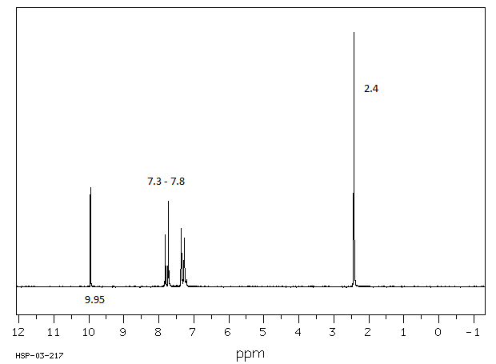
Chapter 15 Lecture 28 Questions 2 + 3
The peak at 9.95 ppm is the absorption for which proton?
2.4 ppm?

Slide 70
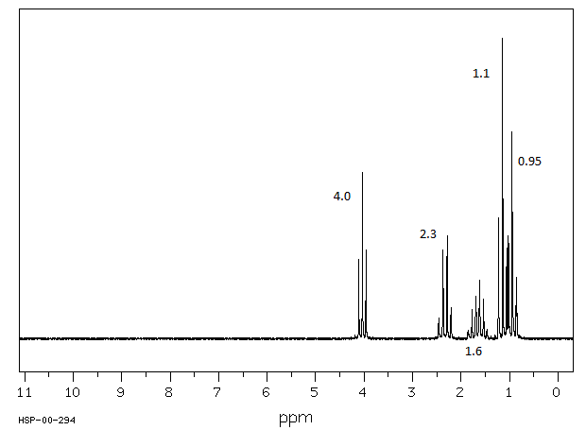
Chapter 15 Lecture 28 Questions 4,5,6,7

Slide 71
Chapter 15 Lecture 28 Question 8
Structure?

Slide 72
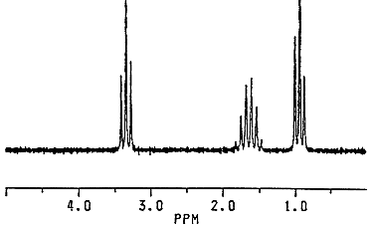
Question 9 The molecular formula for this compound is C₆H₁₄O. What is the structure of the compound?

Slide 73
Chapter 15 Lecture 28 Question 10
Which two elements cause protons to have broad peaks in ¹H NMR.

Slide 74
Chapter 15 Lecture 28 Question 11
Which structure tends to appear as 2 doublets in ¹HNMR?

Slide 75
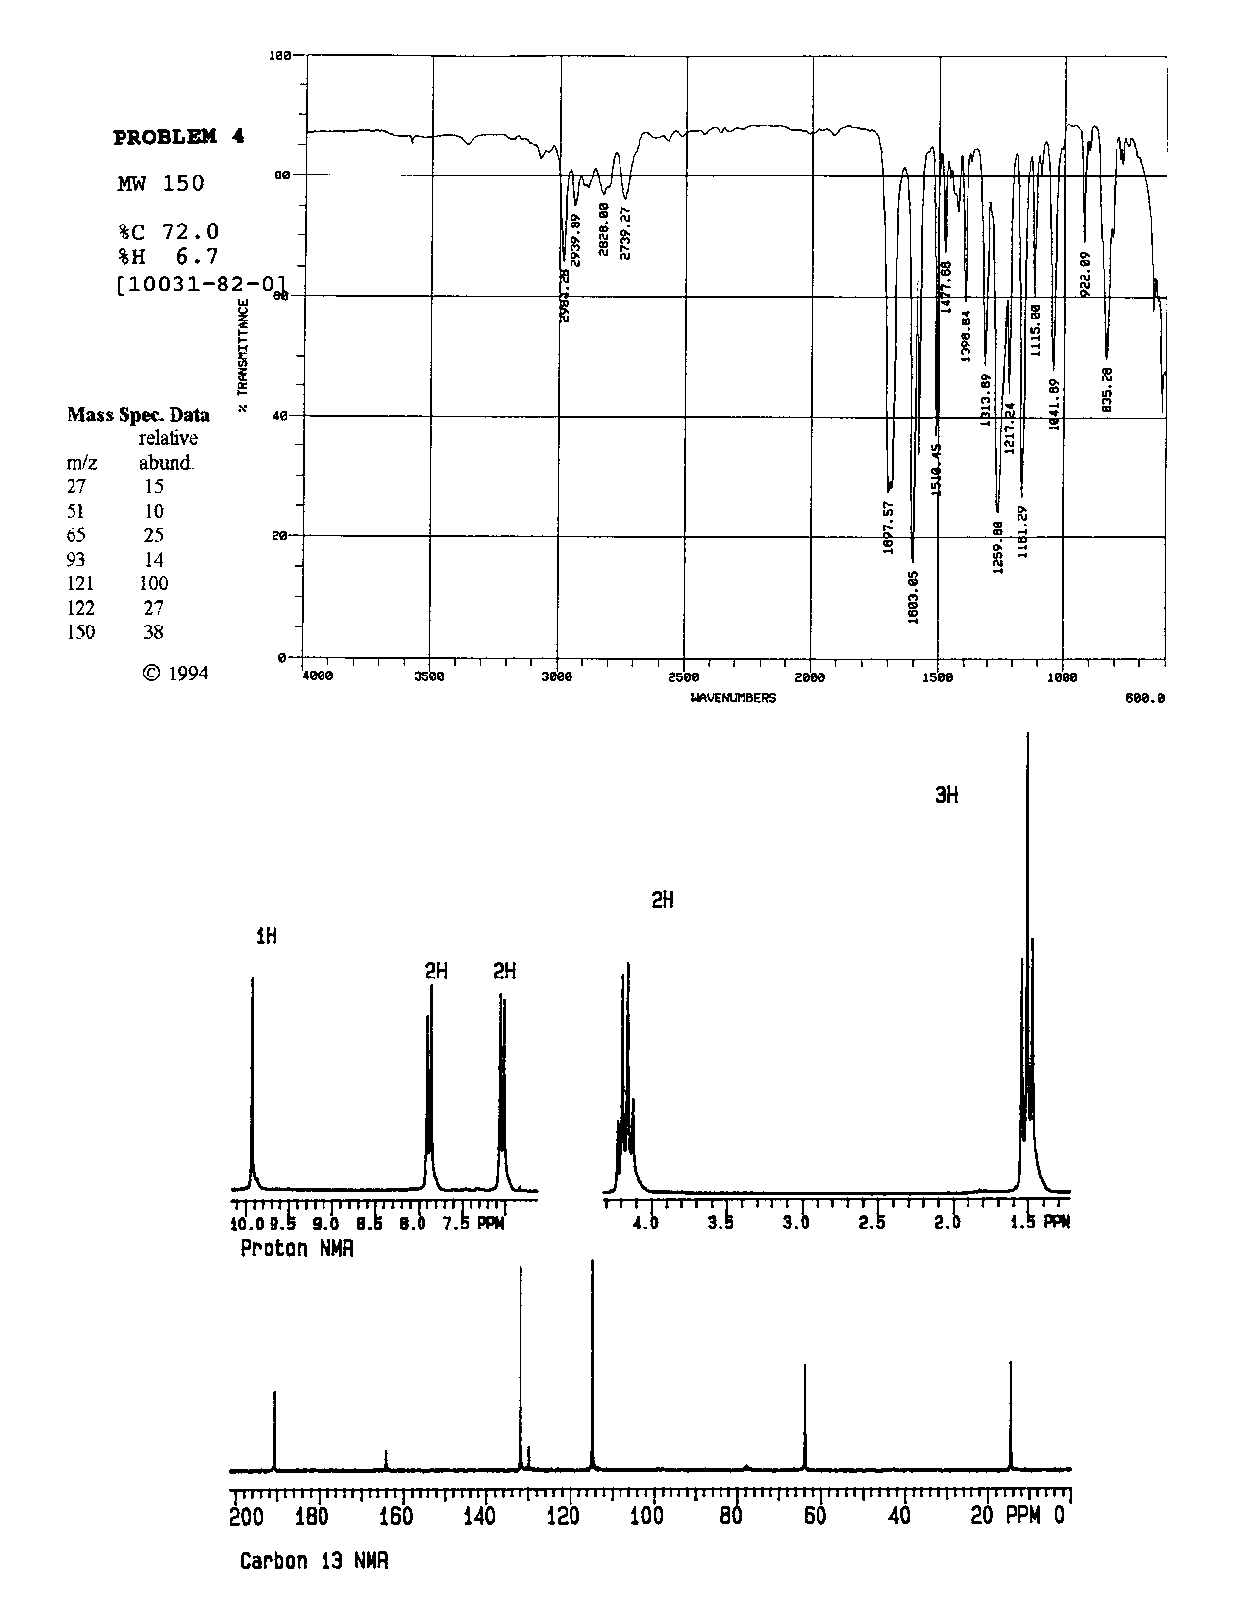

Slide 76
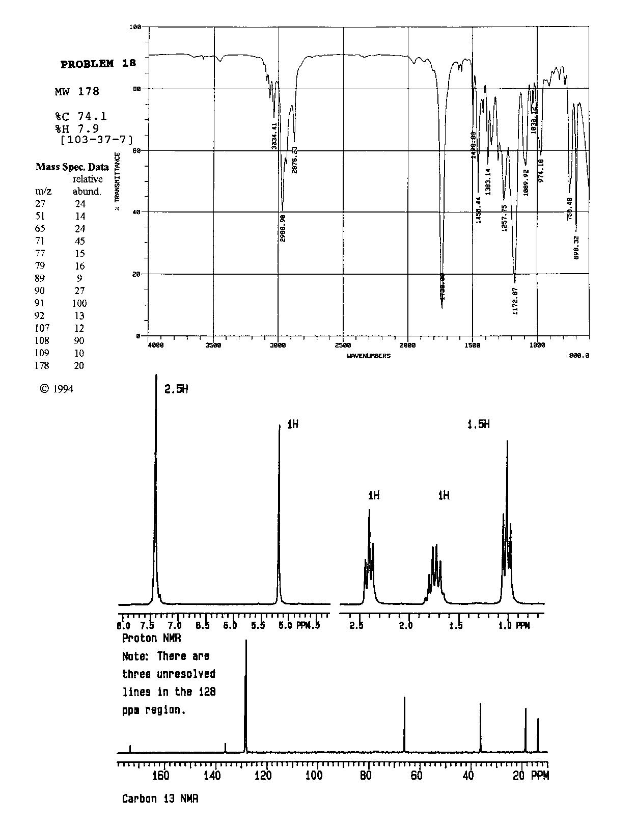

Slide 77
Scaffolding Electrophilic Addition
Product of the addition of HX to a symmetrical alkene
Mechanism of addition
HOMO and LUMO in each step
Acid catalyzed hydration of a symmetrical alkene
Mechanism of acid catalyzed hydration
  Role of the acid catalyst
Addition of HX to an unsymmetrical alkene: 2-methylpropene
  Regiochemistry and Markovnikov's rule
Carbocation stability
  Inductive effects, hyperconjugation, polarizability and alkyl groups
  Resonance effects and addition to vinyl halides and vinyl ethers

Slide 78
Scaffolding Electrophilic Addition
Stereochemistry of addition
  Formation of both enantiomers
What happens if there is no good nucleophile
  Carbocationic polymerization
  Lewis acids and initiation
  Suitable alkenes
Carbocation rearrangements and addition
  Preference for more substituted carbocation
Carbocation rearrangements and ring expansion and contraction

