Slide 1
Transformation of the Traditional Organic Chemistry Lecture Sequence into a Hybrid of Face to Face Peer Learning and Online Lecture
Vincent Maloney

Slide 2
Introduction
Outline
Journey to “flipping” the course i.e. Why?
Previous course structure
Flipped course structure
Student survey
Assessment
Observations

Slide 3

Why Change Everything?
Improved Learning
Mounting evidence that active learning techniques are more effective than traditional lecture
Hake, R. R. American Journal Physics, 66, 1998, 64-7
S. Freeman et al. Proceedings of the National Academy of Sciences, 111 (23), 2014, 8410 – 8415
Flipping the course just extends such practices

Slide 4
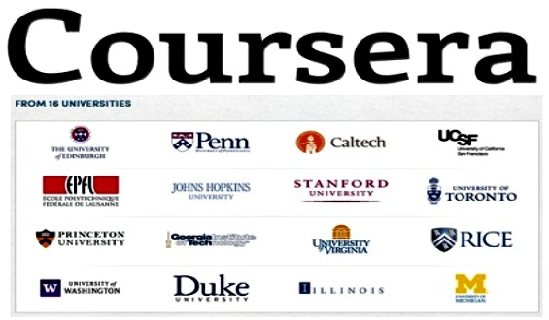
MOOCs
Massive Open Online Courses
Can university professors be replaced? Should courses be taught a different way?

Slide 5
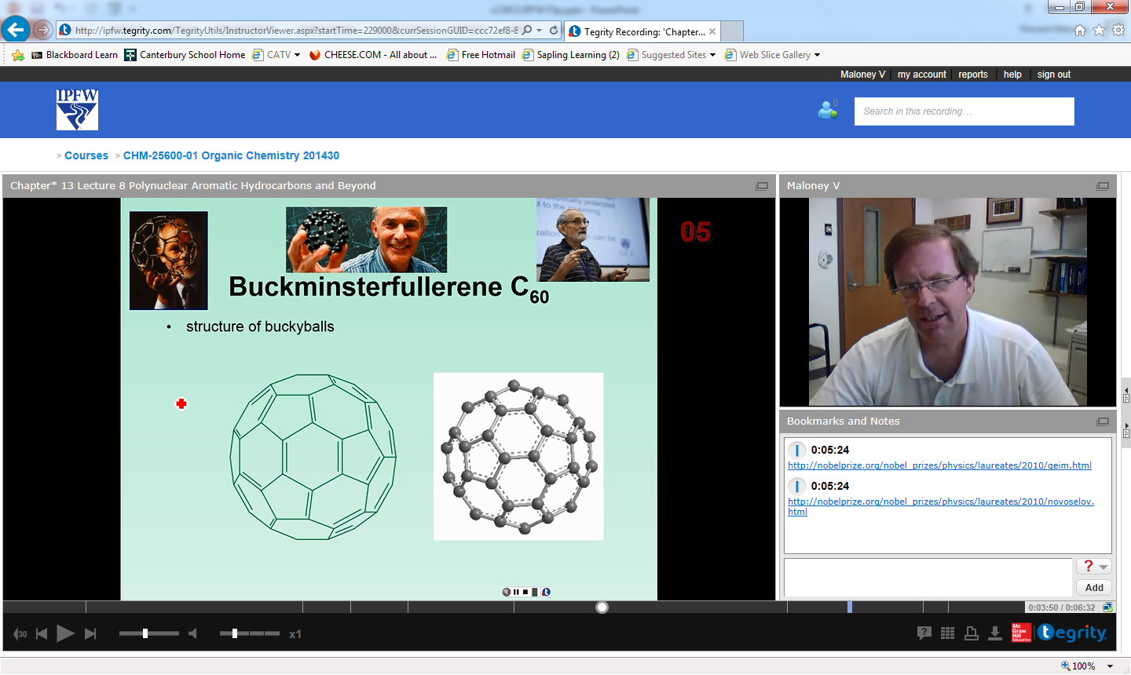
Recorded Lectures
Around for a long time
What’s different
Much easier to access and watch anywhere
Can be watched repeatedly

Slide 6
Other Benefits
Retention
In specific class
At university
Interactive learning
Interactions that build relationships
Students and professors
Others students
Smith, K. A., Sheppard, S. R., Johnson, D. W., Johnson, R.T Journal of Engineering Education, 94, No. 1 2005, 87-101.

Slide 7
Traditional Lecture
Students read text before lecture (maybe)
Lecture given in traditional manner
After class, students work on assignments
May work together
May ask instructor questions
Problems in understanding not recognized until homework turned in or quiz/exam

Slide 8
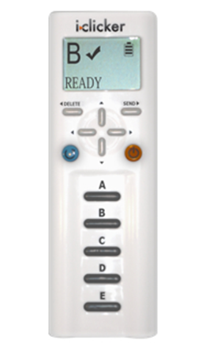
Organic Chemistry IPFW
Traditional lecture plus
Clickers questions
~ 3 per class with peer to peer problem solving
Review sessions
2x per week
Peer to peer problem solving
~40% of class attended
Arrangements for those who could not attend
Lectures recorded on Tegrity for subsequent viewing
Courses partially flipped!

Slide 9
Flipping IPFW Organic Chemistry
Course flip?
Move traditional lecture out of face to face class
Place homework and review in a peer to peer problem solving format into face to face class
Notes:
Although there has been a lot said and written about the course flip, in case you don’t know what it is, one description would say …

Slide 10
Flipping IPFW Organic Chemistry
Course Preparation
Summer 2013: recorded most lectures for both semesters
Syllabus + 1st Day
Explained course format and grading
Rationale: data supporting active learning and different class format
For their benefit
Instructions for clickers
General chemistry review 1st day

Slide 11
Flipping IPFW Organic Chemistry
What is the suggested length of video lectures?
50 min.
15 min.
10 min.
6 min.
2 min.

Slide 12
Flipping IPFW Organic Chemistry
Record lectures < 20 min.
Lecture length based on topic
1.5 – 20 min.

Slide 13
Flipping IPFW Organic Chemistry
Record lectures < 20 min.
Lecture length based on topic
1.5 – 20 min.
Chunking (Nilson)

Slide 14
Flipping IPFW Organic Chemistry
What is the suggested number of concepts that should be covered in a video?
1
2
5
Variable

Slide 15
Flipping IPFW Organic Chemistry
295 lectures recorded year
130 fall semester
≈17 h, ≈ 20.5 classes!
165 spring semester
≈17 h, ≈20.5 classes!
What happened to the other 23.5?

Slide 16
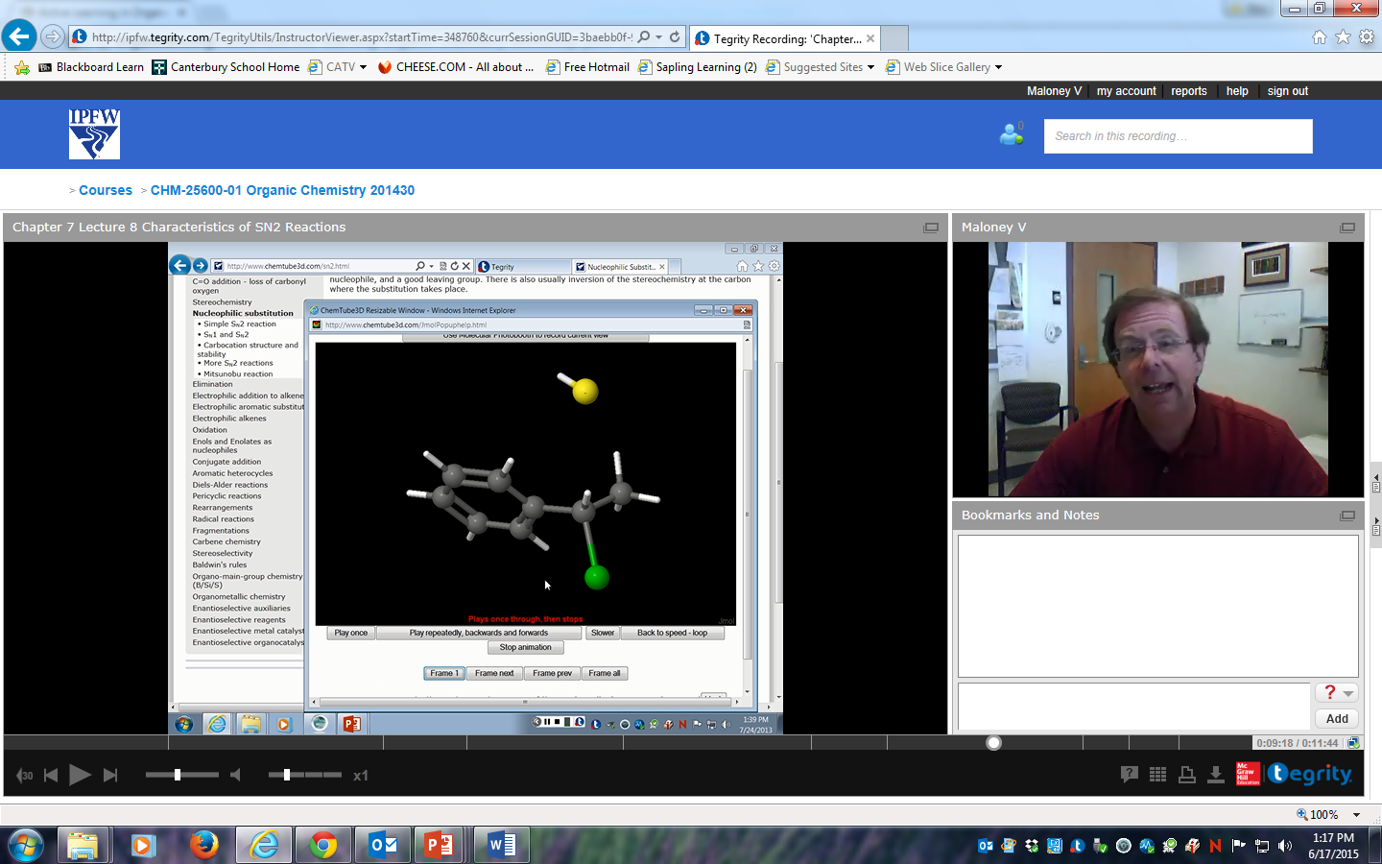
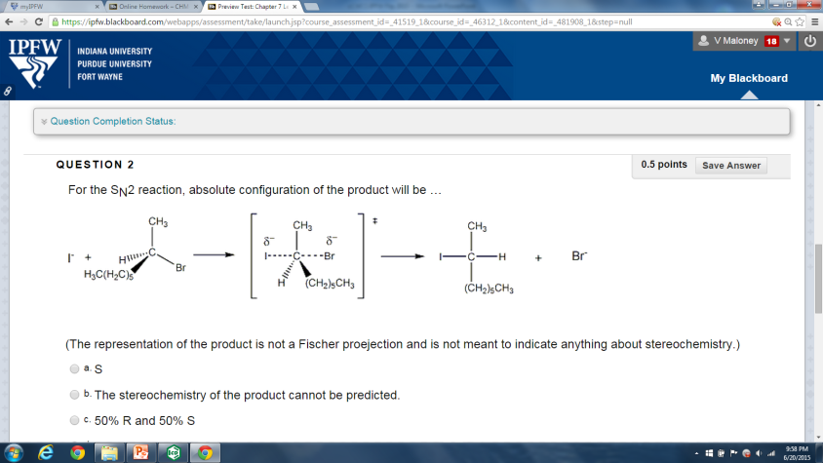
Flipping IPFW Organic Chemistry
Students watch lectures before class
Students complete online homework assignment in Blackboard
162 questions in fall
98 questions in spring

Slide 17
Flipping IPFW Organic Chemistry
Face to Face Class
Nearly entire class devoted to peer to peer problem solving
98 students fall semester
88 students spring semester
No review or mini lecture at beginning of class!

Slide 18
Flipping IPFW Organic Chemistry
How many questions were covered in a class?
3-5
5-7
10-12
14-16

Slide 19
Flipping IPFW Organic Chemistry
Review session and some traditional homework from text now in class
Everyone benefits from “review sessions”
Time neutral for student
Exam/quiz schedule kept the same

Slide 20
Student Survey
Given last week both semesters
IRB approval pending
22 questions
Likert Scale
1 strongly disagree to 5 strongly agree

Slide 21
Student Survey
I prefer watching the online lectures because it allows more time to work on difficult problems and concepts in class.
I believe that I learned material better with the current format than I would have if the course had been presented in the traditional format.

Slide 22
Student Survey
I understand the material better when I can work on problems with other students during class.
I got to know more classmates in this class than I would have in a traditional format.
The current format should be continued for organic chemistry.
A. Yes B. No C. Neutral

Slide 23
Conclusions
Solid majority believes they are learning material better
Larger majority thought method should be continued
If meeting and building relationships helps with retention and obtaining a degree, then there is evidence that “flipping the classroom” does that.

Slide 24
Assessment and Grades
Assessment
Pre- and post-test scores not available
Compared grades to 2011-2012 and 2012-2013 organic classes.
Obviously limited, many variables, exams and quizzes not the same
Perhaps broad changes can be observed
Data complicated by drop/make-up policy and changes to accommodate flip
End of spring semester: National ACS 2004 Organic Chemistry Exam

Slide 25
Assessment and Grades
Grading Fall
Year | Quizzes | Nomenclature Quiz | Exams | Final Exam | Clicker | Homework | Total
2013 | 100 | 0 | 200 | 150 | 50 | 50 | 550
2012 | 100 | 25 | 200 | 150 | 25 | 50 | 550
2011 | 100 | 25 | 200 | 150 | 25 | 50 | 550

Slide 26
Assessment and Grades
Grading Spring
Year | Quizzes | Nomenclature Quiz | Exams | Final Exam | Clicker | Homework | Total
2014 | 100 | 0 | 200 | 200 | 50 | 50 | 600
2013 | 100 | 25 | 200 | 200 | 25 | 50 | 600
2012 | 100 | 25 | 200 | 200 | 25 | 50 | 600

Slide 27
Assessment and Grades Overall Results
Good news
Students like it
Over the entire year, the performance of the “flipped class” was comparable to the previous two “traditional” classes including the ACS exam

Slide 28
Assessment and Grades Overall Results
No improvement in grades????
Substantial portion of “lecture” already contained active learning.
“highest impact on courses with 50 or fewer students”
High end of medium size class
S. Freeman et al. Proceedings of the National Academy of Sciences, 111 (23), 8416 0 8415, 2014

Slide 29
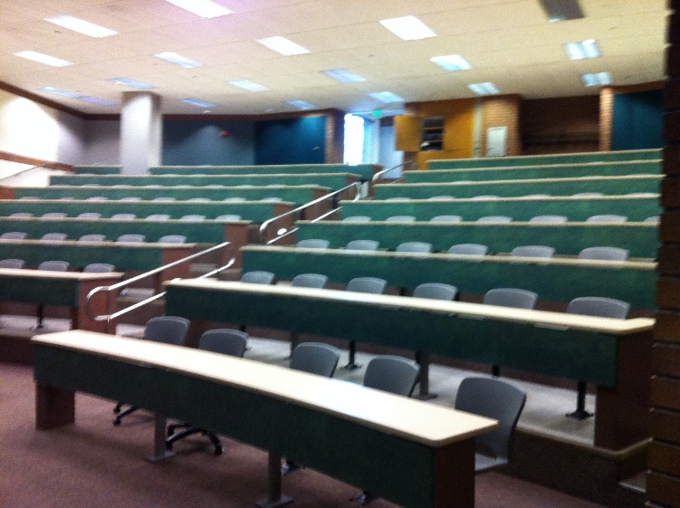
Assessment and Grades Overall Results
Help in the classroom
Fall semester CHM 11100 General Chemistry
No help in the classroom
Spring semester CHM 11100
1 Supplemental Instructor in classroom

Slide 30
Assessment and Grades Overall Results
What do you think happened to the grades the following semester with an SI student?
Improved
Became worse
Unchanged

Slide 31
Observations: Students
Students may resist flipped learning.
Some uncertainty at first but very little pushback
Very little review in face to face classes
Varies with class
More interactions with students after class
Suggested ways to improve online lectures

Slide 32
Observations: Instructor
Much time investment required up-front but more efficient over time.
Maybe best to evolve course so that flip doesn’t occur all at once
Flipping the class does not involve sacrificing content.

Slide 33
Observations: Instructor
Allowed for increased rigor and more explanations
More flexibility in pacing material

Slide 34
Observations: Improvements
Getting out to the students
Keep on task
Reduces just getting answers from best students
Reduces “bad” anonymity
> 50 Students: get help!

Slide 35
Observations: Improvements
More homework questions
Increased number and rigor of pre-class questions
Add post class questions
Scaffolding!
Build up student mastery through a series of questions
“lecture” by asking questions

Slide 36
Conclusions
Majority of students prefer flipped class
Student did meet more fellow students
Effect on retention and graduation?
Comparable grades but can be improved
How can you do it?

Slide 37
Thanks!
Center for Enhancement of Learning and Teaching
Gail Rathbun
Ludwika Goodson
Stephanie Stephenson
ITS
Mike Phillips
SI: Ian Gatchell!

Slide 38
NMR
¹H NMR allows following information to be determined about a molecule
what types of H atoms (protons) are present
e.g. -CH₂-CH₃
-CH₂-O
-CH₂-Cl
# of H atoms (protons) that are present
# of H atoms nearby to absorbing protons (spin splitting)

Slide 39
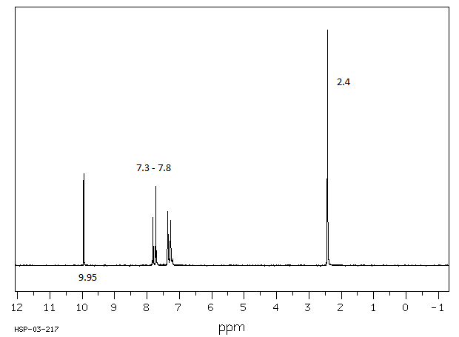
Chapter 15 Lecture 28 Questions 2 + 3
The peak at 9.95 ppm is the absorption for which proton?
2.4 ppm?

Slide 40
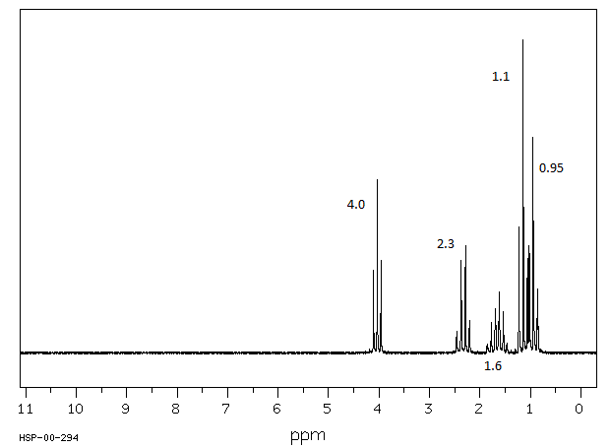
Chapter 15 Lecture 28 Questions 4,5,6,7

Slide 41
Chapter 15 Lecture 28 Question 8
Structure?

Slide 42
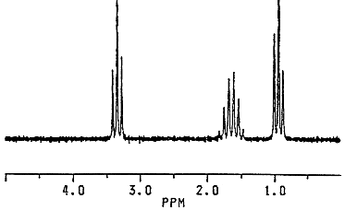
Question 9 The molecular formula for this compound is C₆H₁₄O. What is the structure of the compound?

Slide 43
Chapter 15 Lecture 28 Question 10
Which two elements cause protons to have broad peaks in ¹H NMR.

Slide 44
Chapter 15 Lecture 28 Question 11
Which structure tends to appear as 2 doublets in ¹HNMR?

Slide 45
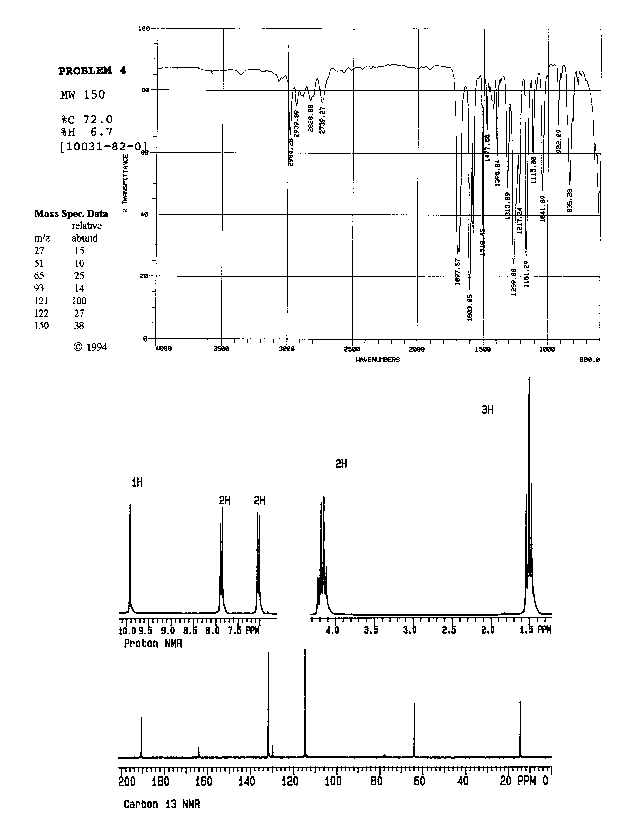

Slide 46
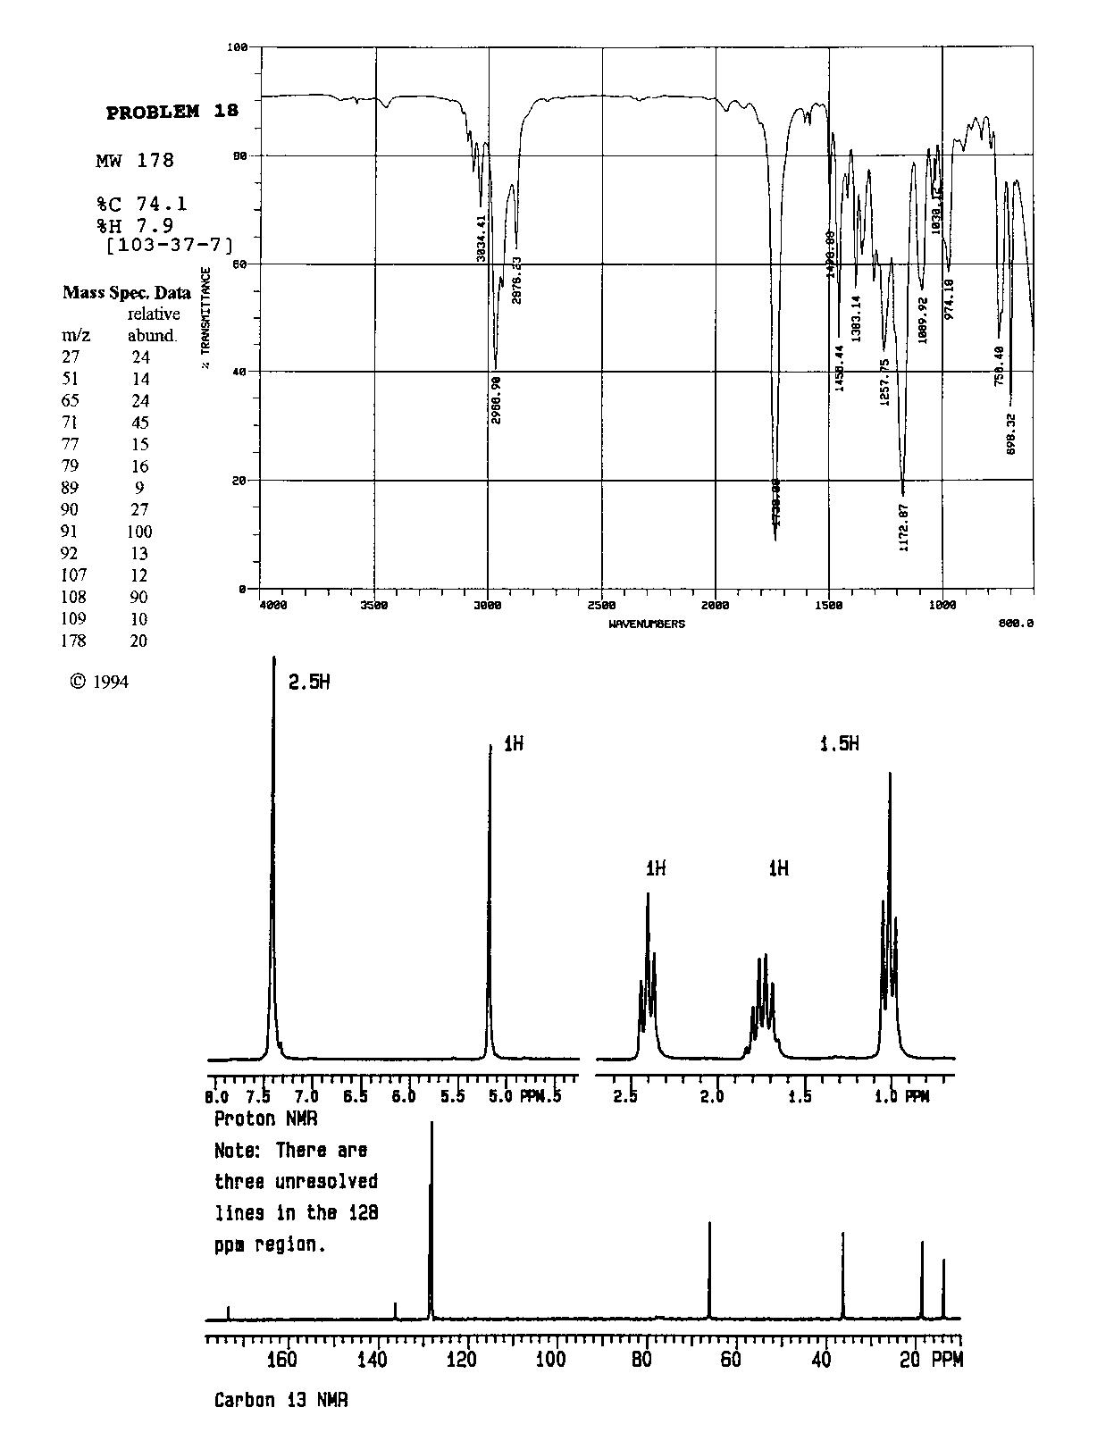

Slide 47
Scaffolding Electrophilic Addition
Product of the addition of HX to a symmetrical alkene
Mechanism of addition
HOMO and LUMO in each step
Acid catalyzed hydration of a symmetrical alkene
Mechanism of acid catalyzed hydration
Role of the acid catalyst
Addition of HX to an unsymmetrical alkene: 2-methylpropene
Regiochemistry and Markovnikov's rule
Carbocation stability
Inductive effects, hyperconjugation, polarizability and alkyl groups
Resonance effects and addition to vinyl halides and vinyl ethers

Slide 48
Scaffolding Electrophilic Addition
Stereochemistry of addition
Formation of both enantiomers
What happens if there is no good nucleophile
Carbocationic polymerization
Lewis acids and initiation
Suitable alkenes
Carbocation rearrangements and addition
Preference for more substituted carbocation
Carbocation rearrangements and ring expansion and contraction

