Slide 1
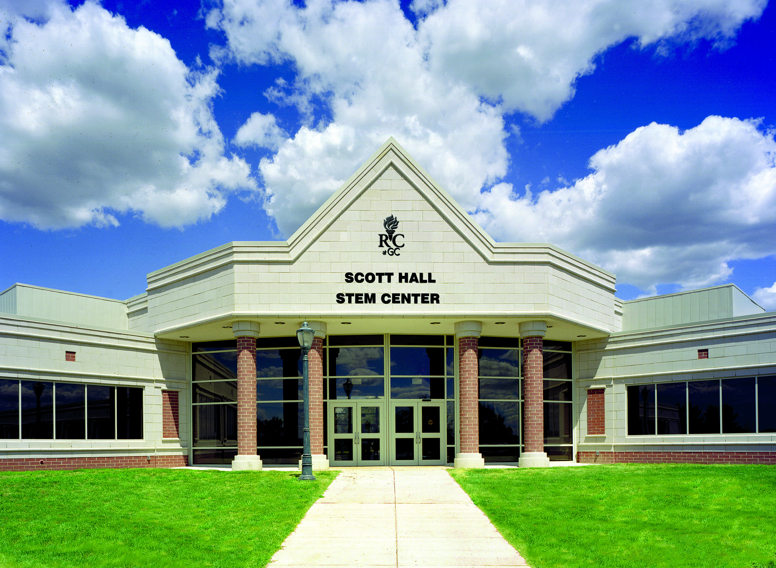
The Flipped Organic Classroom at Rowan College at Gloucester County
Bob Rossi
ALOC Workshop, June 20 – 23, 2016
Cincinnati, OH

Slide 2
Agenda
About RCGC
Video Lecture Topics and Assignments
Use of Classroom Face-to-Face Time
Student Outcomes
Student Surveys

Slide 3
Rowan College at Gloucester County
Current Course Demands
RCGC
STEM

Slide 4
Rowan College at Gloucester County
Organic Chemistry
4 sections in Fall:
  3 organic I, 1 organic II.
3 sections in Spring:
  2 organic II, 1 organic I.
Section capacity limited to 20-24 students.
Typical class composition by major:

Slide 5

“Flipped” Organic Classes at RCGC
Video Lecture Topics and Assignment
  Created >350 video “Lecture-On-Demand” topics to cover the two semester sequence:
    Organic I – 44 hrs.
    Organic II – 47 hrs.
  Organized generically by topic, arranged by text chapter:
    Each topic typically 10 - 20 minutes length.

Slide 6
Before Class
Video lectures assigned in 2.5 to 3 hr. segments/week.
Videos available through CollegeAnywhere®
Students required to:
  Keep notes.
  Prepare 2-3 questions.

Slide 7
During Class
Ten question video quiz - graded immediately.
    50% correct to stay for remainder of class.
Q & A session on concepts presented in the videos.
    Give “mini-lecture” reviewing trouble spots or guidance.
Problem solving portion - peer-learning format:
    Students stand and work in teams of 3 - 4 at “huddle-boards” to solve problems.
      Teams determined by grade in prerequisite course.
      Used iPads to access problems.
      Problems taken from text.
    Roamed from team to team.
    Incorporated i>Clicker® questions.

Slide 8
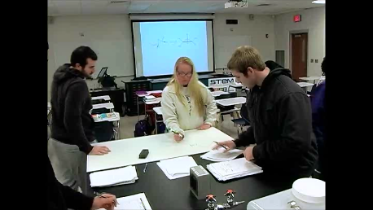
“Flipped” Organic Classes at RCGC

Slide 9
Student Outcomes

Slide 10
Student Outcomes

Slide 11
Student Outcomes
Flipped
Traditional

Slide 12
Student Outcomes
Traditional
Flipped

Slide 13
Student Outcomes
Traditional
Flipped

Slide 14
Student Outcomes
Traditional
Flipped

Slide 15
Student Outcomes
Traditional
Flipped

Slide 16
Student Survey Results – Organic I

Slide 17
Student Survey Results – Organic I

Slide 18
Student Survey Results – Organic I

Slide 19
Student Survey Results – Organic II

Slide 20
Student Survey Results – Organic II

Slide 21
Student Survey Results – Organic II

