Slide 1
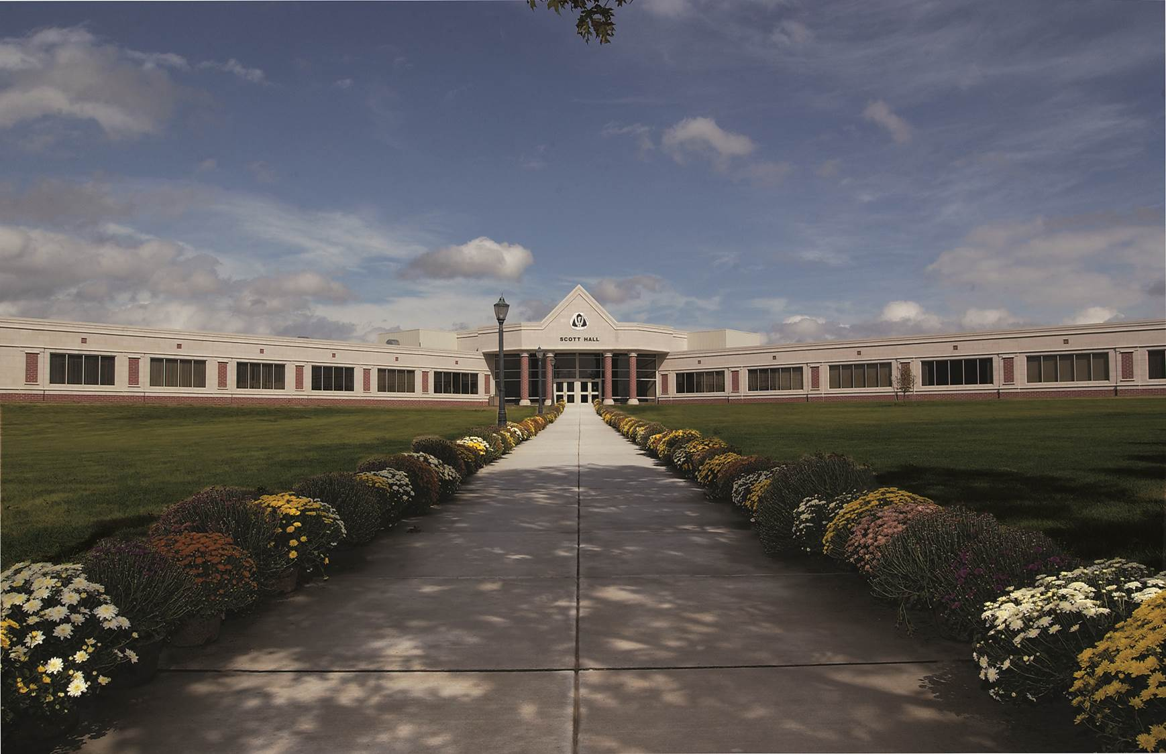
The Flipped Organic Classroom at Rowan College at Gloucester County
Bob Rossi
ALOC Workshop, June 22 – 25, 2015
Washington, D.C.

Slide 2
Agenda
About RCGC
Video Lecture Topics and Assignments
Use of Classroom Face-to-Face Time
Student Outcomes
Student Surveys

Slide 3
Rowan College at Gloucester County
Current Course Demands
RCGC
STEM

Slide 4
Rowan College at Gloucester County
Organic Chemistry
4 sections in Fall:
  3 organic I, 1 organic II.
3 sections in Spring:
  2 organic II, 1 organic I.
Section capacity limited to 20-24 students.
Typical class composition by major:

Slide 5

“Flipped” Organic Classes at RCGC
Video Lecture Topics and Assignment
  Created >350 video “Lecture-On-Demand” topics to cover the two semester sequence of Organic Chemistry
    Organic I – 44 hrs.
    Organic II – 47 hrs.
  Organized generically by topic and arranged by chapter of text in use
    Each topic typically between 10 and 20 minutes length
    Video lectures were typically assigned to the class in approximately 2.5 to 3 hour segments per week
  Videos available to student on PC’s (Windows and Mac) and other mobile devices by direct URL link to CollegeAnywhere®

Slide 6
“Flipped” Organic Classes at RCGC
Use of Classroom Face-to-Face Time
  Typically start class with question and answer session based on key concepts presented in the videos.
  Give “mini-lecture” reviewing those concepts that were obvious trouble spots (“muddiest point”).
  Problem solving portion of the class time handled in a collaborative team/peer learning format
    students stand and work in teams of 3 or 4 at “huddle-boards” to solve problems.
    instructor now a “coach” roaming from team to team to answer questions, lend support/guidance as needed and engage in deeper concept discussions.
    incorporated i>Clicker® questions.

Slide 7
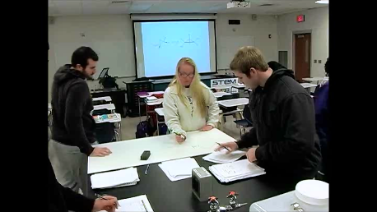
“Flipped” Organic Classes at RCGC

Slide 8
Student Outcomes

Slide 9
Student Outcomes

Slide 10
Student Outcomes
Flipped
Traditional

Slide 11
Student Outcomes
Traditional
Flipped

Slide 12
Student Outcomes
Traditional
Flipped

Slide 13
Student Outcomes
Traditional
Flipped

Slide 14
Student Outcomes
Traditional
Flipped

Slide 15
Student Survey Results – Organic I

Slide 16
Student Survey Results – Organic I

Slide 17
Student Survey Results – Organic I

Slide 18
Student Survey Results – Organic II

Slide 19
Student Survey Results – Organic II

Slide 20
Student Survey Results – Organic II

