Slide 1
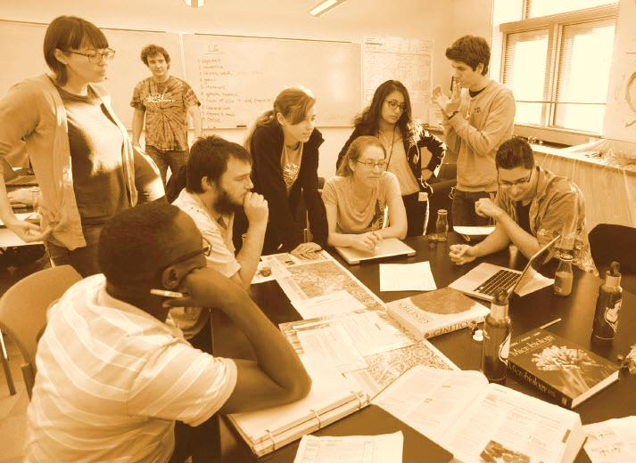
Peer-to-Peer Learning Pedagogies
Bob Rossi
ALOC Workshop – Washington, D.C.
June 22 – 25, 2015

Slide 2
“Studies of chemistry education during the past decade demonstrate that various forms of socially mediated learning (in which students create meaning through interactions with others) produce positive outcomes, including significantly higher test scores, higher final grades, better conceptual understanding, lower course withdrawal rates, and positive impacts on attitudes”*
*Kober, Nancy. Reaching Students: What Research Says About Effective Instruction in Undergraduate Science and Engineering. National Academies Press, 2015, p14.

Slide 3
Agenda
Peer Instruction (PI)
Think-Pair-Share and Think-Pair-Share-Square
Team-based Learning (TBL)
Problem-based Learning (PBL)
  Process Oriented Guided Inquiry Learning (POGIL)
  Peer-Led Guided Inquiry (PLGI)
Group/Team Roles, Dynamics and Make-up
Peer-to-Peer Instruction at RCGC

Slide 4
Peer Instruction
First introduced by E. Mazur³³ for Introductory Physics at Harvard University, 1991.
An instructional strategy for engaging students through “structured questioning” interspersed during modified lectures.
Lectures are segmented consisting of short “key point” presentations.
Lecture segment followed by a “ConcepTest”.
  short, qualitative, multiple choice conceptual questions on the subject just discussed.
Each key point takes ≈ 15 minutes to cover.
  7-10 minutes of lecturing, 5-8 minutes for a ConcepTest.
³³Mazur, E. "Peer instruction: A user’s manual" Addison-Wesley, 1996

Slide 5
Peer Instruction
Format of the ConcepTest³³
  Question posed (1 minute).
  Students given time to think (1-2 minutes).
  Students record/report individual answers.
  Neighboring students discuss their answers (2-4 minutes).
  Students record/report their revised answers.
  Feedback to instructor – tally answers.
  Explanation of correct answer (2+ minutes).

Slide 6
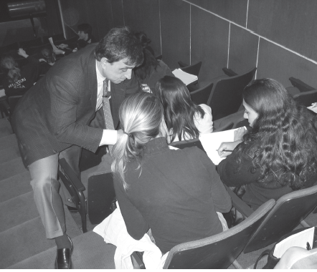
Peer Instruction
Changes in Teaching Practices with PI
  Lectures are shorter/flexible.
  Improvising becomes commonplace.
  When students are thinking, instructor gets a break.
  During the convince-your-neighbors discussions, instructor participates.
  ConcepTests elicit more questions than traditional lecturing.

Slide 7
Peer Instruction
Guidelines for designing good ConcepTest questions:
  Focus on a single important concept.
    Corresponding to common student difficulty.
  Question needs to require thought:
    Make assumptions
    Make estimates
    Develop a model
    Work that model out
  Provide plausible distracter choices.
  Be unambiguously worded.
  Neither too easy nor too difficult.

Slide 8
Flipping the Classroom with Peer Instruction⁶⁷
Before Class | Students complete an assignment and respond to questions. Instructors analyze student responses to prepare ConcepTests.
During Class | Typical PI workflow
After Class | Students complete problem sets and review ConcepTests from class.
⁶⁷Schell, J. and E. Mazur (2015). "Flipping the Chemistry Classroom with Peer Instruction."
Chemistry Education: Best Practices, Opportunities and Trends: 319-344.

Slide 9
Think-Pair-Share (TPS)/Think-Pair-Square-Share (TPS2)
Introduced by F. Lyman³², 1981.
Students pair up to share thoughts on a problem initiated by the instructor.
Strategy is designed to foster short class discussions.
Process:
  Brief lecture.
  Problem/question posed.
  30-45 seconds to think individually.
  Students form pairs.
    Pairs turn to another pair (TPS2).
  Students share thoughts.
³²Lyman, F. (1987). "Think-pair-share." Unpublished University of Maryland paper.

Slide 10
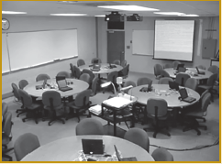
Team-based Learning (TBL)
Developed by L. Michaelsen⁴⁰, 1990’s.
Learning-centered teaching strategy used by business and health science professional schools.
Employs small student groups called teams.
  5-7 students per group.
  Groups seated at 7’ diameter tables.
Students study topics in advance.
In-class students:
  Demonstrate knowledge by answering IRAT.
  Answer same questions as a group, reach a consensus.
  Instructor provides feedback and clarification.
  Teams presented with a problem.
Backward design, outcomes-based approach to stay focused.
⁴⁰Parmelee, D., L. K. Michaelsen, et al. (2012). "Team-based learning: A practical guide:
AMEE Guide No. 65." Medical teacher 34(5): e275-e287

Slide 11
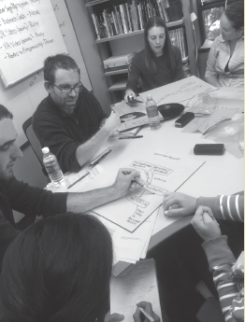
Problem-Based Learning (PBL)
Developed by H. Barrows³, 1996.
  Adopted by McMaster University for medical education.
Learning that results from understanding and resolving a problem.
Process - students:
  Divided into groups and presented with a problem, and delegate roles.
  Brainstorm to clarify problem and identify learning goals.
  Engage in independent study (outside class).
  Reconvene in a group to share, evaluate resources/information and work toward a solution (outside class).
  Present their solution.
  Instructors role throughout is one of guidance/support.
³Barrows, H. S. (1996). "Problem-based learning in medicine and beyond: A brief overview."
New directions for teaching and learning 1996(68): 3-12

Slide 12
Process-Oriented Guided Inquiry Learning (POGIL)
Peer-Led Guided Inquiry (PLGI)
First reported by J. Spencer¹⁹, 1999.
Similar to PBL with the exception of the use of guided inquiry activities/worksheets.
Process:
  No lectures.
  Students organized into formal groups with assigned roles.
  “Workshop/Peer leaders” are used in PLGI modification³⁰.
    Successful previous students that have good communication/people skills.
  Guided inquiry activities/worksheets to develop/learn concepts.
  Students reinforce learning by reading text.
  5-minute quiz given each class covering the previous material.
  Instructor moves among the groups observing/listening.
    Intervening only when absolutely necessary.
  Students are graded individually.
¹⁹Farrell, J. J., R. S. Moog, et al. (1999). "A Guided-Inquiry General Chemistry Course."
Journal of Chemical Education 76(4): 570

Slide 13
Group/Team Roles, Dynamics and Make-up
POGIL Groups:
  Very formal, with well defined roles -
    Manager – manages the group, ensures members are fulfilling their roles.
    Recorder – records names and roles of group members, and group answers and explanations. Official record keeper of the group.
    Technician – performs all technical operations of the group including use of calculator and computer.
    Reflector – observes and comments on group dynamics.
    Presenter – presents oral reports to the class.

Slide 14
Group/Team Roles, Dynamics and Make-up
PI, TPS/TPS2, TBL, PBL:
  Mostly very informal.
  Some assigned students according to grades in –
    Pre-requisite course,
    Overall GPA,
      Group of 4 composed of 1 “A”, 2 “B”, and 1 “C” student.
    Maintain heterogeneity regarding ethnicity and gender.
  Some encouraged active group participation by offering “teamsmanship points” to all members of a group whose exam average is ≥ 80%.
  Some provided a mechanism to “fire” a group member for poor performance.
  Some groups were recreated every few weeks.

Slide 15
Peer-to-Peer Learning at RCGC
Totally flipped classroom
  10-15 minute mini-lectures given at the beginning of class only to address unclear concepts.
  Majority of class time dedicated to applied problem solving in groups.
Students were asked to work in self-assigned informal groups of 3-4.
  Very informal, no specific roles assigned within each group.
  Occasionally needed to restructure group.
  Peer leader used this past semester.

Slide 16
Peer-to-Peer Learning at RCGC
Students work on problems standing at 2’ by 4’ white boards.
  Problems taken from the text.
    Advance access through LMS.
  Most require illustrating structures, reactions and/or mechanisms.
  Some guidance given depending on the complexity.
i>Clicker questions interspersed with in-class problems to poll individual student understanding of the concepts.
  Multiple choice questions very similar to ConcepTest questions.
    Mainly from publishers TestBank.
    No advance access.
    Sometimes would permit group discussion first.
  Group discussion, re-poll if < 70% correct.
  Reviewed after re-polling.

Slide 17
