Slide 1
Livescribe pens
A Short Description of How Livescribe Pens Are Used in the Chemistry Department at Dartmouth College.
Cathy Welder, Dartmouth College
cCWCS – Active Learning in Organic Chemistry
Denver, CO, June 8, 2014

Slide 2
What Can You Do with the Pen?
Record audio only.
Record writing only.
Record audio and writing.
Record audio then add written material during playback. (Syncs audio to paper.)
Files can be transferred to your computer and then shared.
Livescribe 3 (iOS devices) displays written material on screen as you write.

Slide 3
How do we use the pens?
Lecture Material
  Flipped classroom
  Remedial or tutorial topics
Answer Keys
  Quizzes
  Exams
  Problem sets
Data Sharing and Electronic Notebooks in Teaching Labs
Research Notebooks

Slide 4
How might we use the pens going forward?
Recorded Office Hours
Project written material by mirroring iOS devices
  Reflector app ($13)
  http://www.airsquirrels.com/reflector/
  Apple TV

Slide 5
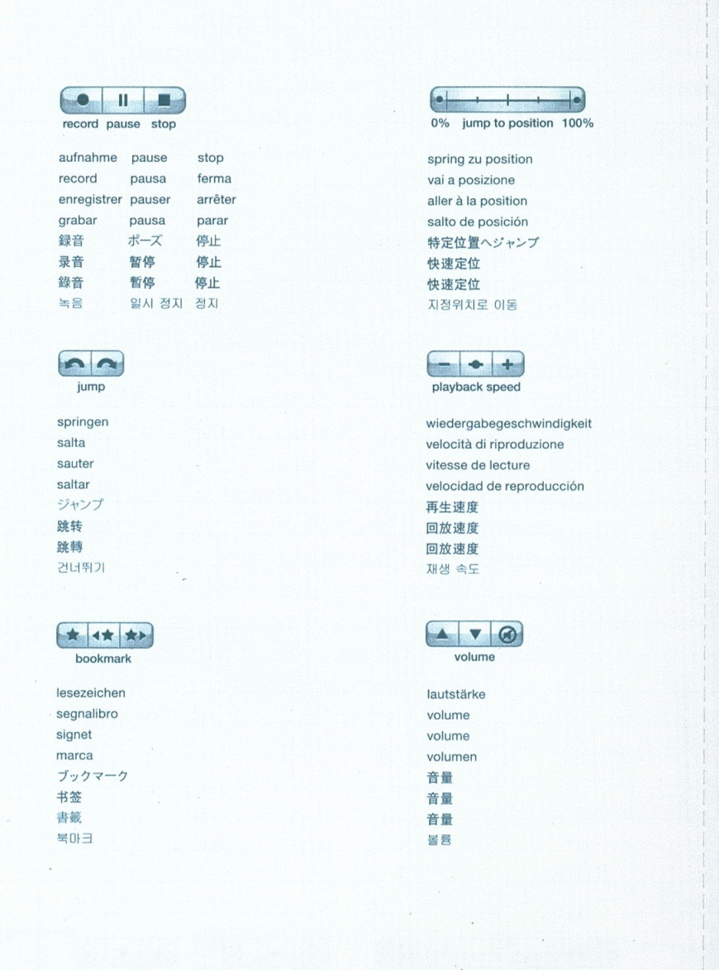
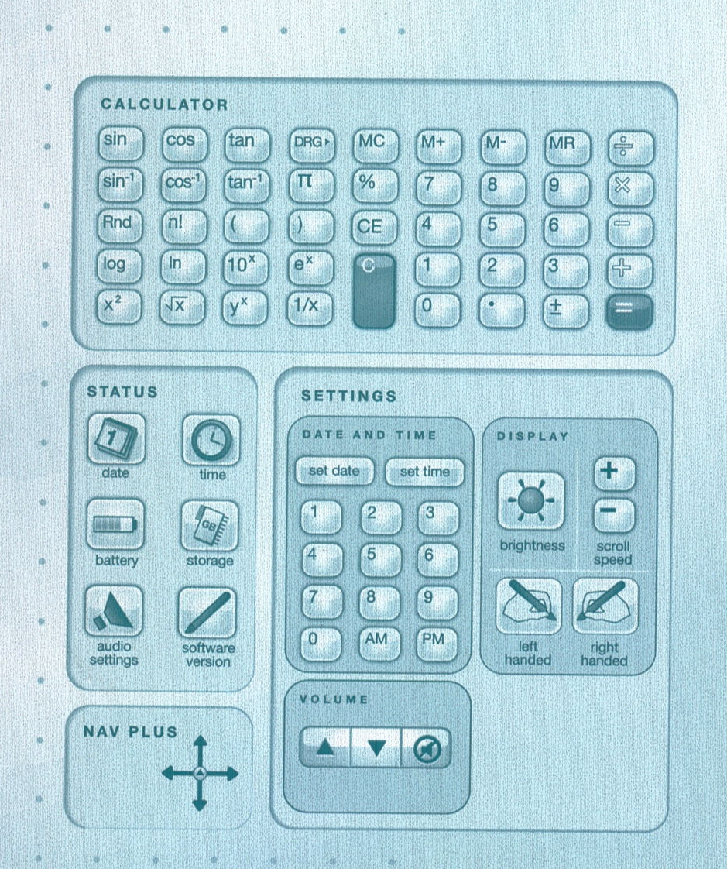
Introduction to the Pen

Slide 6
Introduction to the Pen
Controls are found at the bottom of each page.
Demonstration
  Record only audio or writing
  Record audio and writing
  Transfer to computer (Use Livescribe Desktop.)
  Create pencast (pdf file, to computer)
  Archive notebook
  Livescribe 3 with Reflector.

Slide 7
Pros
Notes are converted to a digital format.
Text is searchable, even with poor handwriting!
Pencasts can be sent to Evernote, Facebook, OneNote, mobile devices, and your computer.
Echo and Sky pens work with PC or Mac.
Livescribe 3 uses microphone and storage capacity of newer iOS devices (iPad, iPad Mini, or iPhone)
Comes with 500 MB free online storage.

Slide 8
Cons
Pen is somewhat bulky/heavy. (Less of a problem with the Livescribe 3)
You cannot write in color.
Ink cartridges are small. (5 refills for $7)
You cannot edit the audio. (You can pause.)
Syncing Sky pen by wifi drains battery. (It comes with a USB cable.)
Read app reviews before purchasing.

Slide 9
Helpful Hints
Write before you speak.
Be careful not to cover camera with finger when writing.
Bookmarks put a star on top of the last thing you wrote, partially covering it.
Mac users may need to open Adobe Acrobat Reader first and then open the pencast within Reader.

Slide 10
Helpful Hints
1 GB gives ~ 100 hours of recording time.
Permanently remove data from the pen by archiving the notebook.
Print notebook pdf files from the Livescribe website rather than from Livescribe Desktop.
3-D Recording Premium Headset ($20) records better sound.

Slide 11
Apps to Consider
Costs (Livescribe.com)
Item | Cost
Echo Pen | $120 (2 GB)
Sky Pen | $170, 200, 250 (2, 4, and 8 GB)
Livescribe 3 | $150
Ink Cartridges | 5 for $7
Headset | $20
3-subject notebook (150 sheets) | $9
Paper tablet – converts pen to mouse
MyScript – converts handwriting to digital text
Foreign language travel phrases

