Slide 1
Flipping with Just-in-time teaching
Justin Houseknecht (Wittenberg University, Ohio)

Slide 2
What is JiTT?
Reading
Homework Problems
Class
“Students respond electronically to carefully constructed web-based assignments which are due shortly before class, and the instructor reads the student submissions ‘just-in-time’ to adjust the classroom lesson to suit the students' needs.”
– Gregor Novak, IUPUI
enables
informs

Slide 3
Pre-Class Reading
But my students cannot learn from a textbook!
  Most students only read the book when necessary
  Most college sophomores have poor reading skills
JiTT provides assistance
  Reading questions (2-3 per class session)
  Detailed reading guides that include learning objectives (half page per class session)
  Online homework
  Video mini-lectures (?)

Slide 4
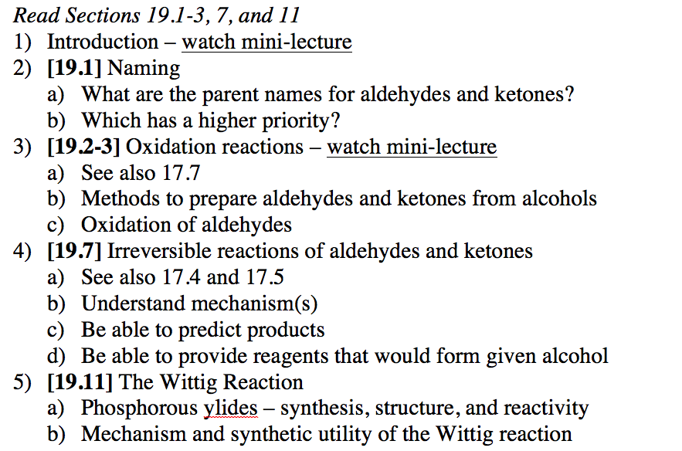
Pre-Class Reading - Textbook

Slide 5
Pre-Class Reading
What is Chemistry good for essays
  <1000 words
  Answer for extra credit
  C&EN articles (?)

Slide 6
Pre-Class Reading
Pre-class reading is important
  Provides framework for future knowledge
  Productive reading is an essential skill
Some students will resist / resent
  Mostly positive feedback
  95% compliance rate

Slide 7
Pre-Class Homework
How can they do homework before we’ve taught them anything?
  Expect some pushback
  Reading guides, opening questions, etc. are teaching tools
Suggestions
  Low stakes
  Tutorial
  Be explicit about how it informs class

Slide 8
Pre-Class Homework
JiTT Questions
  1-2 subject-specific questions, essay best
  1 “what did you struggle with” question
  Completed through course-management system
Online Homework
  OWL, WileyPLUS, Web Assign, etc.

Slide 9
JiTT Questions and Arnold Arons’ (1979) Taxonomy of Reasoning Attributes
Understanding new terms and definitions
  What is a hydrate?
Ability to explain a concept or term in own words
  Explain why aldehydes typically favor their hydrate form more than ketones.
Demonstration of thinking process
  Describe the retro- and forward synthesis of 2-pentanol from any carbonyl compound.
Ability to see connections between subject and own experience
  Ethanol is metabolized to acetic acid by what type of process? How could you perform this conversion in the laboratory?
Simkins and Maier, p 85

Slide 10
JiTT Questions and Arnold Arons’ (1979) Taxonomy of Reasoning Attributes
Drawing inferences from data
  Examine Table X.X and discuss the effect of electron withdrawing groups on hydrate formation.
Estimation
  Estimate the position of the equilibrium for the reaction of methyl magnesium bromide with acetone.
Translating words into symbols and vice versa
  Nomenclature
Relating concepts to “common sense”
Discuss ethical implications
  Explain why chromium (VI) reagents are rarely used to oxidize alcohols despite their low cost and high efficacy.
Simkins and Maier, p 85

Slide 11
Practice
Prepare a reading assignment for the hydration of alkenes.
  Series of JiTT questions
  Outline of learning objectives

Slide 12
Grading Pre-Class Homework
Keep it simple
  1 – minimal effort
  2 – incorrect answer or low effort
  3 – partially correct answer with some effort
  4 – correct or nearly so answer with high effort
Must give yourself time to incorporate answers into class
Simkins and Maier, p 17

Slide 13
Typical JiTT Responses
Why is use of the Wittig reagent to prepare alkenes better thanother methods to make alkenes you have learned previously?
The Wittig reagent is much better than the methods we learned previously because the position of the C=C bond is very predictable and is where the C=O bond was before. In the previous reactions, we would have multiple products and could not control completely control the position of the C=C bond.
I really do not know. I theorize the spontaneous decomposition of the ylide reagant, reducing the purification step to achieve an alkene.
The Wittig reagent yields a product where the C=C bond is always where the C=O bond was in the reactant. No alkene isomers (except E,Z isomers) are formed. Other methods that we have learned previously can yield a mixture of alkenes.
Muzyka

Slide 14
Typical JiTT Responses
What irreversible reactions of aldehydes and ketones would you most like reviewed in class tomorrow?
the wittig reaction
I am a little confused on Wittig Reaction. The mechanism for the most part made sense however formation of the alkene from the Ph3P intermediate how exactly does this happen?
Can we go over the wittig reaction? I understand what's happening but I don't see why.
The Wittig reaction made a bit of sense to me but I didn't understand how the mechanism to bond oxygen to phosphorous and to bond the carbons at the same time could occur. that mechanism just seemed a bit to unstable to occur, especially since the reaction is irreversible and needs stable intermediates.

Slide 15
JiTT Informs Class Activities
Show anonymous JiTT responses at beginning of or during lecture to introduce / frame concepts
Design cooperative (or individual) learning exercises
  Think-Pair-Share
  Jigsaw
  Gallery Walk
  Huddle boards / iPads
Simkins and Maier, p 69-74

Slide 16
Why go through all this effort?
Students learn more
  Exam scores increase (5-8%)
  DFW rates decrease (from 26 to 6%)

Slide 17
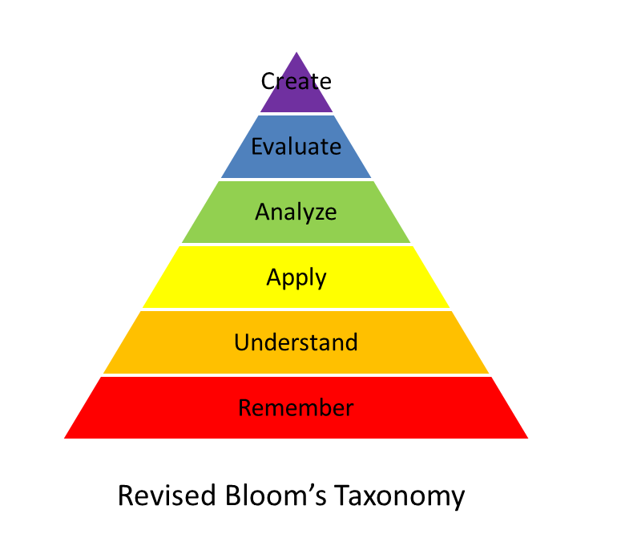
Why go through all this effort?
Consistent with findings in cognitive science
  Metacognition
  Bloom’s taxonomy
Consistent with goals of higher education
  Reading ability
  Learning communities and teamwork
  Written and oral communication
www.wordpress.com

Slide 18
Major Challenges of Flipping with JiTT
Time (instructor and students)
  Reduce number of different due dates / times
  Be mindful of time required
Organization
  Reference sections of textbook repeatedly
  Detailed study guides for exams
Student resistance – it isn’t lecturing

Slide 19
What course management system is at your institution?
Blackboard
Moodle
Desire2Learn
Canvas
Other

