Slide 1

Flipping the organic chemistry classroom using the Explain Everything app
Justin B. Houseknecht
Wittenberg University
Springfield, Ohio

Slide 2
Background
Previous 7 years
  15-20 students per section x 2 sections
  80% Biology majors, mostly pre-med
  Tuesday / Thursday 90 min + lab
  Highly interactive lecture
  26% DFW rate
2013 changes
  Just-in Time Teaching (JiTT) and Explain Everything used to flip class
  51 students in two class sections and 3 labs
  6% DFW rate

Slide 3
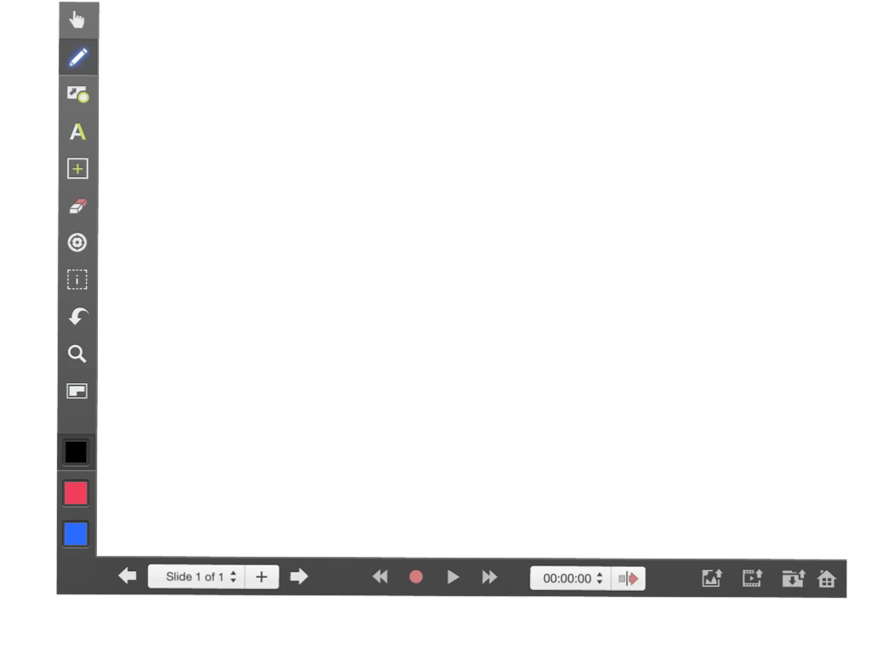
Explain Everything

Slide 4
Just-in Time Teaching
Reading guides
5-15 min lectures
Online homework
Muddiest point
Mini-lectures
Group work
Reading
Homework Problems
Class
informs
enables
informs

Slide 5
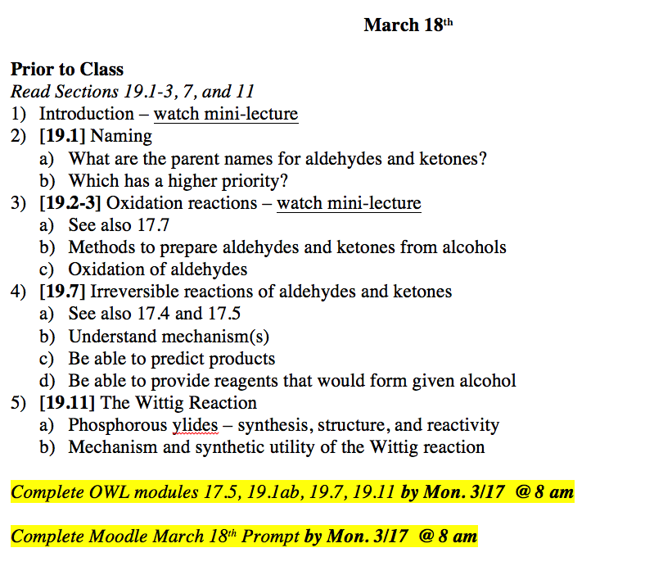
Tuesday March 18th Pre-Class Reading

Slide 6
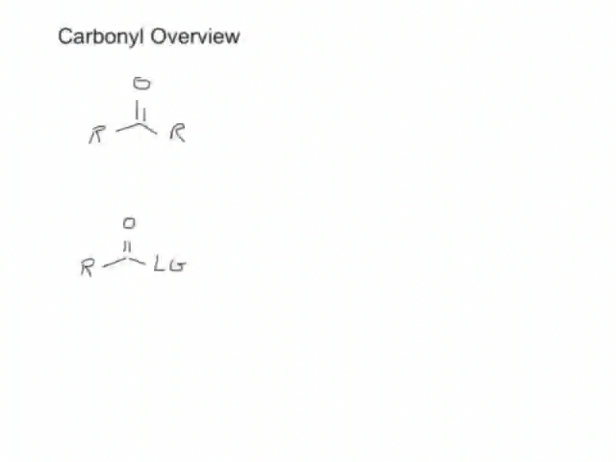
Introduction to Carbonyls Mini-Lecture

Slide 7
Just-in Time Teaching
Reading guides
5-15 min lectures
Online homework
Muddiest point
Mini-lectures
Group work
Reading
Homework Problems
Class
informs
enables
informs

Slide 8
Reduction of Carbonyls
Mini-lecture - [19.7] Can you also explain this a little more thoroughly, and how we get ":H-"? I understand that it's using hydrogen as the nucleophile rather than as an electrophile...but what exactly is ":H-"?
Group work – Synthesize the following from a carbonyl compound:

Slide 9
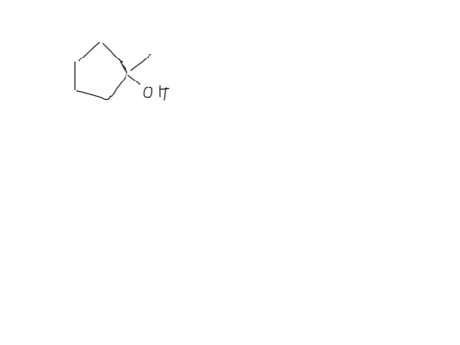
Synthesis Solution

Slide 10
Explain Everything Advantages
Problem solving / viewing solutions
Teamwork
  Value classmates
Written and oral communication skills
  Drawing practice
  Writing to learn

Slide 11
Observations
Students did better in 2013 (flipped classroom), particularly weaker students

Slide 12
Observations
Video mini-lectures universally loved
Organization of time and material was a major challenge
Vast majority saw benefit of flipped pedagogy, but few who didn’t were adamant
Solutions database was under-utilized

Slide 13
Acknowledgements
Wittenberg students and colleagues
cCWCS and OrganiCERs
Wittenberg Information Technology

