Slide 1

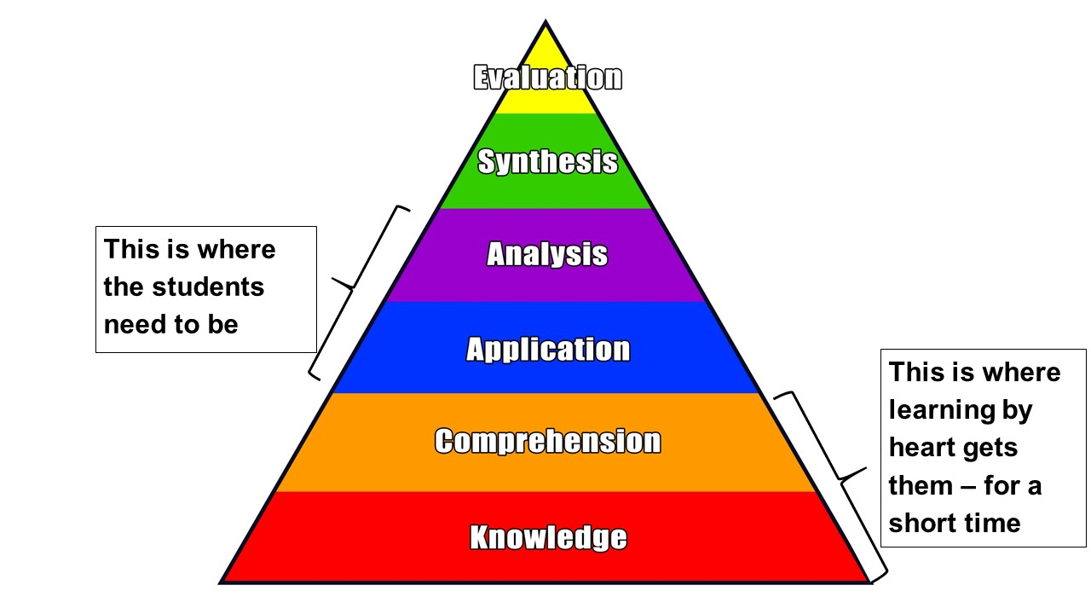
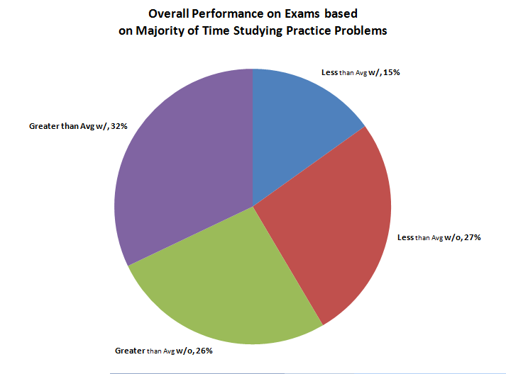
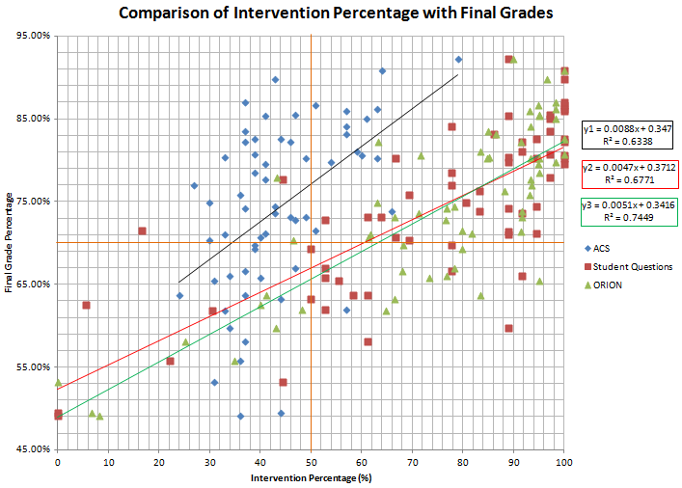
Interventions in a Flipped Organic Chemistry Class that Lead to Higher Learning
James Lamblin, Anja Mueller*
Department of Chemistry and Biochemistry, Central Michigan University, Mount Pleasant, MI 48859, *muell1a@cmich.edu
INTRODUCTION
Problem:
2-semester Organic Chemistry sequence is foundational course; students are supposed to be able to apply its content in future courses.
When taught in a standard lecture format, students mostly learned by heart; were not able to remember most content next semester
Students were not able to apply content to solve different problems.
RESULTS AND DISCUSSION, CONT.
Team Diagnostic Survey
Teamwork improves and students mostly enjoy working with their team, but difficulties with teamwork have become more apparent at the end
A lot of comments about how much they have learned from their team members
Teaching Methods Questionnaire
We asked the students which interventions made them interact with the content and which they thought helped them learn
Students Became More Aware
Of different levels of learning and different learning techniques; of their own group skills; of their own awareness
Preparation
Students needed reading guides for effective reading; students asked for more videos
In-Class Quizzes with Student Responsive System
To review students’ preparation
Vocabulary
Crossword
Puzzle
To distinguish between vocabulary and concepts
Sample
Questions on all Blooms Level for Each Concept
For practice and metacognition
Student Exam Questions
For practice
Games for Organic
Chemistry
For practice
Supplemental Instruction by TA
For practice
Skills Videos and Mini-Lecture Videos
For class preparation
Exam Wrappers
For metacognition, teaching better study habits
Textbook
For class preparation
Group Work with POGIL and
Daily-Life
Worksheets
In class
Online Homework
Including Adaptive Online Homework Homework and additional
practice
Active Learning
No lecture in class;
order based on concept map
Additional Problem: Students’ Metacognition
Students not aware on which level they are learning
Students are not aware of which level they are supposed to learn
Students have not learned many learning techniques; mostly learning by heart
Pedagogy and Interventions used to get the students to learn on a higher level:
See center
RESEARCH QUESTIONS, METHODS
How did student metacognition increase due to using different pedagogy and interventions?
How did the course delivery improve learning (measured by standard exam or Blooms taxonomy)?
Which of the interventions increased interaction with content?
Which of the interventions helped students learn?
How did the students learn to work effectively as a team?
2-tailed t-test was used to determine significance of differences.
Students’ Study Habits and their Correlation to Class Grade
Over time, the use of the textbook and notecards decreased; students maintaining that had lower exam grades.
Students spent more time with Organic Chemistry games; students using that for exam preparation ended up with higher exam grades.
Students practiced more with student exam questions and the adaptive homework system; especially the student exam questions had a positive effect on the exam grades.
Some of the results contradict the students opinion about what helped them learn.
Statistically significant: Negative correlation between American Chemical Society Standard Exam and class grade; standard exam is a multiple-choice test, class exams are large majority short answer and problem solving.
Questionnaire/Administered | Examples of Questions Asked
Science Motivation Questionnaire (SMQ II) Beginning and end of semester Evaluates intrinsic, career, and grade motivation, self-determination, self-efficacy | The chemistry I learn is relevant to my life. Understanding chemistry will benefit me in my career. I will use chemistry problem-solving skills in my career
Metacognitive Inventory Beginning and end of semester Evaluates students’ metacognitive skills | When I do .. problems, I try to learn more about the concepts so that I can apply this knowledge to test problems. I use graphic organizers (diagrams, flow-charts, etc.) to better understand problems ..If a problem takes several attempts and I cannot get it right, I get someone to do it for me and I try to memorize the procedure.
Team Diagnostic Survey (TDS) Beginning and end of semester Evaluates support of teams, structure of teams, leadership of teams, team member effectiveness | This team has an ideal mix of members - a diverse set of people who bring different perspectives and experiences to the work. Instructors are readily available to teams in this class to coach. Team members do not carry their fair share of the workload.
Teaching Methods Questionnaire End of semester Evaluates correlation between time spent on intervention and effectiveness for learning | The correlation questions were asked using a 5 point Likert scale from 0 to 4. Opinion question: What did you think of the “inverted” method of teaching this course?
Out-of-Class Practice
A lot of options for students; Student exam questions most effective overall; Games most effective per time spent
In-Class
Worksheets were difficult, needed all group members; instructors could not talk to all groups each class; students became more independent in learning
CONCLUSIONS
Student habits shift to practicing from learning by heart
Students become aware of different levels of learning
Group skills improve
Students become more realistic in evaluating their metacognition and group skills
Student motivation continues to be grade motivation
RESULTS AND DISCUSSION
Data for Organic Chemistry I, ca. 70 students (2nd semester not analyzed yet).
Majority of declared students are Biology/Biomedical Sciences majors.
Motivation (SMQII)
Main motivation at beginning and end is grade motivation
Self-efficacy is low at beginning and significant lower at the end
Metacognitive Inventory
Students rate their metacognition very high at the beginning, significantly lower at the end (become more realistic)
STUDENT COMMENTS
Lecture, more videos
Do some teaching.
I do all my learning on my own. Honestly, I barely learn anything in class. The class period really needs more explanation and instruction of major concepts.
They are doing a great job. That exam was just confusing because of the reagents. I do not recall seeing any of them in the notes or worksheets.
Keep doing what they are doing
ACKNOWLEDGMENTS
FaCIT/CETL: Dina Battaglia, Justin Bruner, Phillip Coffman, Eron Drake, John Jackson, Brian Roberts, Andrew Starner, Jim Therrell
Wiley: Cara Warne, Sean Hickey

