Slide 1
Flipping with Video
A short description of how I used recorded lectures to help students prepare for class and what I do during the face-to-face class meetings.
Cathy Welder, Dartmouth College
Active Learning in Organic Chemistry Workshop

Slide 2
Outline
By the end of this presentation, you will be able to describe
how and why I create videos for my lecture course.
how I run my flipped classroom using before-class video lectures and an in-class modified peer led team learning approach.

Slide 3
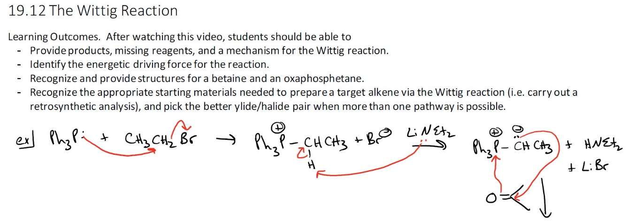
Methods of Creating Videos: OneNote on iPad Pro with Camtasia
Chalk talks were reproduced electronically by mirroring iPad Pro to desktop (using Airserver Connect) and using Camtasia to screen capture the writing in OneNote.
Notes:
As PC user … Mirrored with Airserver Connect app. Used headset for better audio. Numbered videos sequentially in OneNote but removed numbers in the actual recordings. (This is screen shot of OneNote.) Tried to avoid anything that would date the videos. Simply recorded what I would have written on board during a traditional lecture. Recordings were often about half the length of a live presentation. (no student interruptions, no waiting for students to catch up with writing, no pauses for questions) Doceri or Notability could be used as white boards as well.

Slide 4
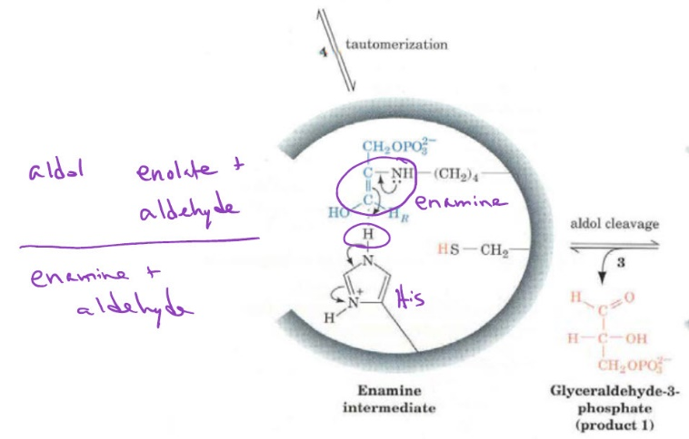
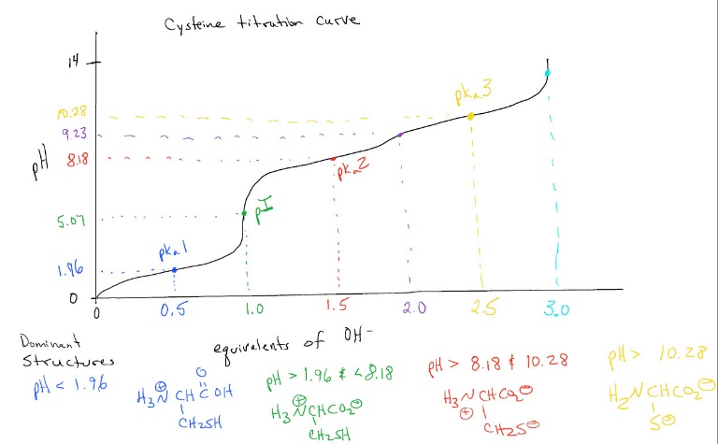
Methods of Creating Videos: OneNote with Camtasia
Notes:
Able to insert PDF files or images and write on them. Able to use many colors and import/write on PDF files or images.

Slide 5
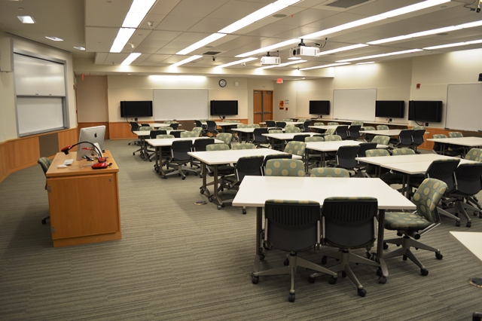
In the Classroom
Students were divided into permanent teams of 5-6 for in-class work.
Peer leaders assisted 2-3 teams every class.
Notes:
Discuss team formation (grade in Organic I, gender, race/ethnicity, desire to lead vs. follow) and size (not 3 b/c someone is often excluded, not 4 b/c they tend to break into two pairs) Discuss the classroom. Team table rotated ~ once a week so no one was always in the front/back/corner. Modified PLTL b/c 1) we used the method during the normal class periods 2) peer leaders were provided a key

Slide 6
In the Classroom
Teams were given one problem at a time. Each problem was debriefed before the class moved on.
Completed 6-8 problems/hour.
Problems and separate solutions were posted in LMS immediately after class.
Challenge: bring enough problems for one class period without it seeming as if we did not work as many problems as I had hoped we would.
Notes:
In the classroom I plugged my iPad Pro directly into the projection system and wrote out solutions to the problems during the debriefing. Carl Wieman says it’s important to discuss why wrong answers are wrong.

Slide 7
Teaching Science Fellow and Learning Fellows
Dartmouth hires recent graduates (Teaching Science Fellows) to work full time for a year with one department, typically with one of the introductory classes.
Students who recently completed the course are hired to serve as Learning Fellows for the quarter.
Notes:
Near peers. $1000-1200 per LF per term. Dartmouth hires 150 LFs each quarter campus-wide. I use one LF per 15-18 enrolled students. Alternatively, some schools have learning assistants enroll in a training course for credit w/o pay.
TSF $41K through Dean of Faculty administered through DCAL. One bio, one chem. Weekly meetings with Lee Witters and separately with the Learning Design team. Meet with DCAL, deans, OPAL, FYSEP, etc. Must read Make It Stick.

Slide 8
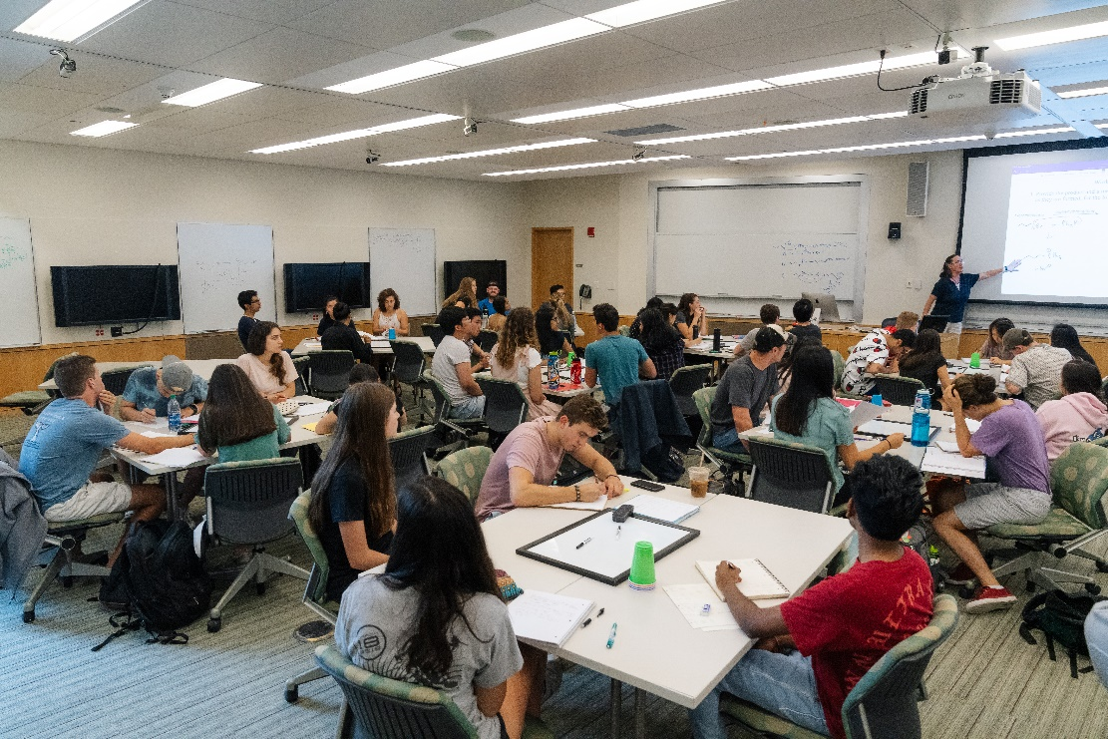
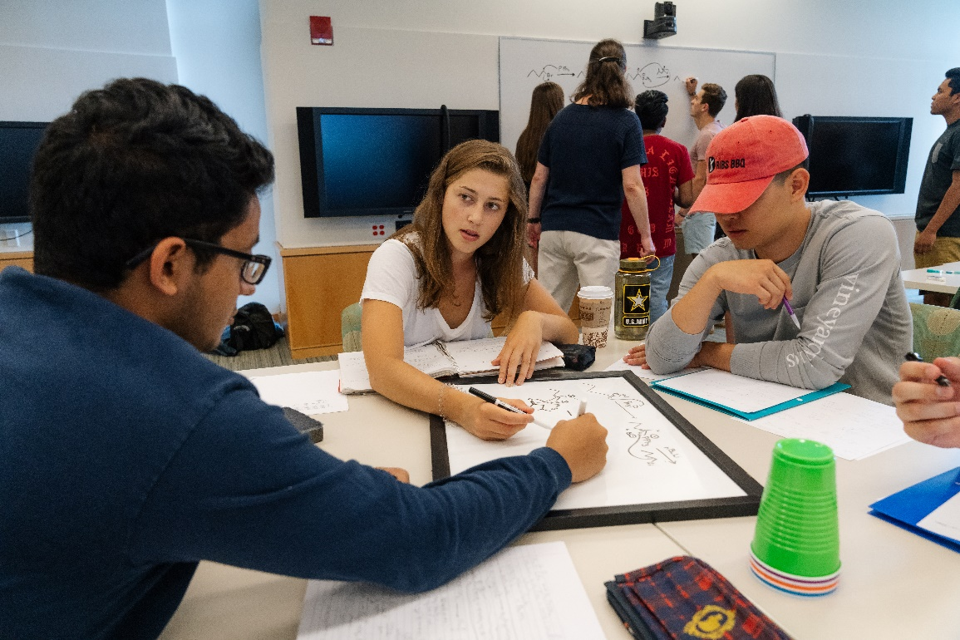
Class in Action
Notes:
Groups could work at their tables or on large whiteboards. No one has their back to the instructor.
Colored cups: green = working on a problem, orange = could use some help when someone has time, red = HELP we’re stuck, blue = we have finished this problem and are ready to discuss then move on

Slide 9
Summary
Videos made with OneNote on iPad (for white board) mirrored to PC (via AirServer) for screen capture with Camtasia.
Problem-solving every day in class with near-peer help available.
More information, including impacts on DFW rates and student grades, can be found here:
Welder, C. O. An All-In Approach to Flipping the Organic Chemistry Classroom Using Elements of Peer-Led Team Learning with Undergraduate Learning Assistants in Active Learning in Organic Chemistry: Implementation and Analysis, ACS Symposium Series #1336, pp119-148, 2019. DOI: 10.1021/bk-2019-1336.ch008.

