Slide 1
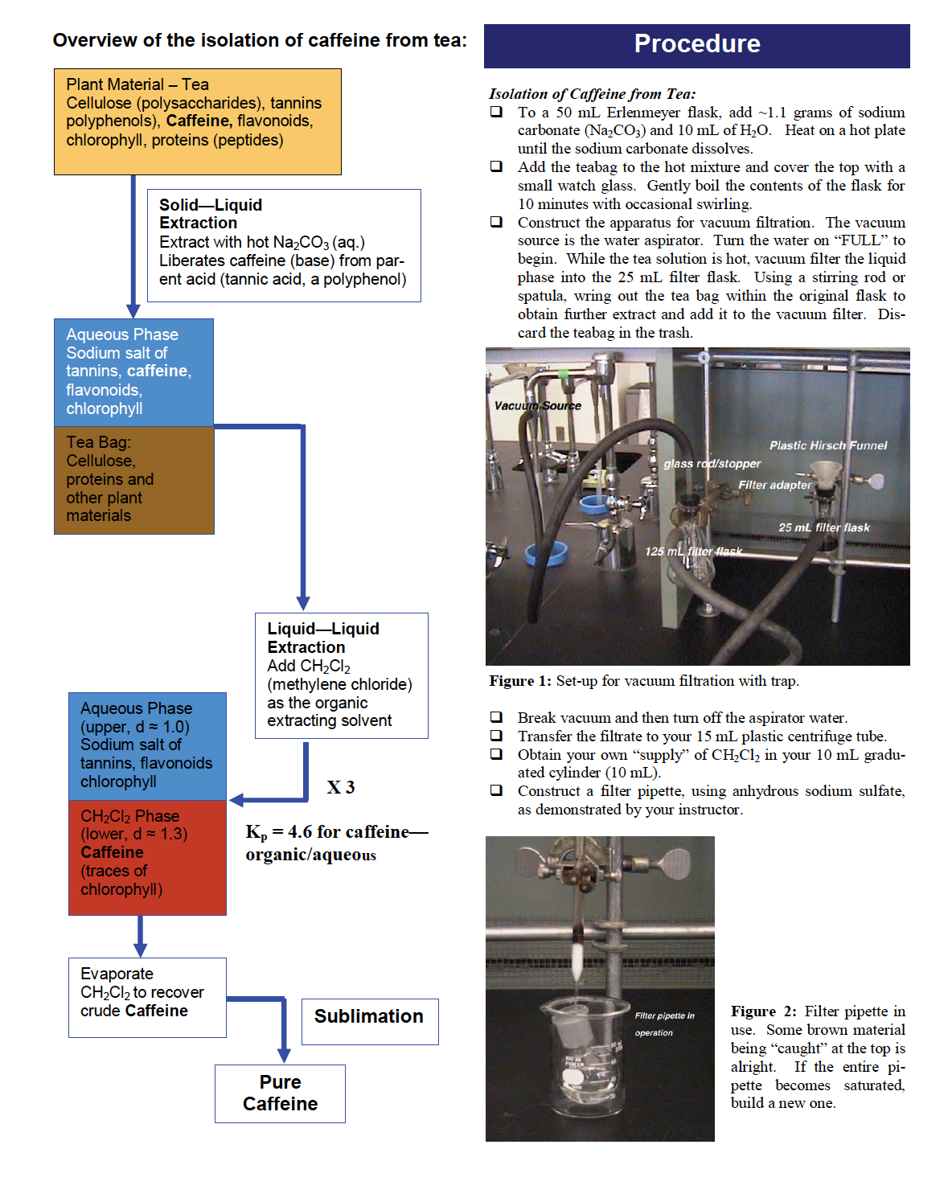
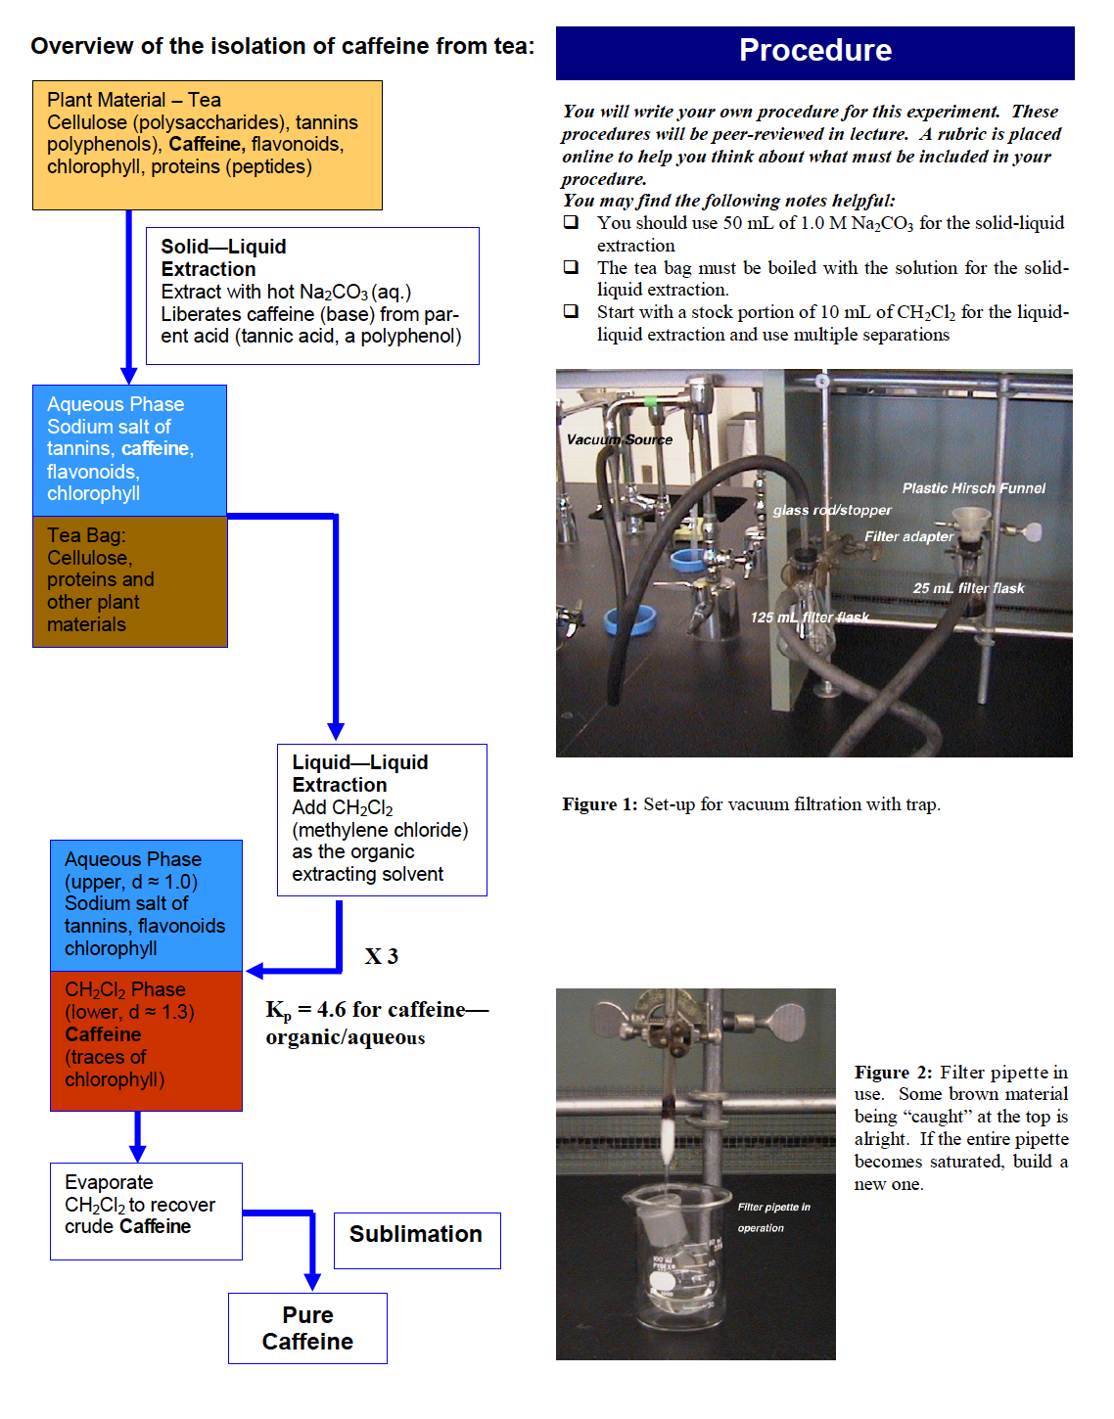
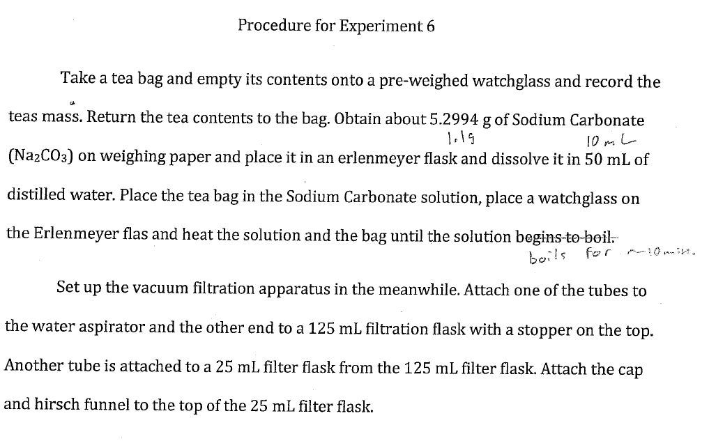
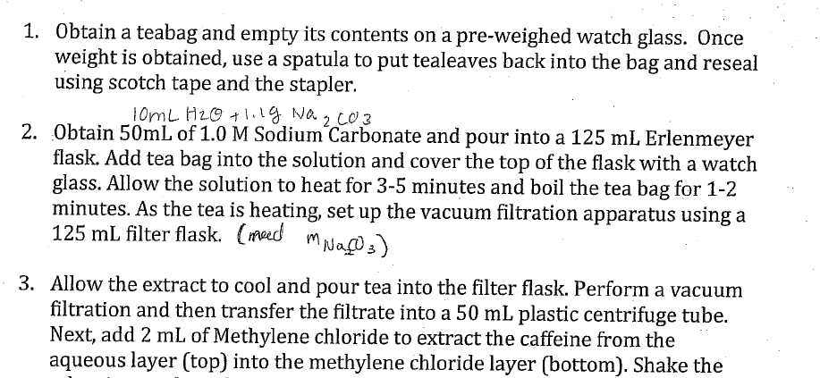
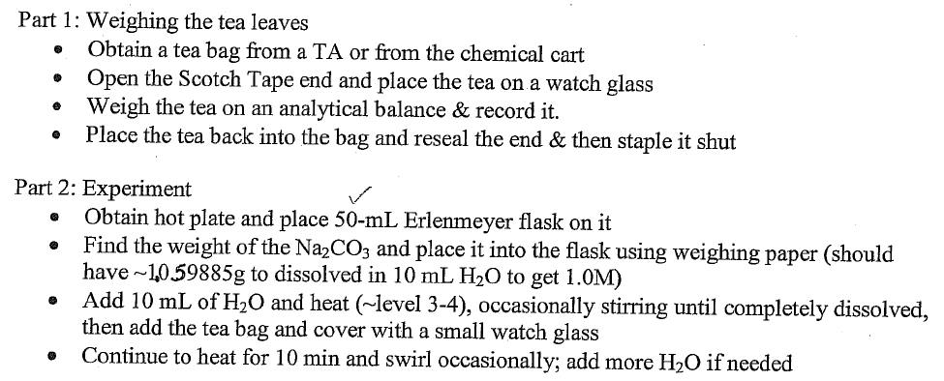

Student derived experimental procedures in a flipped lab experience
Drew Meyer and Rekha Srinivasan
Department of Chemistry, Case Western Reserve University College of Arts and Sciences
Abstract
Important learning objectives for a chemistry department include development of skills based around experimental design and utilization of safe laboratory procedures. A lab course should be an excellent opportunity for students to utilize inquiry based techniques to learn these skills. However, in many lab courses, “cookbook” procedures can stifle these learning opportunities. We have “flipped” the lecture component of our organic lab focusing on student designed experimental procedures. Prior to class time, students watch videos that demonstrate the general experimental techniques and use them to develop an experimental procedure to answer a provided experimental question. In class, students work together to evaluate their procedural design using a rubric to help them consider the relevant safety precautions, necessary data to be collected, relevant physical data to set experimental conditions, reagents, necessary glassware, techniques and calculations needed to execute the experiment. After completing their experiments, the student groups re-convene in a post-lab session to compare and contrast their results, and re-examine their initial design to understand what aspects need to be fine-tuned.
Sample Lab Report With and Without Provided Procedure
With Provided Procedure Without Provided Procedure
Attitude Survey Results
Administered Attitude toward the Subject of Chemistry Inventory version 2
Xu, Xiaoying and Lewis, Jennifer E, J. Chem. Educ. 2011, 88, 561-568.
Three times throughout the summer semester (prior to semester, after experiments with provided procedures, and at the end of the semester)
We see improvement toward “good” statistics in categories hard/easy, complicated/simple, and confusing/clear implying students find chemistry more assessable after lab course
After experiments with student derived protocols, we see move toward uncomfortable, frustrating and unpleasant, implying requiring students to write their own protocols moves them out of their comfort zone
Unclear trend in challenging/not challenging and chaotic/organized
Table 2. Attitude Survey Results
Class Logistics
Tested using summer course of 1st semester organic lab course
Class size: 10-15 students for summer course
Format: 1 lecture hour per 3 hour lab
For summer session 3 hours of lecture for 9 hours of lab
TA support: 2 per lab section
Lab facilities: Individual hood for each student
  Experiments done individually
 | 1st day class |  | After Exp. 1-5 |  | Last day of classes
 | Mean | SD | Mean | SD | Mean | SD
hard | 2.58 | 1.29 | 2.82 | 1.08 | 3.00 | 0.89 | easy
complicated | 3.58 | 0.92 | 3.73 | 1.10 | 4.73 | 1.10 | simple
confusing | 4.33 | 0.93 | 4.45 | 0.93 | 4.82 | 0.87 | clear
uncomfortable | 3.33 | 1.08 | 3.45 | 0.69 | 3.27 | 1.10 | comfortable
frustrating | 3.17 | 1.47 | 3.64 | 1.69 | 3.09 | 1.30 | satisfying
challenging | 3.50 | 1.51 | 2.64 | 1.03 | 3.64 | 0.92 | not challenging
unpleasant | 3.25 | 1.17 | 3.64 | 1.29 | 3.36 | 0.92 | pleasant
chaotic | 4.67 | 1.51 | 5.00 | 1.00 | 4.70 | 1.16 | organized
Sample Peer Review Rubric
For lab protocol for Experiment 6 – Extraction of Caffeine from Tea
Isolation of Caffeine from Tea:
Amounts of materials used will produce 1.00 molar solution of sodium carbonate.
Types and sizes of glassware to be used are appropriate for amounts of material.
Volumes and times for liquid/liquid separation seem reasonable
Clear which component of liquid/liquid separation will be retained?
Correct apparatus for melting point determination mentioned
Experimental Plan
Each student response in range of 1 to 7 with a midpoint of 4. Table arranged so that a larger mean shows a more “positive” response. N=11 for each survey.
Step 1: Standard format experiments
Experiments 1-5 where students are provided lecture, lecture slides, procedure and videos
Observations From Final Lab Reports
Lab videos are an excellent teaching aid for helping students engage in laboratory courses
Students are more connected with the experiment when they are writing their own procedure by observing the videos
Student procedures become more concise and clear as they progress in the course
Providing the videos and asking the students to derive their own experimental procedures is an important step towards teaching them scientific writing and thinking about experiment development
Peer-peer discussion and grading engages students in the lecture hour as opposed to traditional lecturing
Step 2: Derive and review protocols
Experiments 6-10 where students utilize videos outside of class to write their own procedures
Sample of Peer Reviewed Procedures
Step 3: Peer Review sessions
Students participate in peer review sessions with provided rubrics during one hour lecture period to review and compare each other’s procedures
Student 1 Student 2 Student 3
Table 1. Student Responses to Questionnaire
Question | Mean | SD
I enjoyed experiments with provided protocol more than those where I wrote my own protocol | 4.5 | 1.7
I had a better understanding of what I was doing in lab when I wrote my own protocol | 4.3 | 1.6
Writing the protocol for several experiments improved the laboratory experience | 3.3 | 1.3
Funding Provided by
Step 4: Assessment
Student attitude surveys conducted
Final lab report critically analyzed
Each student response in range of 1 to 5 with 1 corresponding to disagree and 5 corresponding to agree. N=11.

