Slide 1
Diversity, Equity, and Inclusion
Active Learning in Organic Chemistry 2022
Jennifer Muzyka

Slide 2
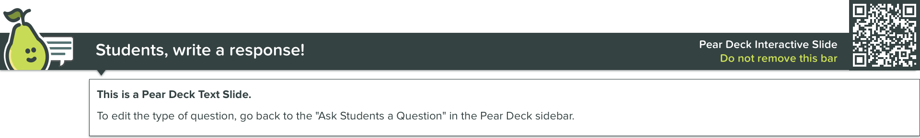
Today’s Icebreaker:
What music do you listen to while you’re grading papers or lab reports?
(I will make a spotify playlist to share with participants in this workshop.)
Notes:
Should we answer out loud, one at a time?
Should we answer in Peardeck?

Slide 3

What does diversity mean to you?

Slide 4
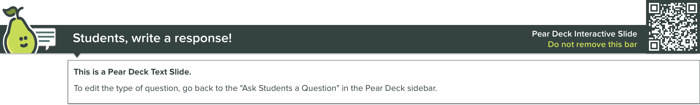
What’s an equity gap?

Slide 5

How does diversity relate to organic chemistry? Why do we have this session in ALOC?

Slide 6
How does diversity relate to organic chemistry? Why do we have this session in ALOC?
Theobald et al “Active learning narrows achievement gaps for underrepresented students in undergraduate science, technology, engineering, and math,” PNAS 2020, 117 (12) 6476-6483.

Slide 7
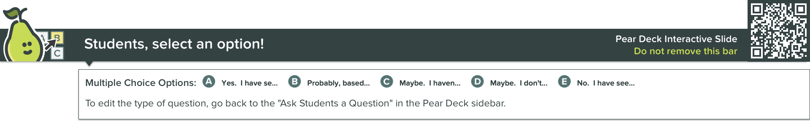
Are there equity gaps in STEM classes at your institution?
A. Yes. I have seen the data.
B. Probably based on what I have seen in my classes.
C. Maybe. I haven't seen the data.
D. Maybe. I don't know what data would be involved.
E. No. I have seen the data.

Slide 8
Are there equity gaps in STEM classes at your institution? How can we respond?
Haak et al “Increased Structure and Active Learning Reduce the Achievement Gap in Introductory Biology,” Science 2011, 332, 1213-1216.
Tanner, “Structure Matters: Twenty-One Teaching Strategies to Promote Student Engagement and Cultivate Classroom Equity,” CBE – Life Sciences Education 2013, 12, 322-331.

Slide 9
Haak et al
"We show that a highly structured course design, based on daily and weekly practice with problem-solving, data analysis, and other higher-order cognitive skills, improved the performance of all students in a college-level introductory biology class and reduced the achievement gap between disadvantaged and nondisadvantaged students—without increased expenditures."

Slide 10
Opportunities to think and talk about subject (Tanner 2013)
Wait time
Time to write
Think-Pair-Share
Don’t try to do too much

Slide 11
Encouraging, Demanding, and Actively Managing the Participation of all Students (Tanner 2013)
Hand Raising
Multiple hands, multiple voices
Random calling (popsicle sticks/index cards)
Whip (around)
Monitor student participation

Slide 12
Building an Inclusive and Fair Classroom Community for ALL students (Tanner 2013)
Learn Students’ Names
Integrate culturally diverse and relevant examples
Work in stations or small groups
Use varied active-learning strategies
Be explicit about promoting access and equity for all students

Slide 13
Monitoring (Your Own and Students’) Behavior to Cultivate Divergent Thinking (Tanner 2013)
Ask open-ended questions
Do not judge responses
Use praise with caution
Establish classroom community norms

Slide 14
Teaching ALL the students in your classroom (Tanner 2013)
Teach them from the moment they arrive
Collect assessment evidence from every student, every class

Slide 15
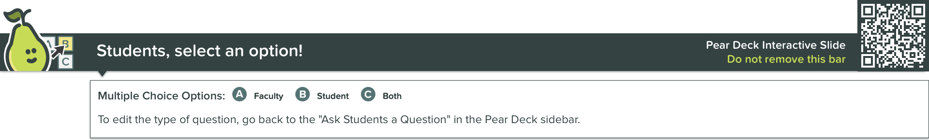
Whose mindset matters to student performance in classes?
Faculty
Student
Both

Slide 16
Whose mindset matters to student performance in classes?
Canning et al “STEM faculty who believe ability is fixed have larger racial achievement gaps and inspire less student motivation in their classes,” Sci. Adv. 2019, 5: eaau4734.

Slide 17
Growth mindset interventions
Fink et al, “Improving general chemistry performance through a growth mindset intervention: selective effects on underrepresented minorities,” Chem. Ed. Res. Pract. 2018, 19, 783-806.
Limeri et al, “Growing a growth mindset: Characterizing how and why undergraduate students’ mindsets change,” International Journal of STEM Education 2020, 7, 35.
Miller, “When do growth mindset interventions work?” Trends in Cognitive Sciences, 2019, 23, 910-912.
O’Leary et al, “Creating inclusive classrooms by engaging STEM faculty in culturally responsive teaching workshops,” International Journal of STEM Education 2020, 7, 32.

Slide 18

Why is inclusive teaching important?

Slide 19

How can you make your classroom more inclusive?

Slide 20
How can you make your classroom more inclusive?
Cooper et al “Fourteen Recommendations to Create a More Inclusive Environment for LGBTQ+ Individuals in Academic Biology,” CBE - Life Sciences Education 2020, 19:es6, 1-18.
Dewsbury and Brame, “Inclusive Teaching,” CBE - Life Sciences Education 2019, 18:fe2, 1-5.
Busch et al "Unveiling Concealable Stigmatized Identities in Class: The Impact of an Instructor Revealing Her LGBTQ+ Identity to Students in a Large-Enrollment Biology Course," CBE - Life Sciences Education 2022, 21:ar37, 1-21.

Slide 21
Inclusive Teaching (Dewsbury and Brame)
Develop self-awareness
Develop empathy
Classroom climate
Pedagogical choices

Slide 22
More inclusive environment for LGBTQ+ (Cooper et al)
Be thoughtful about the language used regarding LGBTQ+ community
Create opportunities for people to describe who they are, avoid assuming people’s identities
Meaningfully advocate for the LGBTQ+ community
Create an inclusive classroom
Conduct research in a way that is inclusive of the LGBTQ+ community.

Slide 23
Faculty LGBTQ+ Identity
Busch et al "Unveiling Concealable Stigmatized Identities in Class: The Impact of an Instructor Revealing Her LGBTQ+ Identity to Students in a Large-Enrollment Biology Course," CBE - Life Sciences Education 2022, 21:ar37, 1-21.

Slide 24

How do you motivate your students to learn chemistry?

Slide 25

What is culturally relevant pedagogy?

Slide 26
What is culturally relevant pedagogy?
“For chemistry, the manner in which the subject is traditionally taught promotes the dominant culture while excluding the experiences of underrepresented minorities. This can unintentionally alienate students that are not included in the majority…Utilizing teaching strategies that connect culture, real world problems, and student interests can serve to mitigate this teaching practice and promote diversity, equity, and inclusion.”
Younge et al “Moving Beyond the Experiment to See Chemists Like Me: Cultural Relevance in the Organic Chemistry Laboratory,” J. Chem. Educ. 2022, 99, 383-392.

Slide 27
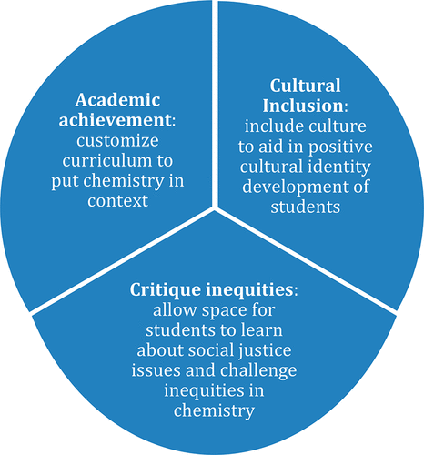
Culturally Relevant Pedagogy

Slide 28
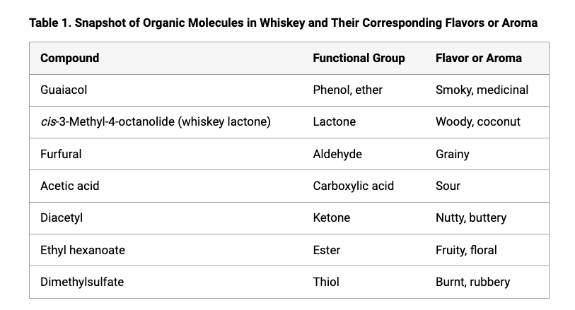

Slide 29

How does student belonging influence chemistry performance?

Slide 30
How does student belonging influence chemistry performance?
Edwards et al “Relationship between Course-Level Social Belonging (Sense of Belonging and Belonging Uncertainty) and Academic Performance in General Chemistry 1,” J. Chem. Educ. 2021, 99, 71-82.
Fink et al “Belonging in general chemistry predicts first-year undergraduates’ performance and attrition,” Chem. Educ. Res. Pract. 2020, 21, 1042-62.

Slide 31

Can belongingness be modified?

Slide 32
Can belongingness be modified?
Brady, et al “A brief social-belonging intervention in college improves adult outcomes for black Americans,” Sci. Adv. 2020, 6: eaay3689.

Slide 33

Questions?

Slide 34
Reflection prompt
What changes might you make in your class(es) to make them more inclusive and/or equitable?

Slide 35
Brady, et al “A brief social-belonging intervention in college improves adult outcomes for black Americans,” Sci. Adv. 2020, 6: eaay3689.
Busch et al "Unveiling Concealable Stigmatized Identities in Class: The Impact of an Instructor Revealing Her LGBTQ+ Identity to Students in a Large-Enrollment Biology Course," CBE - Life Sciences Education 2022, 21:ar37, 1-21.
Canning et al “STEM faculty who believe ability is fixed have larger racial achievement gaps and inspire less student motivation in their classes,” Sci. Adv. 2019, 5: eaau4734.
Cooper et al “Fourteen Recommendations to Create a More Inclusive Environment for LGBTQ+ Individuals in Academic Biology,” CBE - Life Sciences Education 2020, 19:es6, 1-18.
Dewsbury and Brame, “Inclusive Teaching,” CBE - Life Sciences Education 2019, 18:fe2, 1-5.
Edwards et al “Relationship between Course-Level Social Belonging (Sense of Belonging and Belonging Uncertainty) and Academic Performance in General Chemistry 1,” J. Chem. Educ. 2021, 99, 71-82.
Fink et al “Belonging in general chemistry predicts first-year undergraduates’ performance and attrition,” Chem. Educ. Res. Pract. 2020, 21, 1042-62.
Haak et al “Increased Structure and Active Learning Reduce the Achievement Gap in Introductory Biology,” Science 2011, 332, 1213-1216.
Johnson, “Embracing Culturally Relevant Pedagogy to Engage Students in Chemistry: Celebrating Black Women in the Whiskey and Spirits Industry,” J. Chem. Educ. 2022, 99, 428-434.
Tanner, “Structure Matters: Twenty-One Teaching Strategies to Promote Student Engagement and Cultivate Classroom Equity,” CBE – Life Sciences Education 2013, 12, 322-331.
Theobald et al “Active learning narrows achievement gaps for underrepresented students in undergraduate science, technology, engineering, and math,” PNAS 2020, 117 (12) 6476-6483.
Younge et al “Moving Beyond the Experiment to See Chemists Like Me: Cultural Relevance in the Organic Chemistry Laboratory,” J. Chem. Educ. 2022, 99, 383-392.

Slide 36
Growth mindset interventions
Fink et al, “Improving general chemistry performance through a growth mindset intervention: selective effects on underrepresented minorities,” Chem. Ed. Res. Pract. 2018, 19, 783-806.
Limeri et al, “Growing a growth mindset: Characterizing how and why undergraduate students’ mindsets change,” International Journal of STEM Education 2020, 7, 35.
Miller, “When do growth mindset interventions work?” Trends in Cognitive Sciences, 2019, 23, 910-912.
O’Leary et al, “Creating inclusive classrooms by engaging STEM faculty in culturally responsive teaching workshops,” International Journal of STEM Education 2020, 7, 32.

