Slide 1
Collaborative Learning Techniques (CoLTs) and Learning Assessment Techniques (LATs) Active Learning in Organic Chemistry June 15, 2022
Please sit with your Expert Team
Justin Houseknecht, PhD

Slide 2
Session Plan
Formative assessment overview
Expert Teams – clarify CoLT or LAT
Topic Teams – learn about other methods
Expert Teams – finalize implementation plans
 |  | Topic Teams
 |  | 1- Aldehydes and Ketones | 2-Alkenes | 3-Aromatic Substitutions | 4-Carb Acid Derivatives | 5-Spectroscopy
Expert Teams | CoLT 16 Struct Prblm Solv | Animesh A | Cathy | Jennifer C | Kristen B | Sean C
 | CoLT 25 Round Table | Anthony A | Suresh E | Sachin N | Matt L | Christine H
 | LAT 17 TAPPs | Brandon Q | Ami J | Raul RB | Margaret LE | Stephen L
 | LAT 21 Knowledge Grid | Ian R | Carl J | Brian W | Austin S | Matt C
 | LAT 23 Concept Maps | Danielle J | Davis O | Alexey | Wildeliz T | Alyssa P

Slide 3

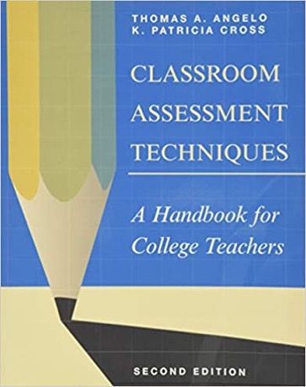
Formative Assessment
Massive impact on student learning
Other methods used:
CoLT 2: Round Robin
CAT 7: Muddiest Point
CoLT 11: Jigsaw
CoLT 1: Think-Pair-Share
Notes:
CoLT 2 - round robin (team rules)
CAT 7 - muddiest point - Pre-Session 4 (JiTT)
CoLT 11 - Jigsaw - here
CoLT 1 - think-pair-share - Session 5 (SoTL)

Slide 4
Expert Teams (20 min)
Use CoLTs and LATs Implementation Plans
Slide #2 lists Expert Teams membership
Complete your own slide as you are able
In Expert Teams:
Briefly introduce yourselves to one another
Discuss method
Revise method descriptions and implementation plans as needed

Slide 5
Topic Teams (30 min)
Use CoLTs and LATs Implementation Plans
Slide #2 lists Topic Teams membership
It may be helpful to use your slide as a visual aid
In Topic Teams:
Describe your method and implementation plan in < 5 min
Learn about the other methods

Slide 6
Expert Teams (20 min)
Use CoLTs and LATs Implementation Plans
Slide #2 lists Expert Teams membership
In Expert Teams:
Discuss observations from meetings with Topic Teams
Revise method descriptions and implementation plans as needed

