Slide 1
JiTT at witt: a hybrid approach
Justin Houseknecht (Wittenberg University, Ohio)

Slide 2
Prior to Flipping with JiTT
Interactive lecture
High DFW rate (for Witt) of 26%
Attempts to help weaker students
  Participation grade
  Review sessions
  Online homework
  Extra credit worksheets

Slide 3
Overview of the hybrid approach
Reading
Homework Problems
Class
Reading guides
5-15 min lectures
Online homework
Muddiest point
Mini-lectures
Group work
enables
informs

Slide 4
Class Information
Tuesday / Thursday 90 min + lab
20-35 students per section, 36-51 per semester
  80% Biology majors, mostly pre-med
Group work on iPads
  Allowed students to choose groups
  Same groups all semester
    Suggested a few changes
  Participation grade – 15%
  Extra credit tournament

Slide 5
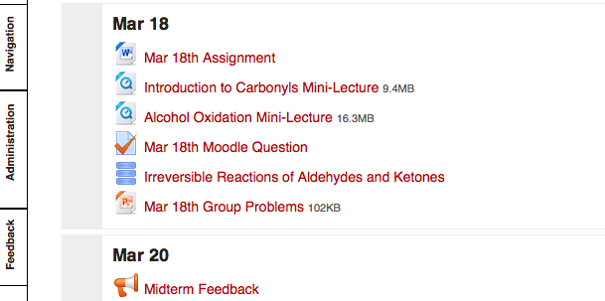
Moodle for March 18th
Posted > 48 hrs before class

Slide 6
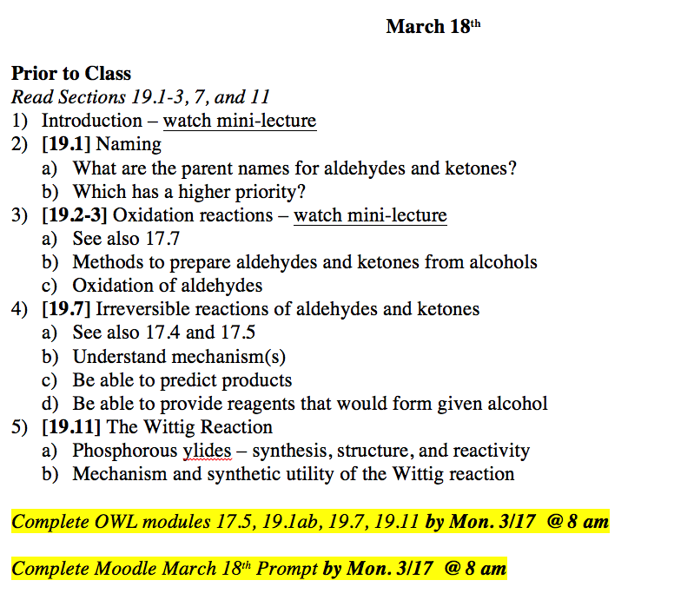
Tuesday March 18th Pre-Class Reading

Slide 7
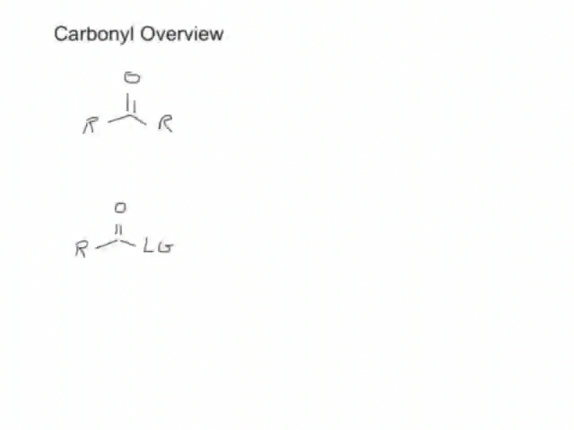
Introduction to Carbonyls Mini-Lecture

Slide 8
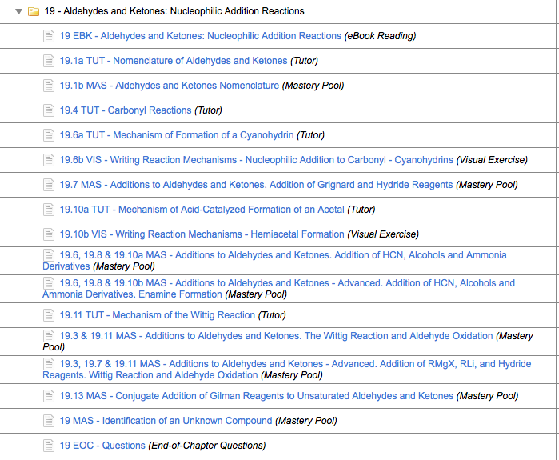
OWL Modules

Slide 9
Moodle for March 18th

Slide 10
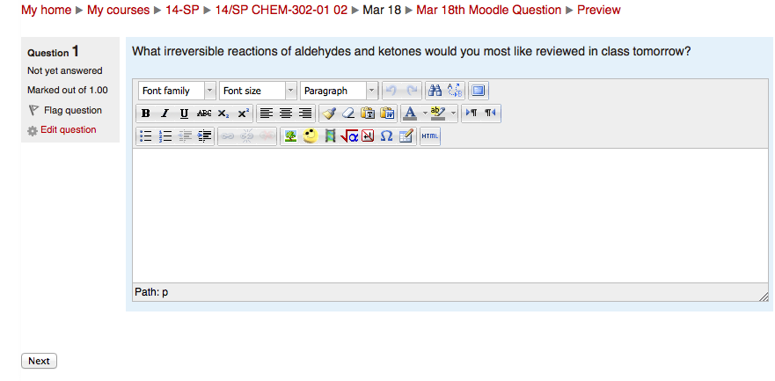
Mar 18th Moodle Question
Due 12-24 hours before class

Slide 11
Moodle for March 18th

Slide 12
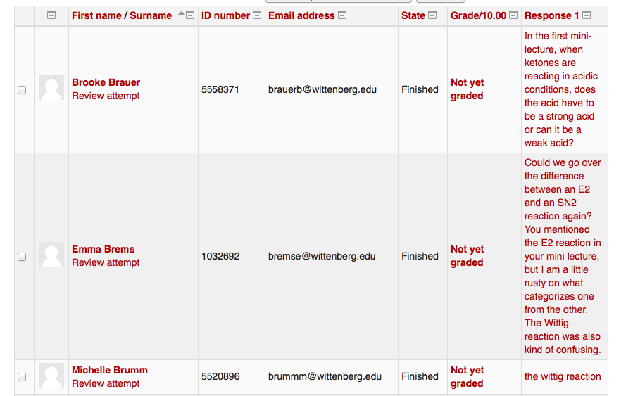
March 18th Class - Preparation

Slide 13
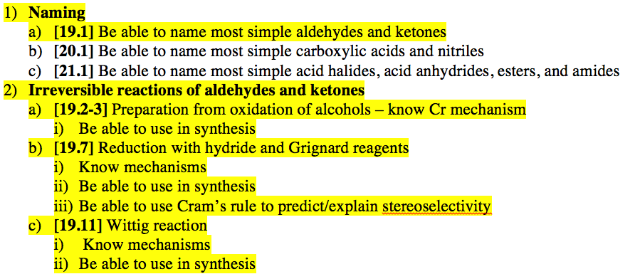
First Slide - Outline

Slide 14
Reduction of Carbonyls
Mini-lecture - [19.7] Can you also explain this a little more thoroughly, and how we get ":H-"? I understand that it's using hydrogen as the nucleophile rather than as an electrophile...but what exactly is ":H-"?
Group work – Synthesize the following from a carbonyl compound:

Slide 15
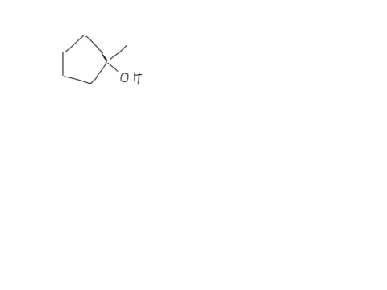
Synthesis Solution

Slide 16
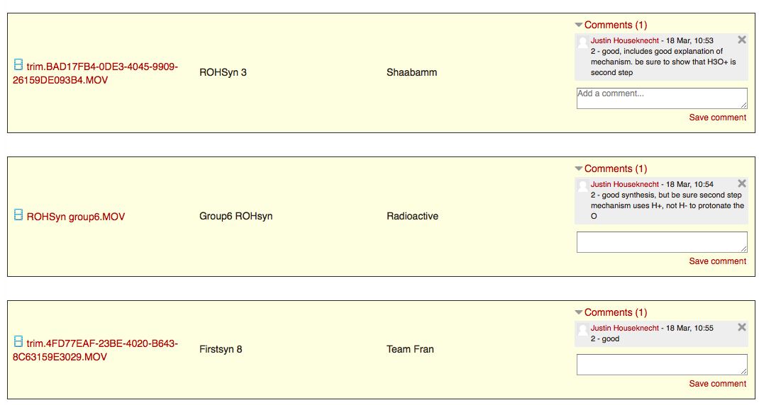
Videos uploaded to Moodle

Slide 17
Remainder of Class
1-2 more group problem-solving sessions
3-6 more mini-lectures from JiTT responses

Slide 18
Post Class Homework

Slide 19
Observations
Students did better, particularly weaker students
Video mini-lectures universally loved
Organization of time and material was a major challenge
Vast majority saw benefit of flipped pedagogy, but few who didn’t were adamant
Solutions database was under-utilized

Slide 20
Just-in-Time Teaching with Peer Instruction
Jennifer Muzyka
cCWCS Workshop
Active Learning in Organic Chemistry

Slide 21
Do you think students struggle when reading technical materials (like organic textbooks)?
Yes
No
Maybe
Some students

Slide 22
JiTT at Centre
Pre-class reading assignment
Questions about reading
Student responses reviewed
Class – answer student questions
Address misconceptions

Slide 23
Logistics
Moodle
Quiz deadlines
Essay questions
Two content questions
One open question, identifying confusion
Generating student buy-in

Slide 24
Thinking of what you want to get out of your college education and this course, which of the following is most important to you?
Acquiring information (facts, principles, concepts)
Learning how to use information and knowledge in new situations
Developing lifelong learning skills

Slide 25
Of these three goals, which do you think you can make headway on outside of class by your own reading and studying?
Acquiring information (facts, principles, concepts)
Learning how to use information and knowledge in new situations
Developing lifelong learning skills

Slide 26
Reading questions & students
Questions point students to important topics
Students process ideas as they write
Students develop reading skills
Students develop writing skills

Slide 27
Reading questions & faculty
Write questions
Read/grade student responses
Develop class materials based on student responses
Feedback from otherwise silent students

Slide 29
Changes in class
Less time on definitions
More time on complex concepts
Slide with reading question
Slide(s) with student responses
Address questions
Clicker questions

Slide 30
What structural features cause some organic compounds to be acidic?
The anions of the organic compounds are stabilized by having negative charge on a highly electronegative atom or by resonance.
In general, functional groups can cause some organic compounds to be acidic. The main functional group that causes acidity is carboxylic acid.
The structural feature is a functional group with a carbon-oxygen double bond. This is otherwise known as a carbonyl group.

Slide 31
What factors influence whether substitution or elimination will occur between an alkyl halide and a nucleophile/base? Summarize these factors in 2-3 sentences.
I don't have a great grasp on this yet but I think that elimination will likely happen in the presence of a strong base and the SN2 reaction dominates when the substrate is not highly substituted. Other than that it seems like there could be mixtures.
For bimolecular reactions, elimination will occur if the reaction involves a strong base. Bimolecular reactions occur under more neutral conditions, like with the use of ethanol and water. I think this is the right answer, but i'm not 100% sure because I don't see any extremely obvious trends. Maybe i'm just missing them, though.

Slide 32
Peer instruction
Students respond individually to clicker question
Instructor looks at response graph
Students discuss concept
Students respond to clicker question again

Slide 33
Question quality
Explain what is meant by the term regiochemistry.
Describe the regiochemistry observed in the reaction of 1-hexene with HCl.

Slide 34
Outcomes
Instructor observations
Student attitudes
http://confchem.ccce.divched.org

Slide 35
References
Novak, G. M.; Gavrin, A.; Christian, W.; Patterson, E. Just-in-time teaching : blending active learning with web technology; Prentice Hall: Upper Saddle River, NJ, 1999.
Simkins, S.; Maier, M.; Rhem, J. Just-in-time teaching: across the disciplines, across the academy; New pedagogies and practices for teaching in higher education; 1st ed.; Stylus Pub: Sterling, VA, 2010.
Smith, M.K.; Wood, W.B.; Adams, W.K.; Wieman, C.; Knight, J.K. Guild, N.; Su, T.T. “Why Peer Discussion Improves Student Performance on In-Class Concept Questions,” Science 2009, 323, 122-124.
Smith, G. A. “First-Day Questions for the Learner-Centered Classroom,” The National Teaching & Learning Forum 2008, 17 (5), 1-4.

