Slide 1
An Introduction to
Backward Design
Cathy Welder, Dartmouth College
Active Learning in Organic Chemistry Workshop

Slide 2
Outline
By the end of this presentation, you will be better able to
define backward design.
identify the 3 stages of backward design.

Slide 3
How would you design a new course?
Pause the video and take a minute to write down various approaches and strategies you might use to design a new course.

Slide 4
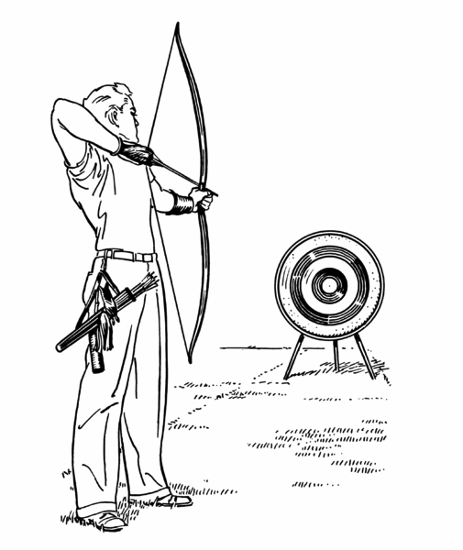
Instruction without Goals….
Ready?
Fire!
Aim.
University of Colorado Boulder Science Education Initiative
http://www.colorado.edu/sei/fac-resources/

Slide 5


What is Backward Design?
From the Scientific Teaching lexicon:
“Designing instructional materials by first setting learning goals, and then designing classroom activities so that students meet the goals.”
From Understanding by Design (UbD):
Think first about specific learnings sought, and the evidence of such learnings, before thinking about teaching and learning activities.

Slide 6
Stages of Backward Design
1. Identify desired results. (goals/objectives/outcomes)
  2. Determine acceptable evidence. (assessment)
  3. Plan learning experiences and instruction (activities)
Notes:
Retrosynthetic arrows! When designing a synthesis, we often take a retrosynthetic approach. Backward design uses similar concepts. Start at the target and figure out how to get there.

Slide 7
Goals vs. Objectives vs. Outcomes
“Assessment language generally moves from the general to the specific …”
Barkley, E.F.; Major, C.H. Learning Assessment Techniques, A Handbook for College Faculty, Wiley, 2016.
Learning Goals – “broad statements written from the instructor’s or institution’s perspective that give the general content and direction of a learning experience.” (Describe what we want students to learn.)
Learning Objectives – “statements of what you intend to teach or cover in a learning experience.” (more specific than goals, not necessarily observable or measurable, instructor-centered)
Learning Outcomes – “describes in observable and measurable terms what a student is able to do as a result of completing a learning experience.” (student-centered)
https://resources.depaul.edu/teaching-commons/teaching-guides/course-design/Pages/course-objectives-learning-outcomes.aspx Accessed 4/1/21

Slide 8
Advantages of Learning Outcomes
Pause the video and take a minute to write down advantages of using learning outcomes from the perspectives of both faculty and students.

Slide 9
Why Create Desired Learning Outcomes?
Student Benefits | Instructor Benefits
Know what is expected | Teach what really matters.
Focused, more productive study time | Write homework, exams, and design instruction at an appropriate level.
Assess themselves | Align your course with other courses.
Learning outcomes are different than a list of topics to be covered, such as chapter titles.

Slide 10
Summary
Backward design refers to first thinking about what you want students to learn, then thinking about how you will assess learning, then determining how you will assist students in learning.
The 3 stages of backward design are
Identify desired results
Determine acceptable evidence of learning
Plan learning activities

Slide 11
Coming up in the next video …
Identifying the major categories of significant learning.
Constructing and critiquing desired learning outcomes.

Slide 12
Acknowledgements
Learning Designers
  Adrienne Gauthier
  Erin DeSilva
Dartmouth Center for the Advancement of Learning (DCAL)
  Cindy Rosalbo
  Prue Merton

Slide 13
References
Handelsman, J., Miller, S., and Pfund, C. Scientific Teaching; W.H. Freeman: New York, 2007.
Wiggins, G. and McTighe, J. Understanding by Design, 2nd ed.; Pearson: New Jersey, 2006.
Bruff, D., McMahon, T., Goldberg, B., Campa III, H., An Introduction to Evidence-Based Undergraduate STEM Teaching. See http://stemteachingcourse.org/ for more information.
The Carl Weiman Science Education Initiative http://cwsei.ubc.ca and http://colorado.edu/sei
Barkley, E.F., Major, C.H. Learning Assessment Techniques, A Handbook for College Faculty; Jossey-Bass: San Francisco, 2016.
Fink, D.L. Creating Significant Learning Experiences, An Integrated Approach to Designing College Courses ; Jossey-Bass: San Francisco, 2013.
DePaul University Teaching Commons https://resources.depaul.edu/teaching-commons/

