Slide 1
An Introduction to
Backward Design and Learning Objectives
Go to www.organicers.org, click on the link to the 2023 workshop, and scroll down to the Session 2 Google Slides for Backward Design.
Cathy Welder, Dartmouth College
Active Learning in Organic Chemistry Workshop
Notes:
75 minutes beginning 11:30 am Eastern Tuesday.
Provide handout (Google Drive and Moodle) of Bloom’s taxonomy (slide 6), Fink’s taxonomy (slide 7), checklist (slide 20), and list of verbs (slide 21 and 22). Link to Learning Goals Inventory (slide 15) on OrganicERs.

Slide 2
Outline
By the end of this presentation, you will be better able to
identify the 3 stages of backward design.
describe Bloom’s taxonomy of cognitive skills.
describe Fink’s taxonomy of significant learning.
construct and critique desired learning outcomes.
Notes:
I will minimize duplication from the hw videos. If you repeat what students were to accomplish prior to class, they quickly learn that they didn’t need to do the hw prior to class and stop preparing.

Slide 3
Stages of Backward Design
Backward design refers to first thinking about what you want students to learn, then thinking about how you will assess learning, then determining how you will assist students in learning.
1. Identify desired results. (goals/objectives/outcomes)
  2. Determine acceptable evidence. (assessment)
  3. Plan learning experiences and instruction (activities)
Notes:
Retrosynthetic arrows! When designing a synthesis, we often take a retrosynthetic approach. Backward design uses similar concepts. Start at the target and figure out how to get there. (This slide is discussed in the video homework.)

Slide 4
Goals vs. Objectives vs. Outcomes
Learning Goals – “broad statements written from the instructor’s or institution’s perspective that give the general content and direction of a learning experience.” (Describe what we want students to learn.)
Learning Objectives – “statements of what you intend to teach or cover in a learning experience.” (more specific than goals, not necessarily observable or measurable, instructor-centered)
Learning Outcomes – “describes in observable and measurable terms what a student is able to do as a result of completing a learning experience.” (student-centered)
https://resources.depaul.edu/teaching-commons/teaching-guides/course-design/Pages/course-objectives-learning-outcomes.aspx Accessed 6/5/23.
Notes:
Point participants to Ch. 1 of Learning Assessment Techniques, Clarifying What You Want Students to Learn
Learning objective – instructor’s purpose for creating/teaching course
Learning outcome – specific, measurable knowledge and skills learner gains from course
Fink uses learning goals and learning outcomes synonymously. (p. 38.)
“Learning goals and objectives generally describe what an instructor, program, or institution aims to do, whereas a learning outcome describes in observable and measurable terms what a student is able to do as a result of completing a learning experience (e.g., course, project, or unit).”

Slide 5
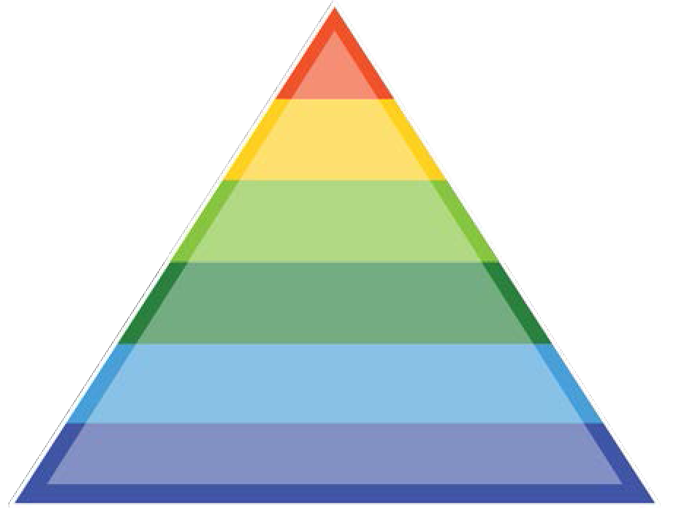
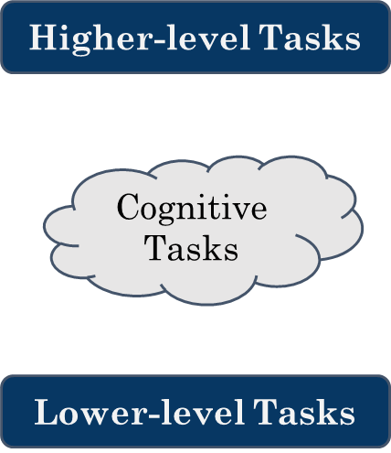
Bloom’s (Revised) Taxonomy
create
evaluate
analyze
apply
understand
remember
from the MOOC, An Introduction to Evidence-Based Undergraduate STEM Teaching http://stemteachingcourse.org/
(Next offering 6/19/23 - 8/13/23.) Accessed 6/5/23.
Notes:
Bloom’s taxonomy of the cognitive domain outlines different cognitive levels. Bloom’s is not covered in the BD video.

Slide 6
Bloom’s (Revised) Taxonomy
Can the student …
create
evaluate
analyze
apply
understand
remember
Produce new or original work? Design, assemble, construct, develop, formulate, author, investigate
Justify a stand or decision? Appraise, argue, defend, judge, select, support, value, critique, weigh
Draw connections among ideas? Differentiate, organize, relate, compare, contrast, distinguish, examine, experiment, question, test
Use information in new setting? Execute, implement, solve, use, demonstrate, interpret, operate, schedule, sketch
Explain ideas or concepts? Classify, describe, discuss, explain, identify, locate, recognize, report, select, translate
Recall facts and basic concepts? Define, duplicate, list, memorize, repeat, state
from the MOOC, An Introduction to Evidence-Based Undergraduate STEM Teaching http://stemteachingcourse.org/ Accessed 3/29/21.
Notes:
Apply – transfer info (1-BuOH vs 1-PrOH example)
Analyze – draw connections by grouping reagents or reaction types: oxidizers, C-C bond forming rxns, etc
Evaluate – This reaction sequence will not give the indicated product. Why not? (Step requires S_{N}2 on 3º halide or organometallic but acidic H.)
Create – Multi-step synthesis

Slide 7
Fink’s Taxonomy of Significant Learning
What types of knowledge do you want students to gain?
Foundational Knowledge (understanding and remembering)
Application (skills and problem-solving)
Integration (connecting ideas, experiences)
Human Dimension (oneself and others)
Caring (feelings, interests, values)
Metacognition (learning how to learn)
Fink, D.L. Creating Significant Learning Experiences, An Integrated Approach to Designing College Courses
Notes:
From Fink: Foundational knowledge provides the basic understanding that is necessary for other kinds of learning. Application learning allows other kinds of learning to become useful. The act of making new connections gives learners a new form of power, especially intellectual power. Human Dimension learning informs students about the human significance of what they are learning. When students care about something, they then have the energy they need for learning more about it and making it a part of their lives. Without the energy for learning, nothing significant happens. Metacognition enables students to continue learning in the future and to do so with greater effectiveness. From Fink: “One important feature of this taxonomy is that it is not hierarchical but rather relational and even interactive.” “The various kinds of learning are synergistic.” You don’t have to give up one kind of learning to achieve another.

Slide 8
Creating Desired Learning Outcomes
Consider
Cognitive level (Bloom)
remember, understand, apply, analyze, evaluate, create
Types of knowledge (Fink)
  foundational, application, integration, human dimension, caring, learning to learn
Scope:
  Course-level
    Broad, overarching
    A few per course
    What do you want them to know from your course 5 yrs. from now?
  Topic-level
    More specific
    Several per topic
    Aligned with course-level learning outcomes

Slide 9
Creating Desired Learning Outcome Statements
At the end of the course, students should be able to …
Goals should
convey relevance and usefulness.
be observable and measurable.
use everyday language and minimize technical jargon.
use descriptive verbs. (Avoid “understand.”)
be aligned with the level of learning that you expect of students.
Notes:
Create performance tasks that explicitly list what the learner should be able to do.
At the end of the course or Before the first exam or In 5 years …

Slide 10
Creating Desired Learning Outcomes
By the end of class, students should understand the reaction of alcohols with HX.
What’s a better way to phrase the desired learning outcome?
By the end of class, students should be able to
  draw the products of the reaction of a 2º or 3º alcohol with HX.
  provide a complete electron-pushing mechanism and a reaction energy diagram that shows the relative energies and structures of starting materials, transition states, intermediates, and products.
  explain why the reaction doesn’t work well for methyl or 1º alcohols.
Professor thinks … | Student thinks …
Notes:
Prof – give products, mechanism, rxn E diagram, effect of rxn condition changes
Student – give the product of a reaction
I use Bloom’s taxonomy to write better Learning Objectives.

Slide 11
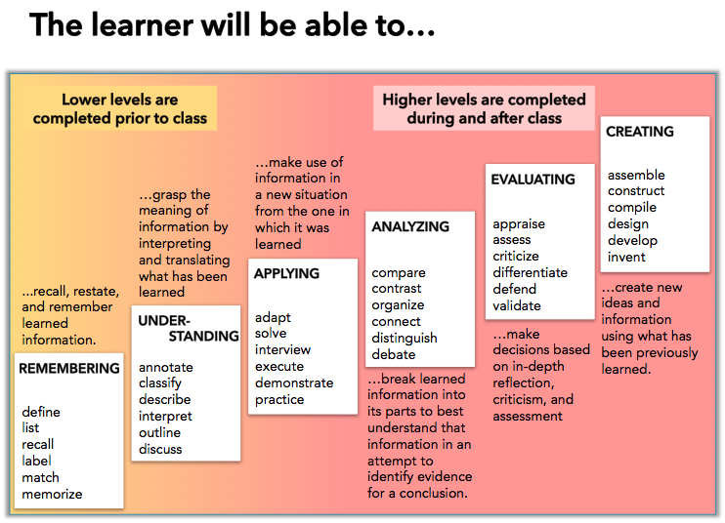
Notes:
See additional verbs in handout.

Slide 12
Examples of Desired Learning Outcomes
Course-Level
You should be able to synthesize a given target from small organic molecules and any inorganic reagents you need. (Any organometallic reagents you wish to use would need to be synthesized.)
Topic Level
After completing Ch. 19 students should be able to:
  Synthesize phosphorus ylides from alkyl halides.
  Synthesize alkenes using the Wittig reaction of a phosphorus ylide with an aldehyde or ketone.
Notes:
Let’s break the first topic-level objective into its components.

Slide 13
Example Topic-Level Learning Outcome
Audience
Behavior (verbs)
Condition
Degree of mastery (optional)
After completing Ch. 19 students should be able to synthesize phosphorus ylides from alkyl halides.
Notes:
Student friendly? Concise? Observable? Measureable?

Slide 14
Course-Level Desired Learning Outcomes
For chapters 16-24, you should be able to
provide electron-pushing mechanisms for most of the reactions we cover. This includes using isotopes such as D, ¹³C, and ¹⁸O to show explicitly where bond changes occur.
predict products of reactions or provide missing reagents if given one or more starting materials and the final product.
fill in missing reagents in a reaction sequence.
convert a given starting material to a given product, showing any intermediate compounds, in a small number of specified steps (often 2 or 3).
synthesize a given target from small organic molecules and any inorganic reagents you need. (Any organometallic reagents you wish to use would need to be synthesized.)
interpret and predict IR, ¹H NMR, and ¹³C NMR spectra of organic molecules.
Notes:
I’m missing metacognition and affective domain goals.

Slide 15
Creating Desired Learning Outcomes
How do I begin?
Someone else’s goals/objectives/desired outcomes
End of chapter summaries
Unpack an exam question
Consider completing this Learning Goals Inventory as a starting point! It’s aligned with Fink’s taxonomy.
http://lawteaching.org/wp-content/uploads/2019/06/LAT_Learning_Goals_Inventory.pdf
Accessed 5/29/23.
Notes:
More material doesn’t equal more learning. Understanding By Design refers to twin sins = too much content/too many activities

Slide 16
In small groups we will …
Write at least one course-level learning objective and at least one topic-level desired learning outcome that align with each other.
Consider cognitive level, types of learning, and scope.
Other things you might consider if time allows:
Can you identify the cognition level of the objective?
Can you re-write the objective to a higher Bloom’s level?
Can you write a question that would assess whether the desired level of learning has occurred?
Notes:
Suggested area – your topic of focus for the workshop
https://docs.google.com/presentation/d/1DULpMSPAcgP_h2tyT3a0RdsmtLC3mVDno_-6rekFtU8/edit#slide=id.p
https://moodle-spaces.centre.edu/pluginfile.php/28239/mod_resource/content/1/BD%20and%20LO%20handout%202022.pdf

Slide 17
Share your Desired Learning Outcomes
In small groups, begin writing desired learning outcomes for the topic assigned to your team on your team’s Google Slides.
Other things you might consider:
Can you identify the cognition level of the goal?
Can you re-write the goal or objective to a higher Bloom’s level?
Can you write a question that would assess whether the desired level of learning has occurred?
Notes:
To be shared during the workshop session.

Slide 18
Acknowledgements
Learning Designers
  Adrienne Gauthier
  Erin DeSilva
Dartmouth Center for the Advancement of Learning (DCAL)
  Cindy Rosalbo
  Prue Merton

Slide 19
References
Handelsman, J., Miller, S., and Pfund, C. Scientific Teaching; W.H. Freeman: New York, 2007.
Wiggins, G. and McTighe, J. Understanding by Design, 2nd ed.; Pearson: New Jersey, 2006.
Bruff, D., McMahon, T., Goldberg, B., Campa III, H., An Introduction to Evidence-Based Undergraduate STEM Teaching. See http://stemteachingcourse.org/ for more information.
The Carl Weiman Science Education Initiative http://cwsei.ubc.ca and http://colorado.edu/sei
Barkley, E.F., Major, C.H. Learning Assessment Techniques, A Handbook for College Faculty; Jossey-Bass: San Francisco, 2016.
Fink, D.L. Creating Significant Learning Experiences, An Integrated Approach to Designing College Courses; Jossey-Bass: San Francisco, 2013.
DePaul University Teaching Commons https://resources.depaul.edu/teaching-commons/

Slide 20
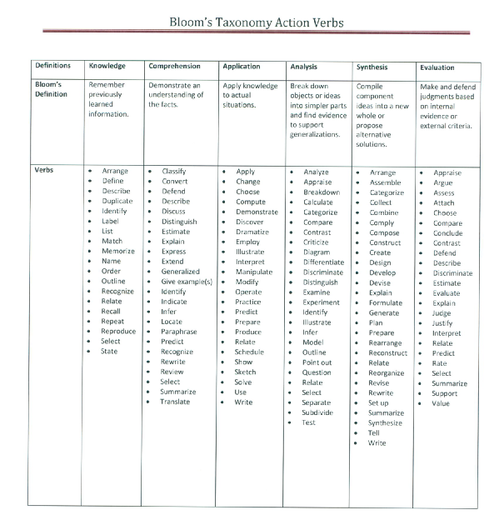
Notes:
This is for the original Bloom’s taxonomy, not the revision. Might be confusing.

Slide 21
Barkley, E.F., Major, C.H. Learning Assessment Techniques, A Handbook for College Faculty; Jossey-Bass: San Francisco, 2016.
Notes:
Verbs that correspond to Fink’s Significant Learning Taxonomy as presented in Learning Assessment Techniques p. 19.

Slide 22
Check-list for creating class-scale learning goals:
Is goal expressed in terms of what the student will achieve or be able to do?
Is the Bloom’s level of the goal aligned with your actual expectations?
Is the goal well-defined? Is it clear how you would measure achievement?
Do chosen verbs have a clear meaning?
Is terminology familiar/common? If not, is the terminology a goal?
Is it relevant and useful to students? (e.g. connected to their everyday life OR does it represent a useful application of the ideas).
http://www.colorado.edu/sei/fac-resources/

Slide 23
Reflection
Take ~ 15 minutes to reflect on the following question.
Based on what you have learned this morning, what changes might you make to your teaching?

