Slide 1
Active Learning in Organic Chemistry
Formative Assessment Techniques
BCCE 2024
Jigsaw Activity
Assignments on the second slide
Complete the information on the slide with your name, a description of your method and your topic specific implementation plan

Slide 2
 |  | Technique Teams
 |  | TT 4: Active Reading Documents | TT 31: Background Knowledge Probe | TT 48: Think-aloud-pair- problem-solving (TAPPS) | CoLT 23: Word Web | CoLT 24: Round Table
Topic Teams | Stereochemistry & Isomerism | 3 | 8 | 13 | 18 | 23
 | Alkenes |  | 9 | 14 | 19 | 24
 | Subst./Elim. Chemistry | 5 |  |  |  | 25-26
 | Nucleophilic Acyl Addition | 6 |  | 16 | 21 | 27
 | Nucleophilic Acyl Substitution | 7 | 12 |  | 22

Slide 3
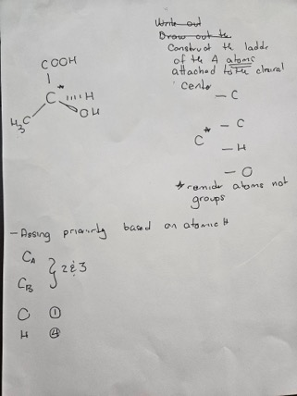
Active Reading Documents - Stereochemistry & Isomerism
Description of Method: – State the learning objective:
When finishing reading this document the student(s) should be able to arrange the priorities of groups attached to a chiral center based on atomic number, ie the CIP (Cahn-Ingold-Prelog) system.
Develop scaffolding activities per main point
Implementation Plan:
Assumption student has completed activities on identifying chiral centers
Student will construct priority atom ladders
Scaffolding support
Construct initial ladder
If any atoms have the same atomic number help further construct the latter
Provide support with multiple bonds
Reminder that it’s based on atomic number
Provide example of student mistakes based on weight rather than Atomic number
Reinforcement activity – have a student find an example homework end of chapter that looks difficult and apply scaffolding technique

Slide 4
[Insert Name] - Active Reading Documents - Alkenes
Description of Method:
Implementation Plan:

Slide 5
Active Reading Documents - Subst./Elim. Chemistry
Description of Method: You will guide students through the reading and analysis of a chosen document on your topic of choice. You will first need to determine what the learning goals are and identify the tasks needed to achieve those goals. Let that direct your prompts for the students as they read, e.g., state the main idea of the article. You must develop a plan for how you will assess their work (plus/minus/checkmark, etc.) and communicate that to the students. Then you must implement and reflect afterwards.
Implementation Plan: The learning objective is for students to determine whether a reaction will proceed via an SN1, SN2, E1 or E2 pathway (or some combination) based on the reaction conditions and reagents given. I will choose a textbook excerpt that discusses the conditions that lead to these various outcomes. I will provide the students with this excerpt in class and have them work in small groups of 3 or 4. The prompts will ask them to define those terms, identify what types of alkyl halides are compatible with each pathway, what types of nucleophiles are favored with each pathway, and what types of solvents are associated with each pathway.

Slide 6
Active Reading Documents - Nucleophilic Acyl Addition
Implementation Plan:
Goal- understand reactivity of carbonyls
Questions
draw a carbonyl bond?
What is the polarity of a carbonyl bond
What reaction would you expect to occur if in acid solution?
What reaction if have a nucleophile?
Draw the reaction.
What is the molecular geometry around the the carbonyl carbon?
What happens to the hybridization and geometry of the carbonyl carbon?
Description of Method:
define a learning goal
Find a reading assignment
Create a handout - main idea/key ideas
Determine a grading scheme
Load active reading document in las
Assign reading and due date , collect and assess
Reflect on results

Slide 7
Active Reading Documents - Nucleophilic Acyl Substitution
Description of Method:
Teaching purpose: Discuss the nucleophilic acyl substitution of reaction of esters and applications
Learning goal: Understand the hydrolysis reaction of esters and mechanism
Implementation Plan:
Reading assignment: Soups and micelles
Parameter: Explain the preparation of soap from oils and fats
Assessment plan: multiple choice pre- and post-tests
Prepare, explain and provide a copy of the handout for the students.
Analyze the results of the assessment tests to determine how this activity help the students to have a better achievement respect to the learning goal.

Slide 8
Background Knowledge Probe - Stereochemistry & Isomerism
Description of Method:
Background Knowledge Probe
A brief check of what students will bring to the classroom session based on what they have learned in previous courses. Very low-or no stakes, quick for students to complete. Also, check for misconceptions. Use these results to plan your class session.
Implementation Plan:
I can draw a Lewis structure of an alkane-confidence
I can draw a Lewis structure of a substituted alkane-confidence
I know what isomer means
I (will/or have) use models to build organic structures

Slide 9
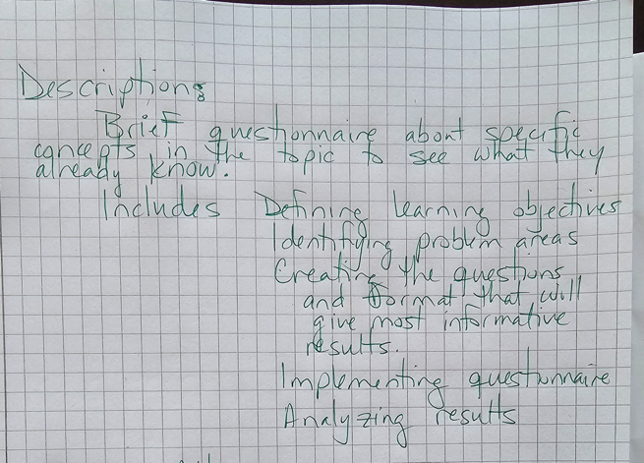
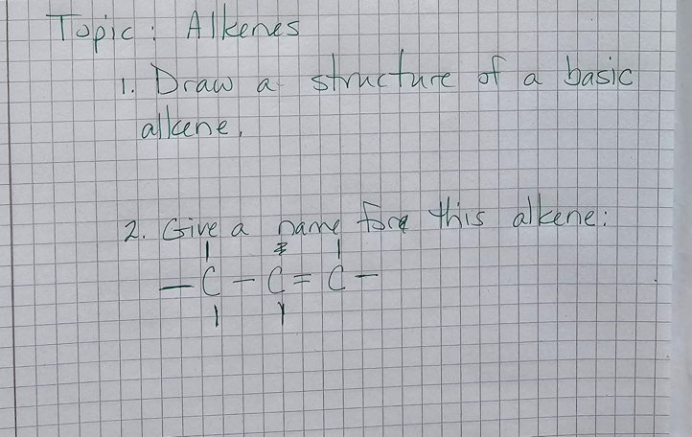
Background Knowledge Probe - Alkenes
Description of Method:
Implementation Plan:

Slide 10
[Insert Name] - Background Knowledge Probe - Subst./Elim. Chemistry
Description of Method:
Implementation Plan:

Slide 11
[Insert Name] - Background Knowledge Probe - Nucleophilic Acyl Addition
Description of Method:
Implementation Plan:

Slide 12
Background Knowledge Probe - Nucleophilic Acyl Substitution
Description of Method:
Survey students before beginning a topic to gauge their prior knowledge and determine the level you need to teach at. Also requires students to recall pertinent topics.
Technique can ask questions in a multiple choice format (good for large classes/little review time) or open-ended (small classes or you have time to read them).
Do not ask questions about content directly, but the ideas the topic relies on. No points associated with the survey.
Implementation Plan:
Send out a quick survey via google form/LMS
Show an image of a Nu- and ask students if it is or not.
2. How confident are you in your answer?
  No
  I’m a little confident
  I’m confident
  I’m very confident.

Slide 13
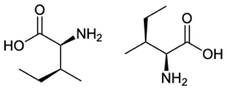
TAPPS - Stereochemistry & Isomerism
Students work in pairs. One student works to solve a problem while describing what they’re doing. The other student listens and asks clarifying questions to push them to explain reasoning. Instructor demonstrates solution.
Student’s find a partner to work with, sitting close to you.
Work on 1 problem for 10 minutes
1. Identify the relationship between the pair of molecules below. Choose the best description from identical, enantiomers, diastereomers.
Approach 1: Build models of each one and compare. Are they mirror images, identical, or neither?
Approach 2: Assign R or S to each stereogenic center and compare configurations at matching centers.

Slide 14
TAPPS - Alkenes
Description of Method:
Handout provided to students
Student #1(problem solver) tells their partner how they would work the problem. Student #2 (listener) asks questions to prompt deeper understanding for themselves and the Solver
Implementation Plan:

Slide 15
[Insert Name] - TAPPS - Subst./Elim. Chemistry
Description of Method:
Implementation Plan:

Slide 16
[Insert Name] - TAPPS - Nucleophilic Acyl Addition
Description of Method:
Implementation Plan:

Slide 17
[Insert Name] - TAPPS - Nucleophilic Acyl Substitution
Description of Method:
Implementation Plan:

Slide 18
Word Web - Stereochemistry & Isomerism
Description of Method:
Develops a visual representation of how ideas interrelates.
Mindmaps of different shapes can be used to illustrate the relationships such as a wed, fishbone, spider depending on what fits ideas best
Implementation Plan:
Students brainstorm topics/words/ideas
Students generate a map of how these topics interrelate connecting terms as the relate to one another
Students compare and discuss
Students generate a combined map

Slide 19
[Insert Name] - Word Web - Alkenes
Description of Method:
Implementation Plan:

Slide 20
[Insert Name] - Word Web - Subst./Elim. Chemistry
Description of Method:
Implementation Plan:

Slide 21
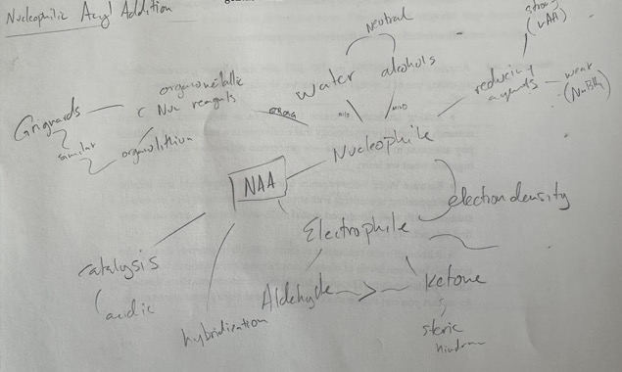
Word Web - Nucleophilic Acyl Addition
Description of Method:
In this activity, students make a collaborative concept map. The main value is to clarify interrelationships between the major concepts. The degree of scaffolding varies depending on the topic and prior knowledge the students have.
Implementation Plan:
If generating terms, students first individually brainstorm words or concepts related to the central topic. They then combine their lists to make a full list of terms.
Terms are arranged visually around the central concept and annotated as necessary for hierarchy (eg. a circle around closely related terms or terms that are subsets of category terms)
Connect terms as students observe them (eg. Nucleophilicity of the nucleophile affects the equilibrium of an acyl addition so they could be connected)

Slide 22
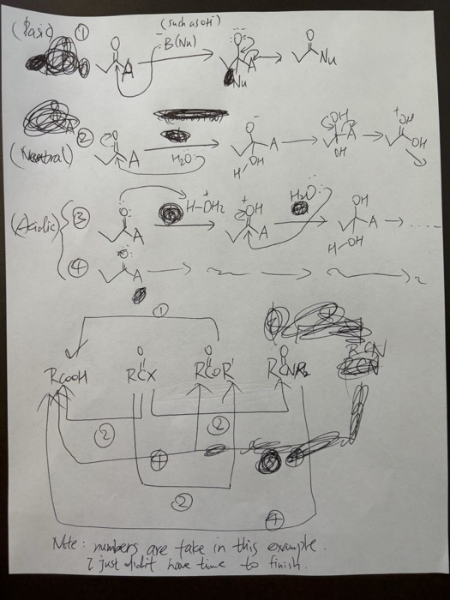
Word Webs - Nucleophilic Acyl Substitution
Description of Method:
In this activity, students create a collaborative concept map to clarify the interrelationships between major concepts, such as conversion between different functional groups through nucleophilic acyl substitution. The level of support provided varies based on the topic and the students' prior knowledge.
Implementation Plan:
This task helps familiarize students with how to draw the mechanism for different types of nucleophilic acyl substitution reactions. Students are asked to list all functional groups within the carboxylic acid derivatives family and use a map to summarize the mechanism pattern of each type of conversion in acidic, basic, and neutral solutions.
Examples:
Mechanism pattern for the conversion from acyl halide to ester in an acidic solution;
Mechanism pattern for the conversion from ester to carboxylic acid in a basic solution;
Etc.
Please see the unfinished example map I created.
This example takes long, and each student can work on one mechanism pattern.
Students should never be asked to try to memorize these patterns separately. This concept map practice is only an exercise opportunity for them to get exposed to different mechanism patterns. They should focus on truly understanding why each pattern should be like that. E.g., there’s almost nothing available in a basic solution to protonate a carbonyl group,.....

Slide 23
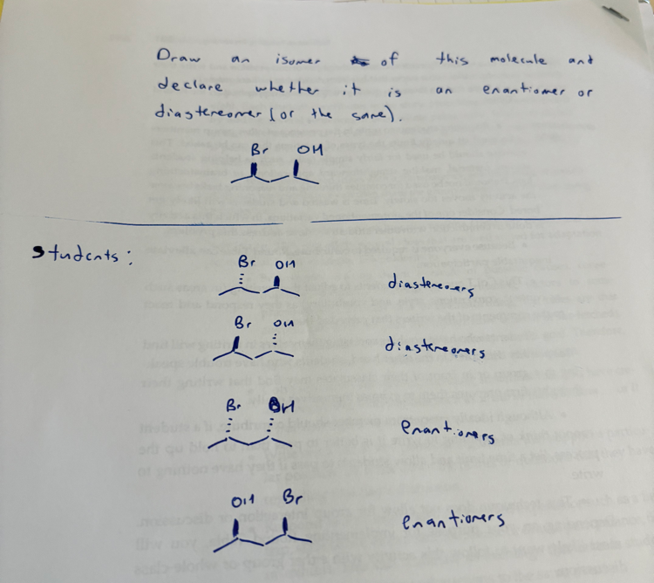
Round Table - Stereochemistry & Isomerism
Description of Method
A group of 4 students are given a prompt. Students each take turns contributing by writing something on the paper and passing it around
Implementation Plan:
Prompt: A molecule with two stereocenters is shown. Draw a stereoisomer of the molecule and identify whether it is an enantiomer or diastereomer.

Slide 24
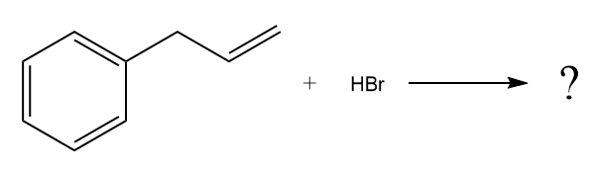
Round Table - Alkenes
Description of Method:
Your group will be given the reactants/reagents/conditions for a reaction. Your group will ultimately come up with the complete, detailed mechanism for that reaction, including curved arrow notation, intermediates, and products.
The first person in your group will draw the starting molecule(s) and curved arrow notation for the first elementary step of the mechanism. The next person will draw the product(s) of that elementary step, based on the curved arrows that were drawn. The next person will label the step as to what was occurring in that elementary step (e.g., proton transfer, nucleophilic addition, etc.). Then the process will repeat for the next step (next person adds curved arrows, next person draws products, next person labels the step), and so on, until the mechanism is complete.
If a member of the group receives the mechanism-in-progress and notices an error, they can discuss with the group, and then make a correction of that mistake before passing things on to the next member.
Implementation Plan:
Draw the complete, detailed mechanism for the following reaction (no peroxides).

Slide 25
Round Table - Subst./Elim. Chemistry
Description of Method:
Take turns responding to prompt with words, phrases, or diagram/graph
Students focus attention by writing and take time to think about response
The round table method supports equal particpation and multiple viewpoints
Implementation Plan:
Example of Substitution:
Student 1: Ethane
Student 2: Ethane + chlorine
—>
Student 3: Chloroethane
Student 4: Chloroethan + HCl
Student or 5: Add details such as SN1, SN2, catalysts for different levels (high school vs. college/university level). Draw in structures instead of words, general description, other info

Slide 26
Round Table - Subst./Elim. Chemistry
Implementation Plan:
Example of Elimination Using Alkyl Halide, basic conditions:
Student 1: 2-bromopentane
Student 2: 2-bromopentane + NaOH
—>
Student 3: pent-1-ene or pent-2-ene
Student 4: pent-1-ene or pent-2-ene + H2O + NaBr
Student or 5: Add details such as SN1, SN2, catalysts for different level, Markovnikov, anti-Markovnikov (high school vs. college/university level). Draw in structures instead of words, general description, other info
Description of Method:
Take turns responding to prompt with words, phrases, or diagram/graph
Students focus attention by writing and take time to think about response
The round table method supports equal particpation and multiple viewpoints

Slide 27
Round Table - Nucleophilic Acyl Addition
Description of Method:
A topic or question is presented to a group of 4
One student writes/draws/contributes to the prompt in a sentence or two (or picture) and passes it to the next student
The next student contributes the next words/phrases/drawings
The document circulates until the team determines it is complete
Implementation Plan:
Students construct a mechanism for a nucleophilic acyl addition. The first student draws a curved arrow, the next student draws the intermediate formed, the third student identifies the type of process (e.g., proton transfer), and the fourth student draws the next arrow. In this fashion, each student completes each task at least once.

Slide 28
[Insert Name] - Round Table - Nucleophilic Acyl Substitution
Description of Method:
Implementation Plan:

