Slide 1
Active Learning Pedagogies
An Overview
Bob Rossi
Active Learning in Organic Chemistry Workshop
June 22-25, 2015 – Washington, D.C.

Slide 2

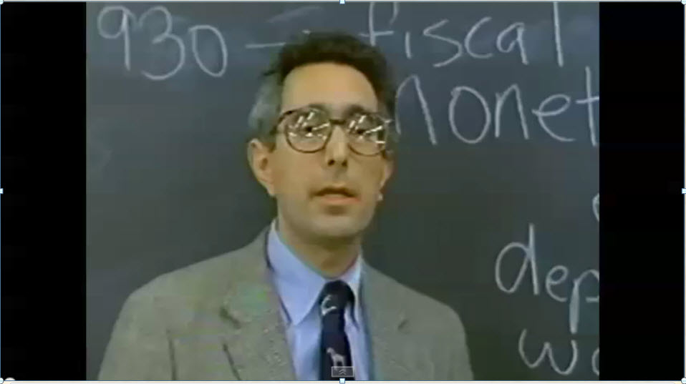
Why should I practice active learning in my classroom?

Slide 3



What is Active Learning?
In-Class -
Application & Peer Instruction
Students practice applying key concepts with feedback
Out-of-Class -
Content Delivery
Students prepare to participate in class activities
Students check their understanding and extend their learning

Slide 6
Separating Fact from Fiction about Flipping
Flipped classroom – new term, old idea.
  Origins of the flipped classroom developed circa 1820’s or 1890’s.

Slide 7
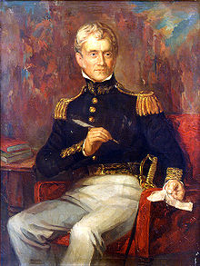
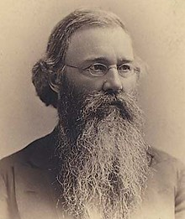
Sylvanus Thayer
Christopher Columbus Langdell
Dean of Harvard Law 1890’s Introduced the concept of “Case Study Method” aka “The Socratic Method”.
Superintendent U.S. Military Academy at West Point 1817
Developed the “Thayer Tenets of Education ⁷²”

Slide 8
Separating Fact from Fiction about Flipping
Flipped classroom – new term, old idea.
  Origins of the flipped classroom developed circa 1820’s or 1890’s.
    Students take more responsibility for their own learning.
  Two seminal publications:
    Eric Mazur, Peer Instruction: Getting Students to Think in Class, American Institute of Physics Conference Proceedings, 1997 ⁴⁹.
    M. J. Lage, G. J. Platt, et. al, Inverting the Classroom: A Gateway to Creating an Inclusive Learning Environment, The Journal of Economic Education 31(1): 30-43, 2000 ⁴¹.
  Jonathan Bergmann and Aaron Sams, Flip Your Classroom, Reach Every Student in Every Class Every Day, 2007 ⁶.
    K-12 implementation

Slide 9
Separating Fact from Fiction about Flipping
A flipped classroom is an approach that can be implemented gradually or all at once.
  One concept
  One chapter
  One section
  One lab
  One class meeting per week
  One course

Slide 10
Separating Fact from Fiction about Flipping
Flipped classrooms do not replace faculty with technology.
  Flipped classrooms are about pedagogy.
  Three key objectives:
    Lift most content coverage out of the class,
    Employ privileged content and application in-class through social/experiential learning,
    Find ways to motivate continued learning after class.

Slide 11
Separating Fact from Fiction about Flipping
Flipped classrooms direct attention away from the teacher and redirects it back to the students.
  Instructor goes from lecturer to learning facilitator
    “From Sage on the Stage to Guide on the Side”³⁸.
  Students take on more responsibility for their learning.
  You can flip your class many ways:
    Video capture
    Lecture/clicker tutorials
    Case studies
    Pre-class screencasts/worksheets
    Peer Instruction
    Think-Pair-Share
    Just-in-Time Teaching (JiTT)
    Pencasting
    Combinations of the above
³⁸Alison King, College Teaching,41(1),30-35,1993

Slide 12
Separating Fact from Fiction about Flipping
Flipped classrooms leverage how people learn best.
  We always learn best when we have some prior content knowledge.
    Let’s run an experiment!

Slide 13
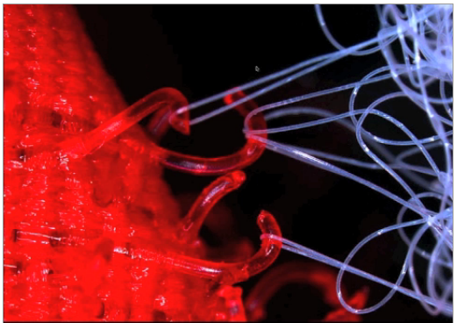
Velcro Theory of Memory

Slide 14
Separating Fact from Fiction about Flipping
Flipped classrooms leverage how people learn best.
  We always learn best when we have some prior content knowledge.
  We learn best when we apply our content knowledge.

Slide 15
Think about something you know really well, something you are considered an expert in.
How did you learn that so well?
By doing it! Practicing it! → Applying it!
“Practice at retrieving new knowledge from memory is a potent tool for learning”, P.C. Brown, H. L. Roediger, M. A. McDaniel – Make It Stick; The Science of Successful Learning (2014) ¹¹.

Slide 16
Separating Fact from Fiction about Flipping
Flipped classrooms leverage how people learn best.
  We always learn best when we have some prior content knowledge.
  We learn best when we apply our content knowledge.
  Flipped classroom helps develop higher-order thinking skills by doing applications in class.

Slide 17
Bloom’s Taxonomy
Traditional Classroom
Flipped Classroom
Creating
Outside of Class
Evaluating
In Class
Analyzing
Applying
Understanding
In Class
Outside of Class
Remembering

Slide 18
Separating Fact from Fiction about Flipping
There will be Challenges
  Significant time investment required up-front, but more efficient over time.
  Will take several iterations to get it right.
  Flipped classrooms are not the cure all.
    Students must prepare outside class.
    Student pushback to doing coursework outside of class.
  Make sure assessments cover out-of-class assignments.
    Great use of clicker questions!

Slide 19

Separating Fact from Fiction about Flipping
Just a few words of CAUTION!
  Some students may resist flipped learning.
    Lecture acts as a security blanket for some students, and teachers.
  Remedy:
    Lecture a little every class period.
  Avoid terms like “Flipped Classroom” or calling your class an “experiment”.

Slide 20
Why is this Important?
  The President's Council of Advisors on Science and Technology⁵⁵ has called for a 34% increase in the number of STEM bachelor’s degrees completed per year over the next 10 years, to retain the U.S.’s historical preeminence in science and technology and recommended adoption of empirically validated teaching practices as critical to achieving that goal.
⁵⁵Olson, Steve, and Donna Gerardi Riordan. "Engage to Excel: Producing One Million Additional College Graduates with Degrees in Science, Technology, Engineering, and Mathematics. Report to the President." Executive Office of the President (2012).

Slide 21
Is Active Learning Effective?
  Recent study²¹ of active learning vs. traditional lecture:
    Meta-analyzed 225 studies that reported data on exam scores and failure rates in undergraduate STEM courses.
    Results show two key outcomes:
      Average exam scores increased by 6% in active learning sections (increase of half a letter grade).
      Students in traditional lecture sections were 1.5 times more likely to fail.
    Results were evident across all class sizes.
      Greatest impact with class sizes of ≤ 50.
²¹ S. Freeman, et. al., “Active learning increases student performance in science, technology,
and mathematics”, Proceedings of the National Academy of Sciences, 111(23), 8410-8415, 2014

