Slide 1
Cognitive Psychology in Teaching
Organic Chemistry
Katie Wissman
ALOC Workshop – 06/15/22

Slide 2
Session Overview
Brief overview of the EBLS
Develop an activity using EBLS
Wrapping up EBLS

Slide 3


Let’s Discuss
As a student, did anyone ever teach you how to study? What did they tell you to do?
As an instructor, do you ever talk to your students about how they should study? What do you recommend?

Slide 4

Evidence-Based Learning Strategies (EBLS)
Concrete examples
Dual coding
Active retrieval (or retrieval practice)
Distributed (or spaced) practice
Feedback and assessment

Slide 5


Concrete Examples: What is it?
Giving specific examples of concepts
e.g.
e.g.
e.g.

Slide 6

Concrete Examples: How have I used it?
Provide examples of abstract concepts in lecture
Encourage students to think of examples themselves

Slide 7
Dual Coding: What is it?
Providing words and visuals to illustrate a concept
Aha!

Slide 8
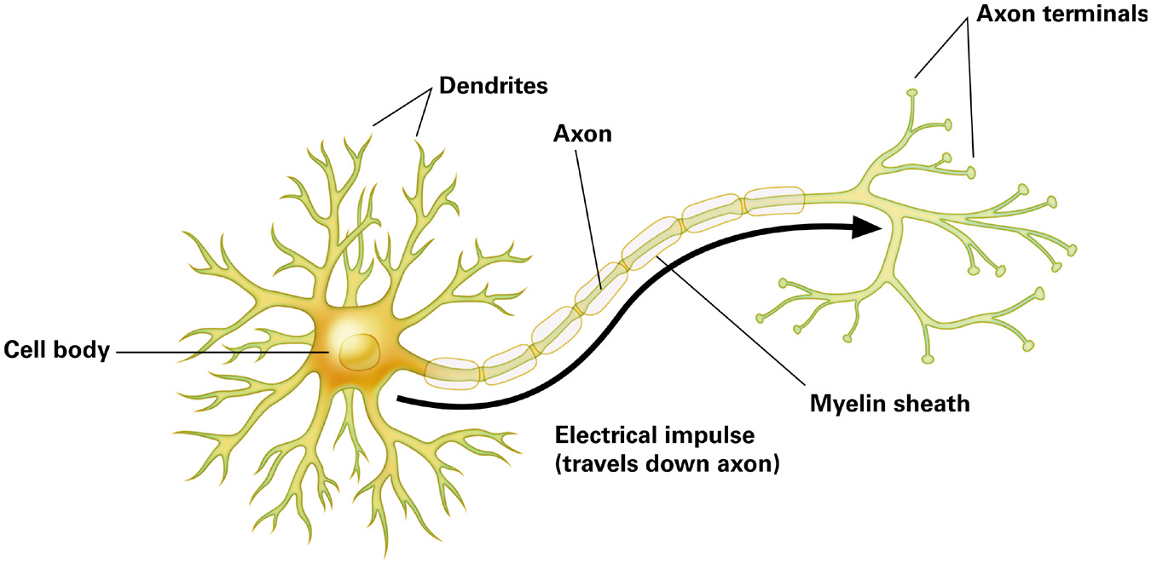
Dual Coding: How have I used it?
Include words and images into lecture slides
Encourage students to incorporate images into their note-taking
The “sender”
The “receivers”
Terminal buttons
Secrete neurotransmitters
Keeps neuron alive
Soma
Insulates axon

Slide 9
An Important Aside
Dual coding is not the same thing as a ‘learning style’
No empirical evidence to support learning styles (Pashler, McDaniel, Rohrer, & Bjork, 2008; Newton & Miah, 2017)
Multiple modalities are beneficial, but one modality is not more beneficial for any given student

Slide 10


Active Retrieval: What is it?
Bringing information from memory to mind
!!!

Slide 11

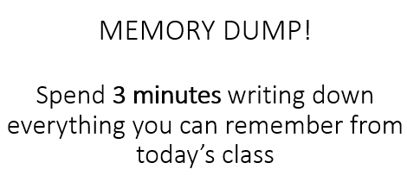
Active Retrieval: How have I used it?
Clicker questions:
  Daily reviews
  Memory dumps
Homework assignments
Which of the following is an example of egocentrism?
Dylan knows that one cookie split into four pieces is the same as the same amount of cookie split into two pieces
Kelley knows when her mom hides a rattle under a blanket, the rattle stills exists
Steve loves to play volleyball. Steve assumes his parents and all his friends also love to play volleyball

Slide 12


Distributed Practice: What is it?
Spreading out the study of information across multiple sessions
DAY 1
DAY 2
DAY 3
EXAM

Slide 13
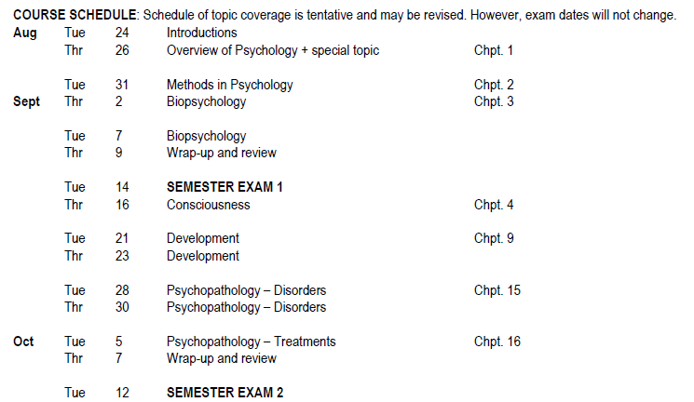

Distributed Practice: How have I used it?
Review days
Cumulative finals
Daily reviews

Slide 14
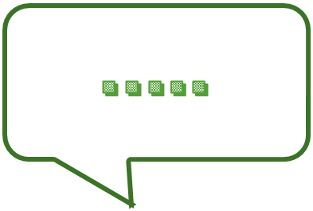
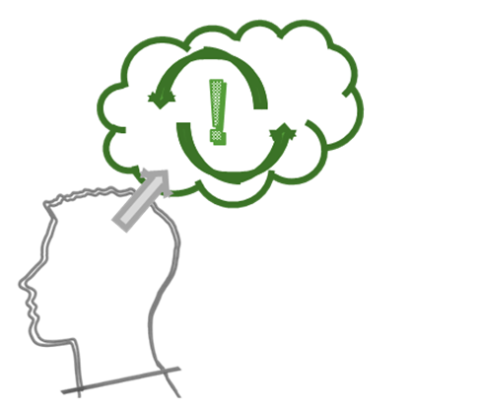

Feedback and Assessment: What is it?
Providing students with information on the progress of their learning and the opportunity to evaluate their learning

Slide 15

Feedback and Assessment: How have I used it?
Feedback:
  Built in check-in points for papers/projects
  Daily reviews
Self-assessment:
  Post-exam questions (or exam wrappers)
  Muddiest point
How well did you do on the exam? (Better than expected, About as expected, Worse than expected)
Do you think your grade accurately reflects your knowledge of the content? (Yes, No, Unsure)
If you were happy with your grade, what is something you’ll do again to prepare for the next exam? If unhappy, what is something you’ll do different for the next exam?

Slide 16
Putting the EBLS into Action
  Design. In your groups, develop an activity in Google Slides that uses one of the EBLS.
  Peer feedback. Provide constructive feedback on another group’s activity.
  Revise. Read through the feedback your group received and refine your activity.
  Present. Share what your group created with the larger group.

Slide 17
Design
In your groups, the goal is to create the following:
  One slide should provide an explanation of the strategy. Put differently, how would you describe/explain this strategy to students? Visuals are often helpful!
  The other slide should provide an illustrative example of how you would use the strategy in your class. In other words, develop an activity that utilizes the strategy.
Consider: How will you introduce the activity? When in the class session would the activity occur? Why would you use the activity? How does the activity help the student and the instructor?

Slide 18
Peer Feedback
Look at another group’s activity and provide them with constructive feedback:
  Group 1 → comment on Group 2
  Group 2 → comment on Group 3
  Group 3 → comment on Group 4
  Group 4 → comment on Group 5
  Group 5 → comment on Group 1
Consider: What’s clear? What’s unclear? What questions, comments, and/or suggestions do you have on what they created?

Slide 19
Revise
Read through the feedback you received. Use this feedback to revise and refine your activity.
Consider: What aspects seem to work well? What aspects need improved or further clarification? Anything else that came out of the feedback process?

Slide 20
Present
Briefly (no more than 2-3 minutes) share the activity your group developed.
Consider: In addition to describing the activity, feel free to also tell us what you learned in the process of development, feedback, and revision!

Slide 21

Wrapping Up
What lingering questions, general wonderings, and/or final thoughts do you have about the EBLS?

Slide 22
Thank you!

